Slide 1


Student Financial Aid
2016-17

Slide 2
What We’ll Talk About
College cost of attendance
Financial aid basics
Free Application for Federal Student Aid (FAFSA)
Programs
CFNC Resources

Slide 3








College Costs
Tuition
Required Fees
Room
Meals (Board)
Books & Supplies
Transportation
Personal & Miscellaneous
Loan Fees
Notes:
Let’s talk about what makes up a college’s cost of attendance.
Tuition buys you a seat in a classroom or access to an on-line course.
Colleges often charge students for various campus facilities and services. Examples:
Student health
Student recreation programs and facilities and athletics
Student union buildings
Performing and fine arts programs
Room – either on campus or off campus in an apartment or house. If the student lives at home, you do not have to pay additional rent out of pocket, of course.
Meals – either the college’s meal plan or cooking for yourself. Even students who commute to campus every day will have some meal expenses.

Slide 4





Financial Aid Basics
Gift Aid – Grants & Scholarships
Self Help – Employment & loans
Merit-Based Aid
Need-Based Aid
Family is primarily responsible for educational expenses
Annual application
Notes:
Financial aid comes in two forms
Gift aid and Self Help
Gift aid is what is commonly referred to as “free money.”
Includes grants and scholarships.
Scholarships, although they don’t have to be repaid, may have criteria the student has to meet to receive or renew the scholarship assistance.
Self Help aid is just what is sounds like – you are helping yourself in some way.
Includes student employment through the Federal Work Study program – which we’ll discuss a little later
And
Educational loans – student and possibly parent borrowing against the student’s future earnings.

Slide 5
Basic Principle of Financial Aid
Cost of Attendance (COA) at Institution - Expected Family Contribution (EFC)
Eligibility for Need-Based Funds at Institution
A family’s ability to pay must be evaluated in an equitable and consistent manner while recognizing special circumstances that may alter a family’s ability to pay. The FAFSA is used for this purpose for federal student aid programs.
Notes:
Cost of Attendance includes tuition, fees, room, board, books & supplies, transportation, personal and miscellaneous expenses.
The federal financial aid analysis formula attempts to determine the family’s ability to pay for educational expenses.

Slide 6
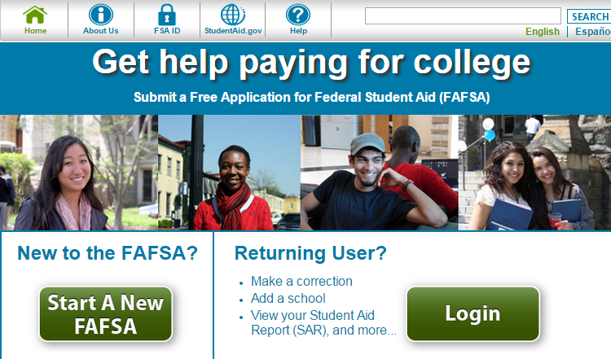
Application Process for Students
Free Application for Federal Student Aid (FAFSA)
  fafsa.gov
Signature is the FSA ID
  FSAID.ed.gov
  *Check the School year*
Notes:
The Free Application for Federal Student Aid (FAFSA) is the form you must complete to be considered for all federal student aid – grants, employment, loans.
Virtually every college requires that you complete the FAFSA.
Apply on-line at www.fafsa.gov
The student and at least one parent whose information is included on the FAFSA must electronically sign the FAFSA using an FSA ID. You can apply for your FSA ID before completing the FAFSA at FSAID.ed.gov
You should not have to pay to complete the FAFSA. If you are asked for credit card information, you are on the wrong website. Be sure it is GOV – for Government – at the end of the address.
You can safely link to the correct web address through CFNC.org – Online Applications tab.

Slide 7
Citizenship – Student Status
U.S. citizen
Eligible noncitizen
  Permanent resident with Permanent Resident Card (I-551 or I-551C)
  Arrival – Departure Record (I-94 form) with one of these designations
    Refugee
    Asylum Granted
    Parolee
    Victim of Human Trafficking
    Cuban-Haitian Entrant

Slide 8





Dependent Students for 2016 - 2017
Answer “No” to all the questions
Born before 1/1/1993
Graduate or Professional Student
Children or other dependents
Notes:
Dependent student answers NO to all of these questions
Born before January 1, 1993?
Working on Masters or Doctorate in 2016- 17?
Married?
Has children or other dependents of his/her own that he/she supports (more than 50%)
On active duty in the U.S. Armed Forces?
A veteran of the U.S. Armed Forces?
Student’s children – student must provide more than 50% of the child’s support.
Support can include income from work, untaxed income and benefits, child support received or paid, health insurance coverage, support in kind, like food, shelter, clothing, etc.
In order to include people other than the student’s spouse or children as dependents, the other person has to live with the student and the student has to provide more than 50% of the person’s support

Slide 9




Dependent Students for 2016 - 2017
Answer “No” to all the questions
Any time since age 13
Both parents deceased
Dependent or Ward of the Court
Emancipated Minor
Unaccompanied youth who are homeless or at risk of homelessness
Has a legal guardian
In foster care any time age 13 or older

Slide 10




Who are the parents?
Biological or adoptive parents married to each other – student lives with both parents
Biological or adoptive parents who are not married to each other and are living together
A single parent who is widowed or never married
Separated/Divorced parents not living together – list the parent with whom the student lived most often – include stepparent information if the parent has remarried
Always include stepparent if a parent has remarried
Notes:
Definition of Parents - Dependent students will be required to include on the FAFSA income and other information from the dependent student’s legal parents (biological or adoptive) regardless of the parents’ marital status or gender, if those parents live together.
•Biological Parents or Same Sex Parents (regardless of state authority related to marriage) should use this response if appropriate
•Smart Logic will modify follow-up questions with gender-neutral identifiers: Parent 1 and Parent 2 instead of mother and father
Following the U.S. Supreme Court decision on June 26, 2013 overturning the Federal Defense of Marriage Act, the Department of Education is reviewing the recent Supreme Court decision on DOMA and its impact on the federal student aid programs. They will provide information and guidance on this matter as soon as it is available.

Slide 11

Household Size
Who is included in the household?
  Student
  Student’s parent(s)
  Parent(s)’ other children if they receive more than half of their support from the parent(s) from July 1, 2016 through June 30, 2017 or would be considered “dependent” if they filed a FAFSA
  Other people who now live with the parent(s) and who will receive more than half of their support from the parent(s) and will continue to receive that support between July 1, 2016 and June 30, 2017

Slide 12
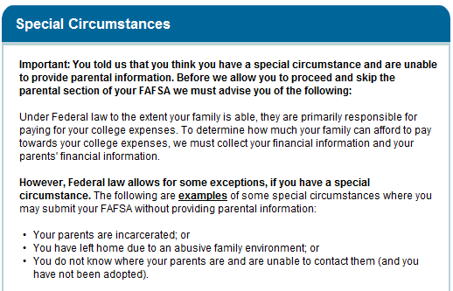
Special Circumstances
Unable to provide parental information
Examples of special circumstances
Student is instructed to complete the FAFSA with his/her financial information – submit it without parental information – and then to contact the Campus Financial Aid Office for further instruction
Notes:
Text of advice FAFSA.gov website gives student in this situation:
Review the following to continue.
Student has special circumstances:
1.We will allow you to submit your FAFSA without parental information, however your FAFSA will not be considered complete.
2.Because your FAFSA is not considered complete, we will not calculate your Expected Family Contribution (EFC) which is the index used by colleges to determine how much student aid you are eligible to receive.
3.If you are approaching any deadlines for your state, college, or scholarship aid, you may want to contact your financial aid administrator before submitting your FAFSA without parental data.
4.Once you submit your FAFSA without parental data, you must follow up with the financial aid administrator at the college you plan to attend, in order to complete your FAFSA and receive an EFC. Also, note the following:
•Under Federal law, only your financial aid administrator has the authority to decide whether or not you must provide parental information on your FAFSA.
•You will have to provide documentation to verify your situation. Gather as much written evidence of your situation as you can. Written evidence may include court or law enforcement documents, letters from a clergy member, school counselor or social worker, and/or any other relevant data that explains your special circumstance.
•After reviewing your circumstances carefully, your financial aid administrator will decide if you must provide parental information or if your circumstances allow you to proceed without providing parental data. Your financial aid administrator's decision is final and can not be appealed to Federal Student Aid.
Student does not have special circumstance, but still is not providing parental information (parents refuse, for example):
Students that do not have a special circumstance and are unable to provide parental information normally do not qualify for federal student aid.
However, in situations where your parent refuses to provide their information on the FAFSA and refuses to provide you with any financial support, there is an exception that allows a student to submit the FAFSA without parental information and receive an Unsubsidized Stafford Loan only.
If you would like to contact the financial aid administrator at your college about receiving only the Unsubsidized Stafford Loan, select "I am submitting my FAFSA to apply for an unsubsidized loan only" and click Next to get additional information.

Slide 13
Parent and Student FAFSA Information
Student’s Adjusted Gross Income, earnings from work, tax liability - from IRS form
Untaxed Income
Other financial information
Asset Information – including
  Cash, savings, checking accounts
  Other real estate and investments
  Business (Small family business – not reported)
  Investment Farm (Family farm – not reported)

Slide 14
Student Aid Report
  FAFSA Results
  An estimate of the Pell Grant and Federal Direct Loan eligibility
  Links to College Navigator for detailed information about the institutions selected:
    Graduation, retention and transfer-out rates
    Tuition and fees
    Institution type
Campus financial aid office gets a copy of your Student Aid Report

Slide 15
Application Process
Apply Early
Meet your college’s deadlines
Do not wait until you are admitted
Complete all questions accurately
Save your FAFSA answers for your own records
Save your Confirmation Page for your own records
Notes:
Some general tips about completing the FAFSA
Apply early – you can apply after January 1 of the year you’re going to school – so for Fall 2009, that’s January 1, 2009.
Some colleges have very early financial aid deadlines – be sure to meet those
Do not wait until you are admitted to complete the FAFSA. You can list up to 10 colleges on the FAFSA on the web.
Complete all questions accurately.
Print and save the FAFSA for your own records.
Students may contact FSAIC to request up to 3 paper FAFSAs by calling 1-800-4-FED-AID (1-800-433-3243)

Slide 16
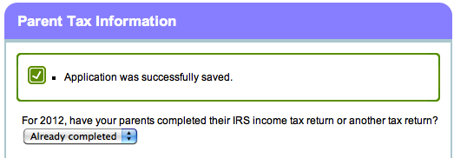
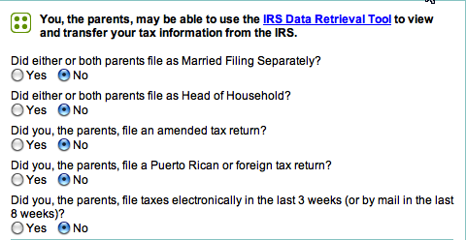
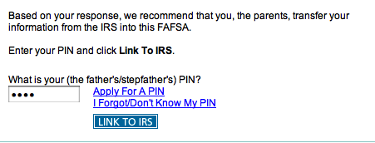
Financial Information – IRS Data Retrieval Tool
Transferring
information directly
from the IRS if
eligible is the fastest
and easiest way to
complete the tax
information
Notes:
The IRS Data Retrieval Tool allows students and parents to access the IRS tax return information needed to complete the Free Application for Federal Student Aid (FAFSA), and transfer the data directly into their FAFSA from the IRS Web site.
(Note: There are several scenarios in which you might not be given the option to use the IRS Data Retrieval Tool, including if you are not eligible to use it.)
To use the IRS Data Retrieval Tool within the application on the student or parent finances pages:
If you indicated that you recently filed your taxes or have already used the IRS Data Retrieval Tool to transfer your tax return information into your application, then click the “Link to the IRS” hyperlink. (Note: If you are eligible to use the IRS Data Retrieval Tool and have not previously used it to transfer your tax return information into your application, then the “Link to the IRS” hyperlink does not display; skip ahead to step 2.)
Enter your Federal Student Aid PIN and click Link To IRS. (Note: Students will not be asked to enter their PIN if they entered a PIN to begin their FAFSA.)
Your FAFSA will be saved and you will be transferred to the IRS Web site.
On the IRS Web site, enter the requested information exactly as it appears on your tax return.
After the IRS has validated your identification, your IRS tax information will display. You can either transfer your information from the IRS, or choose to return to FAFSA on the Web.
If you transfer your IRS tax information, questions that are populated with that tax information will be marked with “Transferred from the IRS.”

Slide 17
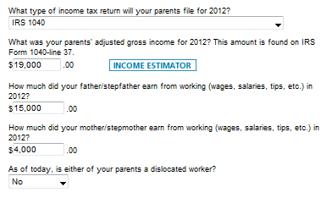
Parent Financial Information
Type of tax form
Tax filing status
Adjusted Gross
Income
Earnings from work
Dislocated Worker
status
Notes:
New – Tax return line numbers will be displayed.
If your parent uses the IRS Data Retrieval Tool and transfers his / her information from the IRS into your FAFSA, the answer to type of tax return will be pre-filled and identified as "Transferred from the IRS.“
If the IRS Data Retrieval Tool is not used the parent and student will enter their information for type of tax return filed, AGI, earnings, exemptions, taxes paid. When the IRS Data Retrieval Tool is used, this information is prefilled.
If the answer to this question is not pre-filled, you must select the income tax return that your parents filed or will file for 2013:
IRS 1040
IRS 1040A or 1040EZ
A foreign tax return
A tax return for a U.S. territory or a Freely
The tax filing status will be the same as the IRS filing statuses:
Single
Head of Household
Married, filed joint return
Married, filed separate return
Qualifying widower
or
Don’t know
If your parents filed a joint tax return, report each parent's earnings from work.
Answer this question about the parent who is completing the application.
A person may be considered a dislocated worker if he / she:
is receiving unemployment benefits due to being laid off or losing a job and is unlikely to return to a previous occupation;
has been laid off or received a lay-off notice from a job;
was self-employed but is now unemployed due to economic conditions or natural disaster; or
is a displaced homemaker.
Select Yes if your parent is a dislocated worker.
Select No if your parent is not a dislocated worker.
Note: If you answer Yes, the financial aid administrator at your college may require proof that your parent is a dislocated worker.
Parents' 2013 U.S. Income Tax Paid
If your parent uses the IRS Data Retrieval Tool and transfers his / her information from the IRS into your FAFSA, the answer to this question will be pre-filled and identified as "Transferred from the IRS."
If the answer to this question is not pre-filled, enter your parents' total tax amount for 2013.
Parents' 2013 Exemptions Claimed
If your parent uses the IRS Data Retrieval Tool and transfers his / her information from the IRS into your FAFSA, the answer to this question will be pre-filled and identified as "Transferred from the IRS."
If the answer to this question is not pre-filled, enter your parents' exemptions for 2012.
17

Slide 18
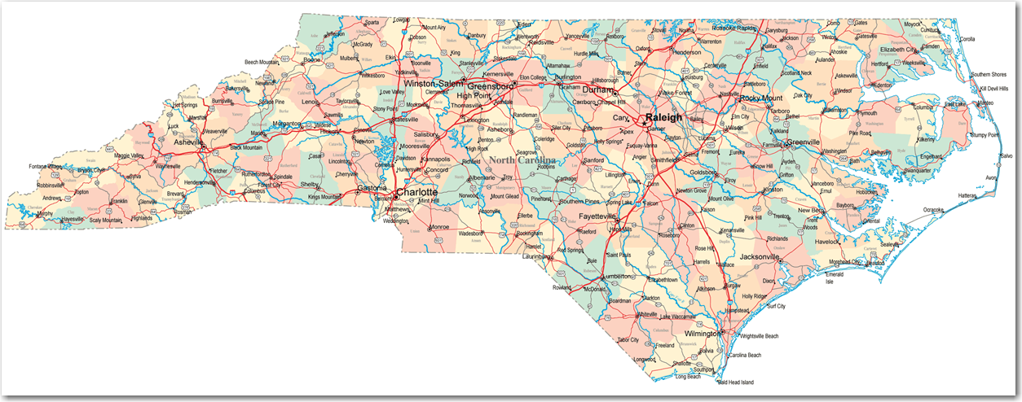
2016 FAFSA Day
Saturday, February 20, 2016
9:00 a.m. to 12:00 p.m. at most locations
Register at CFNC.org or call 866-866-CFNC
Notes:
Some are hosted by colleges/universities
Some are hosted by SECU branches
18

Slide 19

Grants, Scholarships, and Loans
Federal Grants
State Grants
Institutional Grants and Scholarships
Scholarships and Grants from other organizations
Federal Loans – remember that loans must be repaid
Notes:
Effective 2012-13:
No more NCLTG & SCSF – new program is need-based & called “Need-Based Scholarship for Students Attending Private Institutions”
NC Education Lottery Scholarship program available only at UNC Campuses & NC Community Colleges
Limited UNC Need- Based Grants & the Need-Based Scholarship for Students Attending Private Institutions – limited to the full time equivalent of 9 semesters for those enrolled in 4 year degree program and 11 semesters for those enrolled in 5 year degree programs.
North Carolina Forgivable Education Loan for Service
Other changes may be coming – keep up with the news!
Enrollment on or after July 1, 2012 – NO subsidized loans for grad/professional students
Remember that some scholarship/loan programs become “
North Carolina Forgivable Education Loan for Service” for 2012-13.
Suggest people read the details for all programs at CFNC.org – Pay tab

Slide 20

Financial Aid Programs
College Payment Plan
Private Student Loans
Other Personal Loans
Don’t Get Hooked
Notes:
Many colleges offer payment plans that allow you to pay the bill over several months instead of at the beginning of each semester. Check with the college directly about payment plan options.
There are private loans available. The lender will consider your credit score and ability to repay the loan. The lender might also consider the type of institution you attend and your major. INVESTIGATE carefully before signing on the dotted line for a private loan.
Sometimes parents may want to investigate home equity loans or lines of credit or other loan vehicles they might use to meet educational expenses. You should discuss those with your local banker or financial advisor/planner.
A word of caution. Financial aid information is available FREE. You do not have to pay for it. You should not ever send someone money to apply for a scholarship. Be cautious about those who offer to help you qualify for financial aid, no matter your income or assets.
CFNC is a participant in a national campaign to remind students and parents to Not Get Hooked by Misleading Financial Aid Offers.
When in doubt, check it out.

Slide 21
Financial Aid Package – Your Net Cost
Amount of gift aid offered?
Requirements for scholarships?
Is the scholarship renewable?
Requirements for institutional grants?
How much remains to be paid after gift aid?
What is the process for obtaining a Federal Work Study position?
What amounts and types of student and parent loans are recommended?
Notes:
When evaluating a financial aid offer, consider total cost of attendance minus gift aid offered. The remainder has to be covered by the student and family. How will it be covered? Parent and student savings? Current income? Student borrowing? Parent borrowing? Other family members (grandparents, for example)?
What does the student have to do to get the same scholarship support in the future?
Sometimes institutional grants have renewal requirements – ask.
Can a Federal Work Study job help defray personal expenses?
If the student doesn’t qualify for Federal Work Study, are there other employment opportunities on campus?
Is the amount of loan to be borrowed manageable for EACH year?

Slide 22
Information You Might Find On Your
Financial Aid Award Notice
Estimated Cost of Attendance
Disclaimers about the aid offered
Reminder to report the receipt of other financial aid you expect to receive
List of action/steps you must take to complete the process
Terms and conditions that apply to your financial aid offer

Slide 23

Additional Information
Verification
Special Circumstances
  Death
  Disability
  Divorce/Separation
  Loss of Employment
  Unusual Medical/Dental Expenses
  Other
Notes:
Some students will be selected for verification – either by the U.S. Department of Education or your school. Do not panic. They’ll ask you for copies of student and parent IRS forms and other documents about family income and circumstances. Overall, it happens to about 30% of all aid applicants.
If you have special circumstances in your family, contact your campus financial aid office.
This is just a list of some examples – it is not exhaustive.
Ask the campus financial aid office if your circumstances or change in circumstances will impact your financial aid office.

Slide 24
Tax Credits - Calendar Year 2015
Consult the most recent IRS publications and with your tax adviser
IRS.gov has the most recent information and definitions for various programs, including
  American Opportunity Tax Credit
  Lifetime Learning Tax Credit
  Tuition and Fees Tax Deduction
  Student Loan Interest Deduction

Slide 25

Questions

