Slide 1
How Financial Aid Administrators
Can Help Support Students Experiencing Homelessness
NCASFAA
Tuesday, April 5, 8:15 - 9:00 AM EST

Slide 2
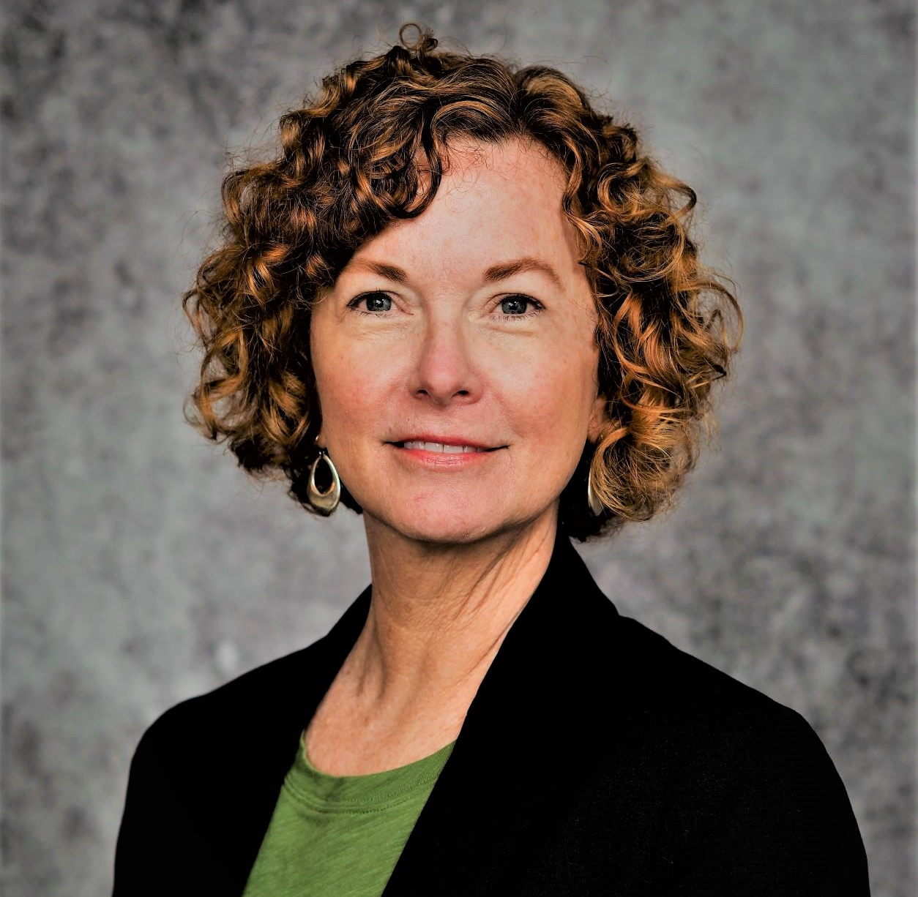
Hello, everyone!
Mary Haskett
Professor Department of Psychology, NC State University
Jillian Sitjar
Senior Higher Education Program Manager, SchoolHouse Connection
Alex Buccelli
Graduate Student & Research Associate, NC State University

Slide 3
Today’s Agenda
National Perspective on Homelessness & Higher Education & COVID Impact
Best Practices in Identifying Students and Assisting with the FAFSA
Higher Education Homeless Liaisons Survey Results
Resources
Q&A

Slide 4
www.schoolhouseconnection.org
SchoolHouse Connection works to overcome homelessness through education. We provide strategic advocacy and practical assistance in partnership with schools, early childhood programs, institutions of higher education, service providers, families, and youth.
Federal and state policy advocacy
Q&A from our inbox
Webinars and implementation tools
Youth leadership and scholarship
FB Group: facebook.com/groups/SchoolHouseConnection
Newsletter: schoolhouseconnection.org/sign-up/

Slide 5
Homeless and Foster Youth Definitions
Homeless Youth: Youth under the age of 24 who lack fixed, regular, and adequate housing
Unaccompanied Homeless Youth: Youth under the age of 24 who lack fixed, regular, and adequate housing and is not living in the physical custody of a parent or guardian
Foster Youth: Youth under the age of 24 who, at any point after age 13, had no living parent, were in foster care, or were a dependent or ward of the court.
Notes:
Jillian

Slide 6
Report from the Hope Center
(Taken from nearly 200K students from 202 colleges and universities)
Source: https://hope4college.com/wp-content/uploads/2021/03/RCReport2021.pdf, p.3

Slide 7
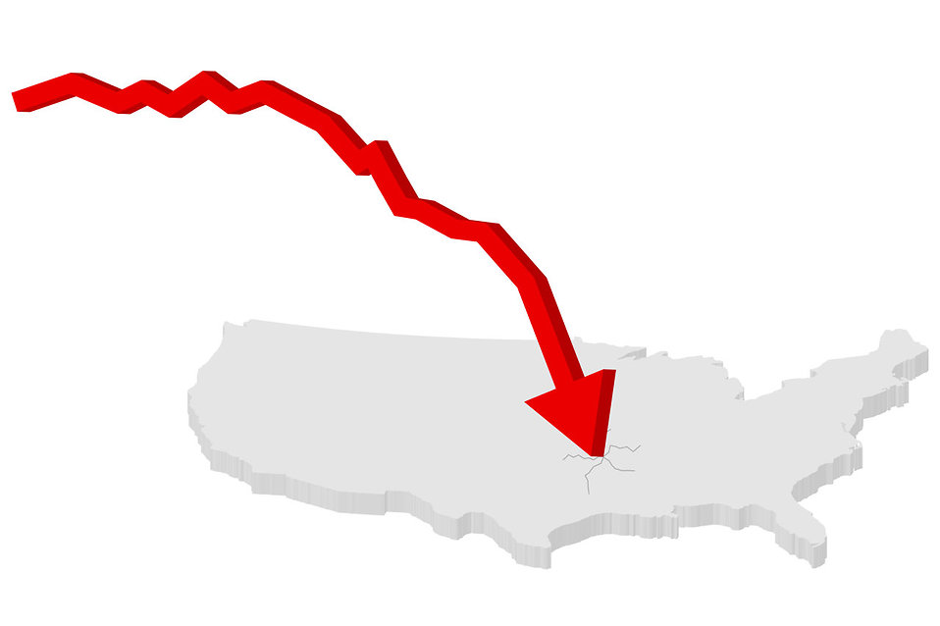
COVID’s Impact on Pursuing Postsecondary Education
Higher education enrollment fell a further 2.7 percent in the fall of 2021 following a 2.5 percent drop in the preceding fall.
Continued enrollment losses in the pandemic represent a total two-year decline of 5.1 percent or 938,000 students since fall 2019.
Source: https://nscresearchcenter.org/current-term-enrollment-estimates/

Slide 8
WHAT DO YOUNG PEOPLE NEED TO BE SUCCESSFUL IN SCHOOL?
Youth with lived experience said:
Connection to positive, supportive adults
Stability - difficult to meet educational needs when you can't meet basic needs
Help navigating financial aid
Knowledge of existing campus support programs and resources (social media, word of mouth, visibility: posters, flyers)

Slide 9
Identification Best Practices
“Any student who faces challenges securing their food or housing and believes this may affect their performance in the course is urged to contact the Dean of Students for support. Furthermore, please notify the professor if you are comfortable in doing so. This will enable her to provide any resources that she may possess.”
Introductory emails
Application & incoming surveys
Partnering with financial aid
Homeless higher education liaisons
Clear referral system
Partnerships with campus police, health services, cleaning staff, etc.
Trainings
Syllabus note
COVID-19: Relying more on faculty

Slide 10
Financial Aid Best Practices
Identification/referrals
Partner with homeless higher education liaisons/campus support programs
Campaign - Intentional outreach out to students experiencing homelessness that the FAFSA is available starting on Oct. 1st
Provide office hours
Professional development opportunities
Utilize existing resources
Making Unaccompanied Homeless Youth Determinations: A Tool for Financial Aid Administrators
Remove barriers for students; focus on the IF, not the WHY

Slide 11
NEW FAFSA PROVISIONS - Applicable for the upcoming Oct. 1st FAFSA
Authorized Entities to Verify UHY Status
School district liaison
Director or designee of a director of an emergency or transitional shelter, street outreach program, homeless youth drop-in center, or other programs serving individuals experiencing homelessness
Director or designee of a director of a program funded under TRIO or GEAR UP
Financial aid administrators (both at current institutions or at another institution who previously made a determination
Homeless or foster care status does not need to be redetermined every year
Determinations of unaccompanied homeless youth and foster youth status must be made as quickly as practicable
More officials and programs are authorized to verify that an applicant is an unaccompanied homeless youth
Source: https://schoolhouseconnection.org/the-fafsa-simplification-act/

Slide 12
NEW FAFSA PROVISIONS - Applicable for the upcoming Oct. 1st FAFSA
Financial aid administrators must consider and accept documentation from one of the authorized entities who are authorized to verify a youth’s status as an unaccompanied homeless youth
Financial aid administrators must make a determination for unaccompanied homeless youth status for those who cannot get determiniations from other authorities
Determinations must be based on a written statement or a documented interview with a student
Determinations must be based on the legal definition of homelessness and unaccompanied - focus on the IF, not the WHY
Source: https://schoolhouseconnection.org/the-fafsa-simplification-act/

Slide 13
A survey of higher education liaisons:
Role preparation & professional development needs
Mary E. Haskett
Alexandra R. Buccelli
Department of Psychology

Slide 14
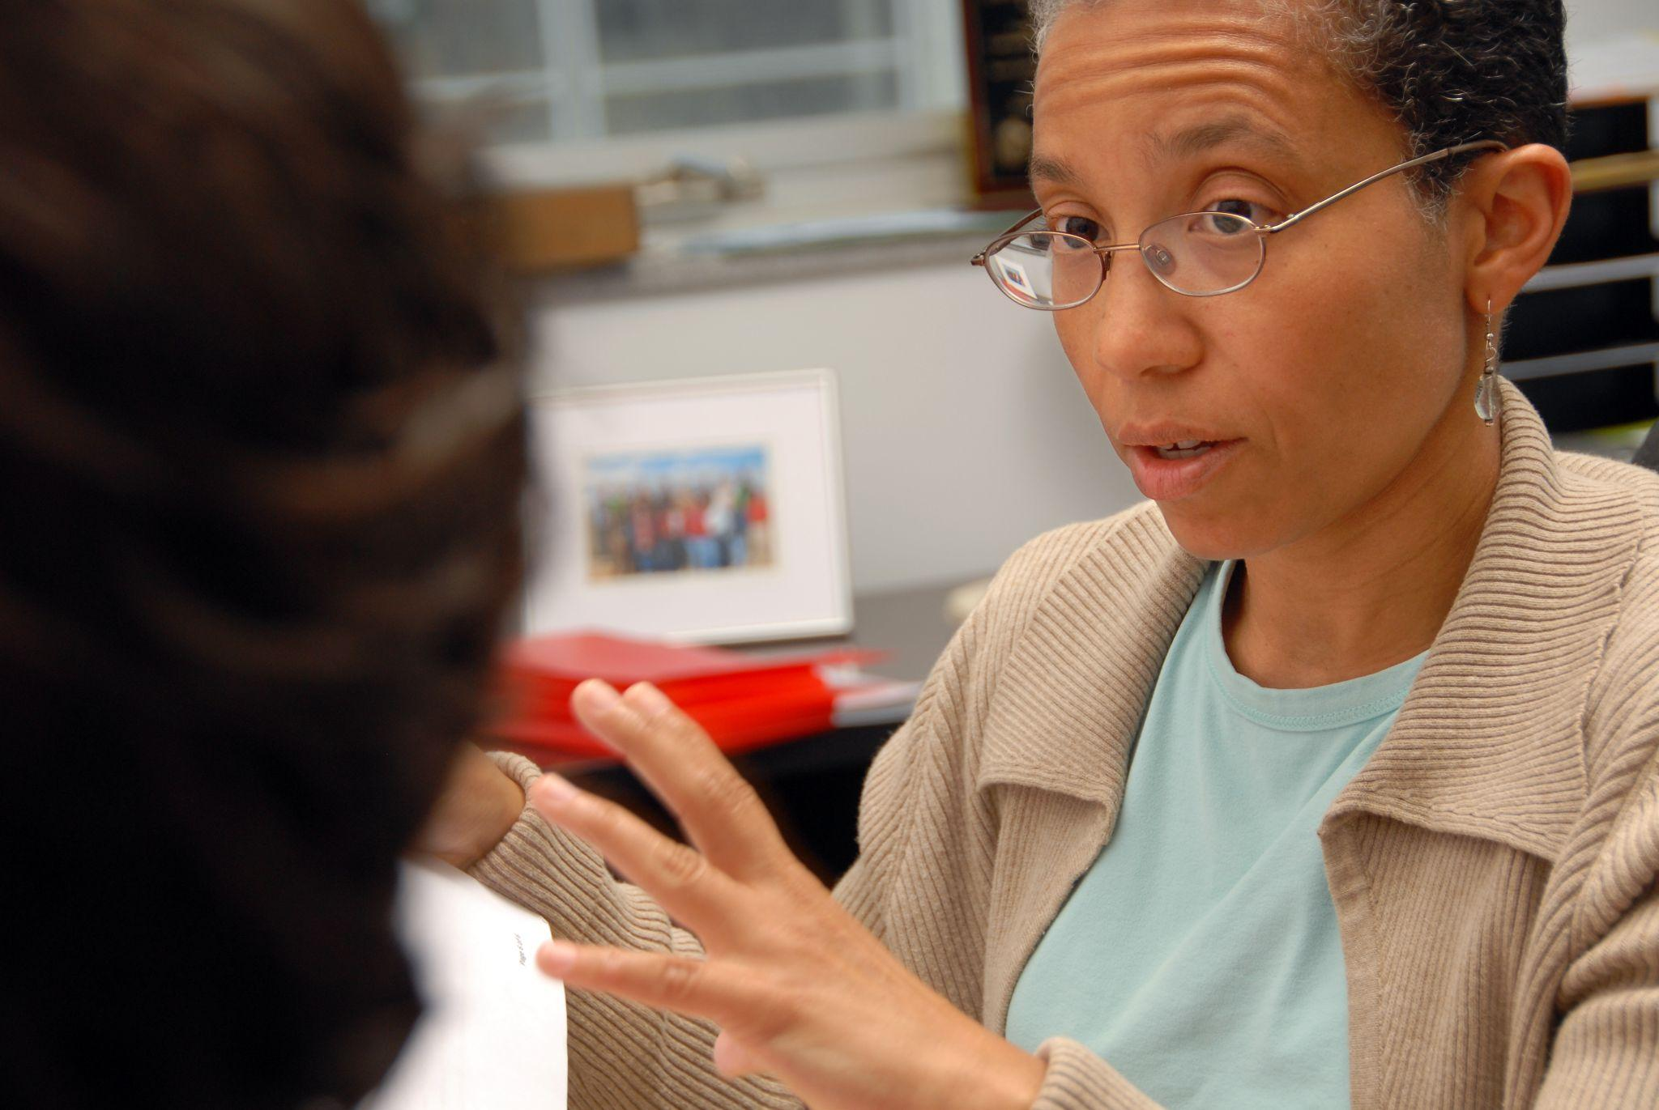
Prior studies of higher education liaisons
Our purpose

Slide 15
Participants
49 liaisons
Type of Institution
21 at community colleges (43%)
19 (39%) at four-year colleges with graduate programs
9 (18%) at four-year colleges without graduate programs
Primary Role
19 identified as liaison or single/designated point of contact
13 identified as FA staff
6 identified as a counselor/advisor
3 as a case manager
7 as “other” (dean, director of student services, director of single stop)

Slide 16
Participants
49 liaisons
Education:
43% had graduate degrees (e.g., higher education, counseling, English)
Experience
7 → 10+ years of experience
17 → 5-10 years
12 → 2-5 years
10 → fewer than 2 years
3 → no reply

Slide 17
Procedures
Recruited from 4 states
Online survey; responses anonymous; gift card drawing
Approved by IRB
20% response rate
Notes:
Survey: 23 questions
Professional background
Preparation for the role
Services provided to students
Perceived need & preferences for professional development

Slide 18
Findings & Recommendations:
Estimated rates of homelessness
Estimated Rates of Homelessness on Campus:
IDK 20%
1-5% 55%
>10% 11%
Basis for estimate:
51% → number of students referred
38% → FAFSA data
11% → data on homelessness
95.5% were confident in their estimate!
Notes:
Alex - we are confidently missing students

Slide 19
Findings & Recommendations:
Time spent in role
In a typical week 73% of the liaisons assisted <6 students
80% of liaisons devoted very little (10% or less) of their time to liaison duties
53% of liaisons’ contact information was not listed on the website as point of contact
Notes:
Alex

Slide 20
Findings & Recommendations:
Preparation for the role
55%: Institution provided appropriate guidance to assist students
51%: Institution adequately staffed & funded liaison role
25%: Received no special training
92%: Engaged in self-directed learning
More guidance, resources, and specialized training are needed.
Notes:
Alex

Slide 21
Findings & Recommendations:
What do students seek?
52% Connection to housing/shelters
44.8% School supplies
44.8% Transportation assistance
32.6% Counseling
34.6% Employment assistance
18.3% FAFSA completion
16.3% Child care assistance
Notes:
Implications

Slide 22
Findings & Recommendations:
Needs for support/training
39% Support for students transitioning from HS
46% Resources for student parents
>50% interested in:
forming partnerships on & off campus
financial aid support
health/wellness & food resources
related policy requirements
72% Identifying & providing outreach

Slide 23
Findings & Recommendations:
Preferred training format
84% online options
66% in-person training
73% connecting with others

Slide 24
QUESTIONS

Slide 25
Slide about EITC
https://schoolhouseconnection.org/earned-income-tax-credit/

Slide 26
Resources
SchoolHouse Connection FAFSA Page
Comprehensive homelessness and financial aid resources including sample verification forms, tip sheets, and more.
Making Unaccompanied Homeless Youth Determinations: A Tool for Financial Aid Administrators
FAFSA Simplification Act
SchoolHouse Connection Higher Education Page
Notes:
Jillian

Slide 27
Contact Information
Jillian Sitjar - jillian@schoolhouseconnection.org
Mary Haskett - mehasket@ncsu.edu
Alex Buccelli - arbuccel@ncsu.edu
Notes:
Jillian

