Slide 1
State Grants Portal
Disbursements, Adjustments, and Reconciliation

Slide 2
Disbursements and Adjustments
Disbursement Statuses- Made disbursements and pending disbursements
Adjustment statuses- Posted adjustments and pending adjustments
Disbursements and Adjustments are transactional
disbursement amount does not decrease when there is an Adjustment.
Award amount is disbursement amount minus adjustment amount

Slide 3
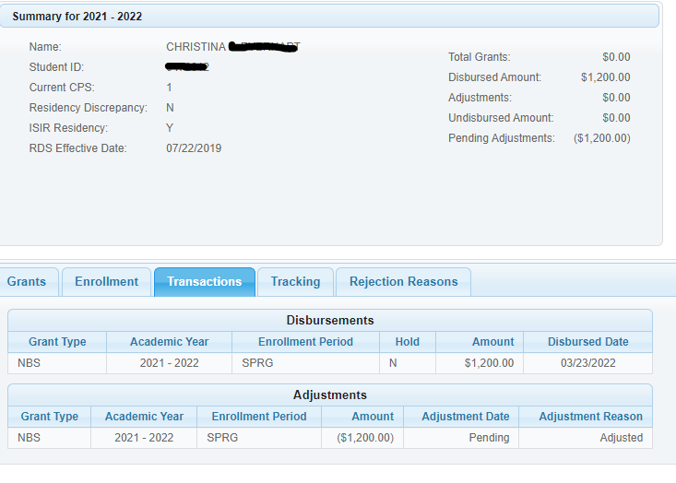
Disbursements and Adjustments
Maintenance, Student screen
Transactions tab
Total grants = zero
Disbursed amount – adjustments = total grants
Disbursed date = disbursement has been made
Amount = amount of original disbursement
Adjustment date pending = funds not yet
posted on this return.

Slide 4
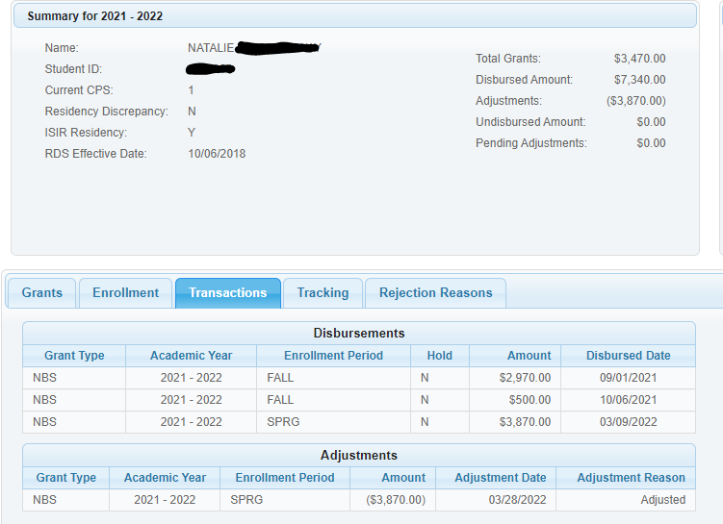
Disbursements and Adjustments
Maintenance, Student screen
Transactions tab
Total grants = $3,470
Disbursed amount – adjustments = total grants
Disbursed date = disbursement has been made
Amount = amount of original disbursement
Adjustment date – date funds
posted on this return.

Slide 5
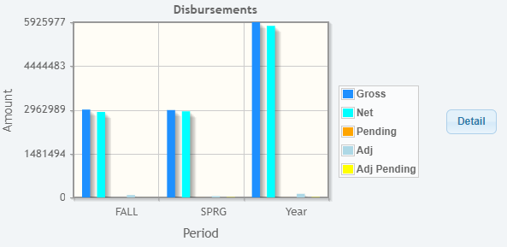
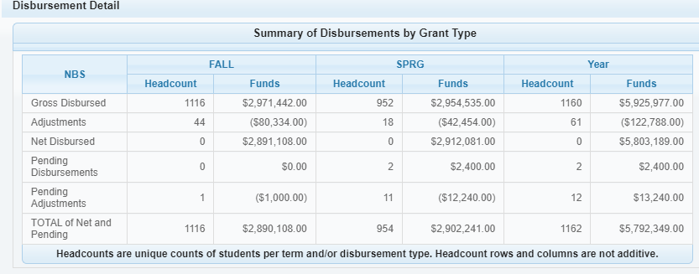
Disbursements- Dashboard
Clicking detail shows a summary
Gross disbursements made and pending,
and Adjustments posted and pending

Slide 6
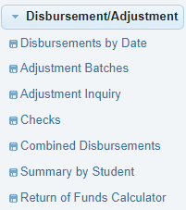
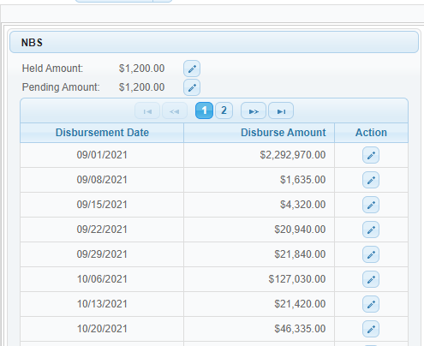
Disbursement/Adjustment options
Disbursements by Date screen
Drill down to detail for held, pending, and
made disbursements
Export to report if desired

Slide 7
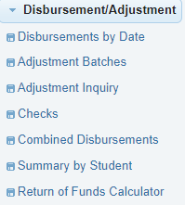
Disbursement/Adjustment options
Adjustment Inquiry screen
Select term and status
Status:
Pending: not posted or batched
Submitted: in a batch but not posted
Completed: posted

Slide 8
Disbursement/Adjustment options
Adjustment Inquiry screen
Amount of adjustment
Date adjustment posted
Batch
School check number and date
Total check amount
Export to report if needed
Harris adjustment is batched, but not yet returned and posted. All others are batched, returned and posted

Slide 9
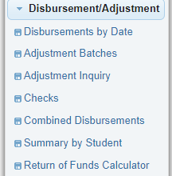
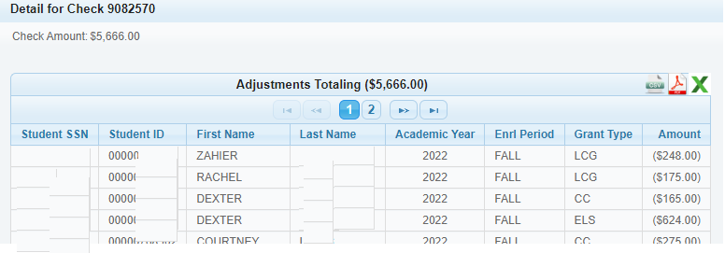
Disbursement/Adjustment options
Checks screen
School check number
School check amount
School check date
Status
Detail, export if desired

Slide 10
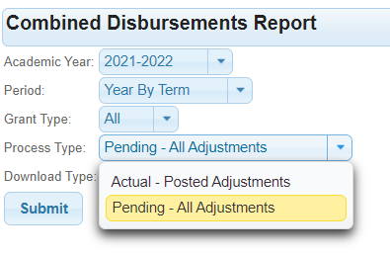
Disbursement/Adjustment options
Combined disbursements
Report/file only- “made” disbursements only
Community Colleges:
Report reflects ONLY posted adjustments (Actual-Posted Adjustments only)
If funds are due back and not yet posted by CFI, report shows pre-adjusted amount
Your reconciliation won’t balance until funds are returned
Correct any erroneous adjustments
UNCs and Privates:
Can run in two modes
Pending- All Adjustments- amounts reflect unposted adjustments
Actual – Posted Adjustments – amounts only posted adjustments
Correct any erroneous adjustments
Return legitimate adjustments

Slide 11
Disbursement/Adjustment options
Summary by Student
Run by Enrollment Period, or Academic Year (sum by grant type)
Include made, pending, or all disbursements
Shows pending and posted disbursements and adjustments
Export to report if desired

Slide 12
Disbursement/Adjustment options
Summary by Student
By enrollment period, all disbursement statuses

Slide 13
Disbursement/Adjustment options
Summary by Student
By year summary, all disbursement statuses

Slide 14
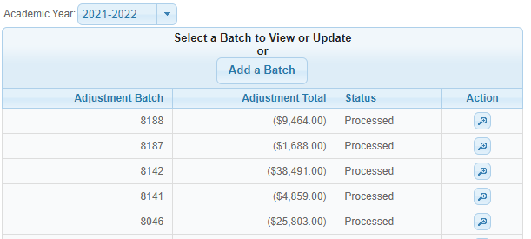
Disbursement/Adjustment options
Adjustment Batches
Create a batch of adjustments
Generate a report
Send check to CFI- check amount = batch amount
Check status of batches, view adjustments due back

Slide 15
Disbursement/Adjustment options
Adjustment Batches
Click Add a Batch to view adjustments due back
Make corrections if needed
Select those to be returned to CFI
Save and request report
Print report from menu option Report Download
Return report with check if possible

Slide 16
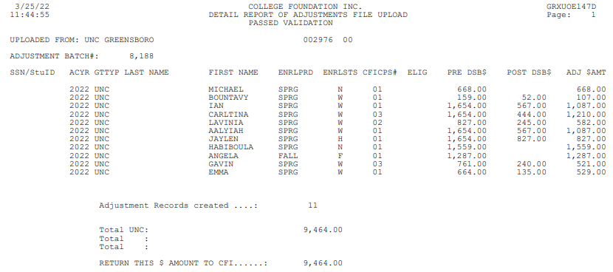
Disbursement/Adjustment options
Adjustment Batches
Print report from menu option Report Download
Return report with check if possible
Download and print

Slide 17
Withdrawal Return of Funds
Current Withdrawal Return of Funds Policy through 2021-2022
Grant amount earned is % of term attended if withdrawing at or before 35%
Grant amount earned = 100% if withdrawing after 35%
If no confirmed last date of attendance or documented academic activity and school found out after 35%, return amount is 50%. Prorated if on or before 35%.

Slide 18
Withdrawal Return of Funds
REVISED Withdrawal Return of Funds Policy for 2022-2023
Change is to allow the official withdrawal date to be used in cases where last date of attendance is not known and no last date of documented academic activity.
If no LDA or official withdrawal rate, return 50%
Change will be made to calculator for 2022-2023 on portal in August 2022. Once the change is made, 2021-2022 calculations will need to be done manually.

Slide 19
Platinum Level Supporters

Slide 20
Gold Level Supporters

Slide 21
Silver Level Supporters

Slide 22
Bronze Level Supporters

