Slide 1


Partnering for Success: NASFAA Has Your Back
April, 2025

Slide 2


About NASFAA
Who We Are
Member institutions serve 9 out of every 10 undergraduates in the US.
Our Mission
NASFAA's mission is to:
Provide essential professional development, information, and services to financial aid administrators.
Advocate for public policies that increase student access to and success in postsecondary education; and
Nurture community and belonging throughout the financial aid profession.
We are committed to diversity throughout
all activities.
29,000+
financial assistance professionals
at
3,000
colleges, universities, and career schools
Our Vision
To ensure all qualified students have access to postsecondary education, no matter their socioeconomic background.
2

Slide 3
NASFAA Resources: Reliable Information & Training

Slide 4

The Ref Desk
A comprehensive index developed by NASFAA and other education partners that has open access for aid professionals.
Find it fast!
studentaidrefdesk.org

Slide 5
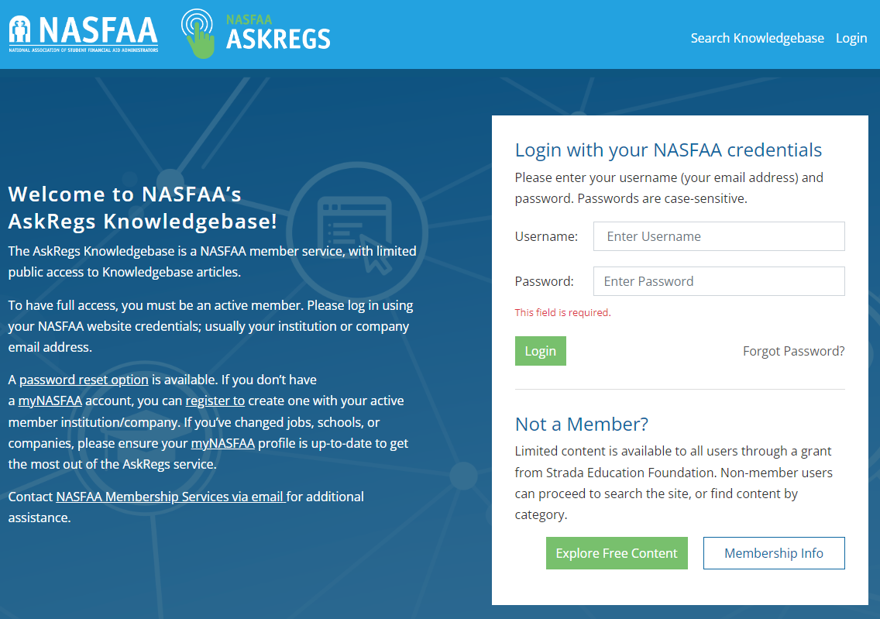
AskRegs
Search the database of “real world” questions and answers
Or
Ask the NASFAA Training & Regulatory Assistance Team a question

Slide 6

NASFAA 2025 - We Hope To See You There!
June 24 - 27, 2025 | Anaheim, CA
https://www.nasfaa.org/conference25
Notes:
https://www.nasfaa.org/leadership
https://www.nasfaa.org/conference25

Slide 7


NASFAA Training Opportunities for 2024-25

Slide 8
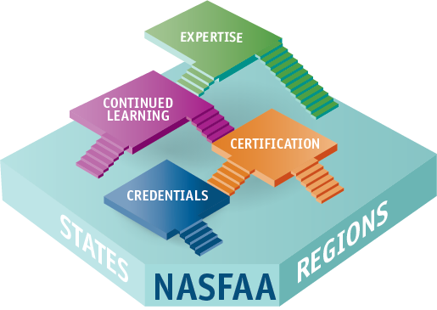
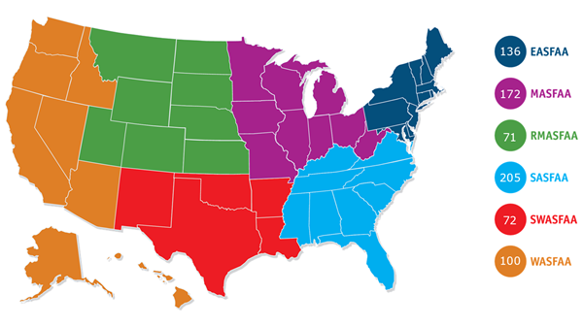
NASFAA Certified Financial Aid Administrator®
(CFAA) Program
Advances and elevates the profession
645
Inspires quality job performance
Creates a competitive edge
Notes:
https://www.nasfaa.org/certification_registry As of December 20, 2024, 756 across the country hold the the FAAC® designation.

Slide 9

Implicit Bias Toolkit
NASFAA invites you to reflect and consider that as financial aid administrators, we directly influence the trajectory of our students' lives through our work.
NASFAA, in conjunction with our member task force, created this toolkit to assist aid offices with awareness
and suggestions to assist in eliminating bias from institutional policies
and procedures.
nasfaa.org/implicit_bias_toolkit

Slide 10

2024 Career Awareness Thought Force Report
Task Force Members:
Chair: Heidi Carl, Purdue University
Megan Chaffee, Governors State University
Sarah Everitt, Gonzaga University
Steven Foster, University of Michigan - Dearborn
Zack Goodwin, University of Nevada, Las Vegas
Daniel Barkowitz, University of Miami
Mary Bass Santiago, Spelman College
Amy Cable, Louisiana Community and Technical College System
Patti Kohler, Western Governors University
Sharon Wilson, Hawaii Pacific University
NASFAA Staff Liaisons:
Charlotte Etier
Dana Kelly
Margot Manning
Susan Shogren
Next Steps:
Career Awareness Toolkit Thought Force
Reclassification Working Group
Notes:
https://www.nasfaa.org/uploads/documents/Career_Awareness_Thought_Force_Report_2024.pdf

Slide 11
NASFAA Board
&
Staff
Notes:
Note to Chair to use this slide as an opportunity to highlight any NASFAA Board & staff members attending the conference.

Slide 12
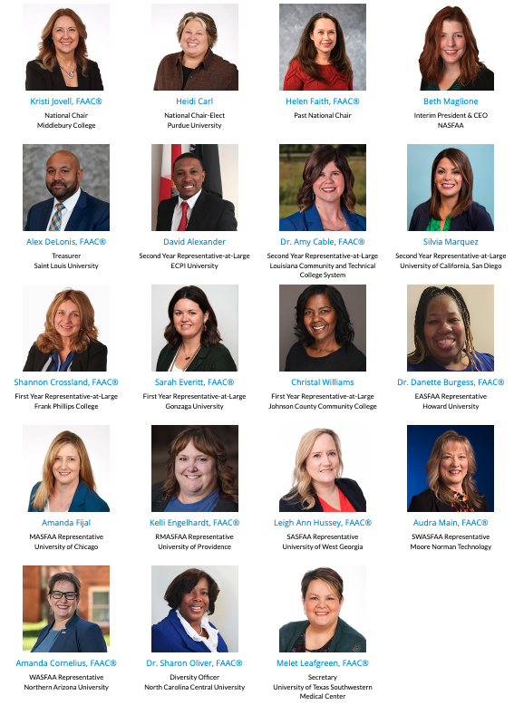

NASFAA’s Board of Directors
"If your actions create a legacy that inspires others to dream more, learn more, do more and become more, then, you are an excellent leader. "
Dolly Parton
Notes:
Sets the mission, vision and strategic plan. Serves to advise the staff and CEO. Oversight and governance.

Slide 13
NASFAA Presidential Search
Learn more about the progress of the presidential search at our Presidential Search Web Center.
Presidential Search Committee:
Dr. Sharon Oliver, Chair
Dr. Amy Cable, Member
Heidi Carl, Member
Amanda Cornelius, Member
Alex DeLonis, Member
Sarah Everitt, Member
Beth Maglione, NASFAA Staff Liaison
Sydney Evans, NASFAA Staff Liaison
https://www.nasfaa.org/presidential_search
Notes:
Aiming to have a candidate identified in early 2025
Web Center: https://www.nasfaa.org/presidential_search
Feedback Form: https://www.nasfaa.org/search_feedback

Slide 14
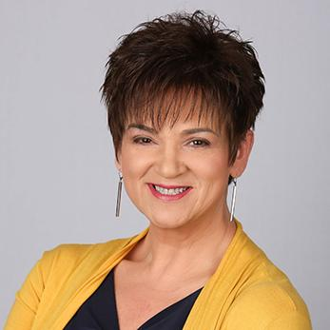
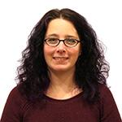
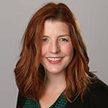


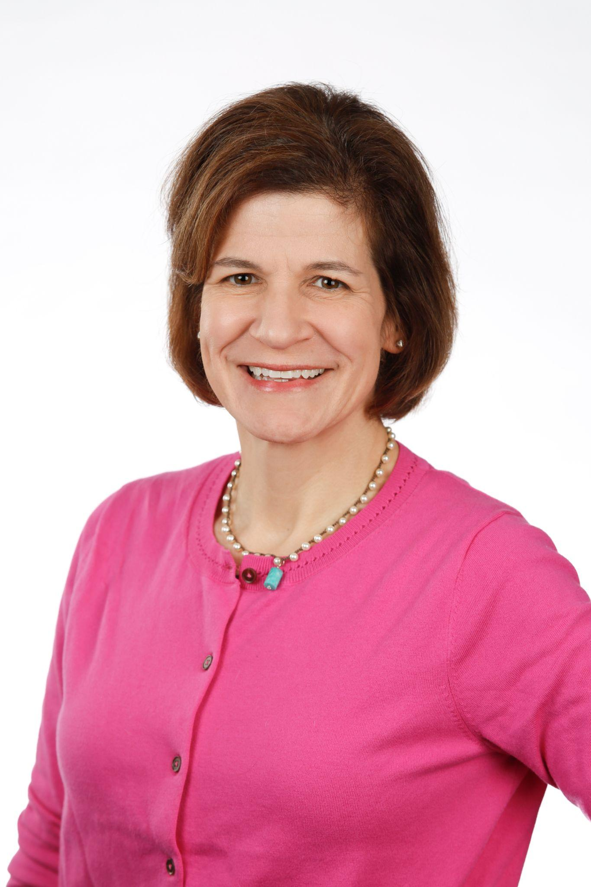
NASFAA Executive Team
Beth Maglione
Interim President and CEO
Mindy Eline
Blue Icon Executive Director, NASFAA Vice President
Sydney Evans
Chief of Staff
Karen McCarthy
Vice President of Public Policy and Federal Relations
Dana Kelly
Vice President of Professional Development & Institutional Compliance
Carrie Conrad
Vice President of Technology & Member Experience
NASFAA is in good hands with a tenured leadership team!

Slide 15
Get Involved with NASFAA!
Notes:
Note to Chair to use this slide as an opportunity to highlight leaders from the individual states. Membership team provided this link, which always contain the most up-to-date list of NASFAA volunteers, sortable.

Slide 16

NASFAA Communities
Benefits of Joining a NASFAA Community
Quick and easy access to your aid colleagues
Professional and personal development
Network building
Real-time conversations with financial aid professionals across the country
Notes:
https://www.nasfaa.org/community

Slide 17
Volunteering with NASFAA
VOLUNTEER
CURRENT TASK FORCES
Enhance your professional development.
Further your leadership potential.
Expand your perspective.
Bolster your resume.
Strengthen your skills in financial aid administration.
Learn new skills in related areas.
Widen your network of colleagues.
2024-25 Associate Member Advisory Board
2024-25 Rapid Response Network
2024-25 State Advocacy Network
2024-25 Under-Resourced School Scholarship Selection Task Force
Reclassification Working Group
Career Awareness Toolkit TF
Visit
nasfaa.org/Get_Involved
for volunteer opportunities.
We welcome new volunteers!
Notes:
https://www.nasfaa.org/Get_Involved

Slide 18
NC Volunteers:
Lee Bray – Leadership Conference Task Forces, Rapid Response, NASFAA U Adjunct, Community Volunteer
Amanda Buchannon – NASFAA U Adjunct
Rachel Cavenaugh – State Advocacy Network
Jackie Copeland - Leadership Conference Task Force, Rapid Response
Paul Coscia - State Advocacy Network
Rachelle Feldman – Executive Leadership Collective, Rapid Response
Emily Jarrell – Rapid Response
Lori Lewis – Rapid Response
Sharon Oliver – BOD, Presidential Search Chair, Association Governance, DLP Task Force & Mentor, Rapid Response
Craig Slaughter, CFAA Program Commission, Ethics Commission, Leadership Conference Task Force
Perry Studevent – Grad/Prof Task Force
William Voris - State Advocacy Network

Slide 19

The Diversity Leadership Program (DLP)
Application period is typically September
Aligns with NASFAA’s commitment to diversity and inclusion.
Creates a pipeline for support and access to mentors.
Under-represented groups within the aid community gain access to leadership opportunities.
Provides participants with important professional development.
nasfaa.org/DLP
Notes:
https://www.nasfaa.org/DLP

Slide 20
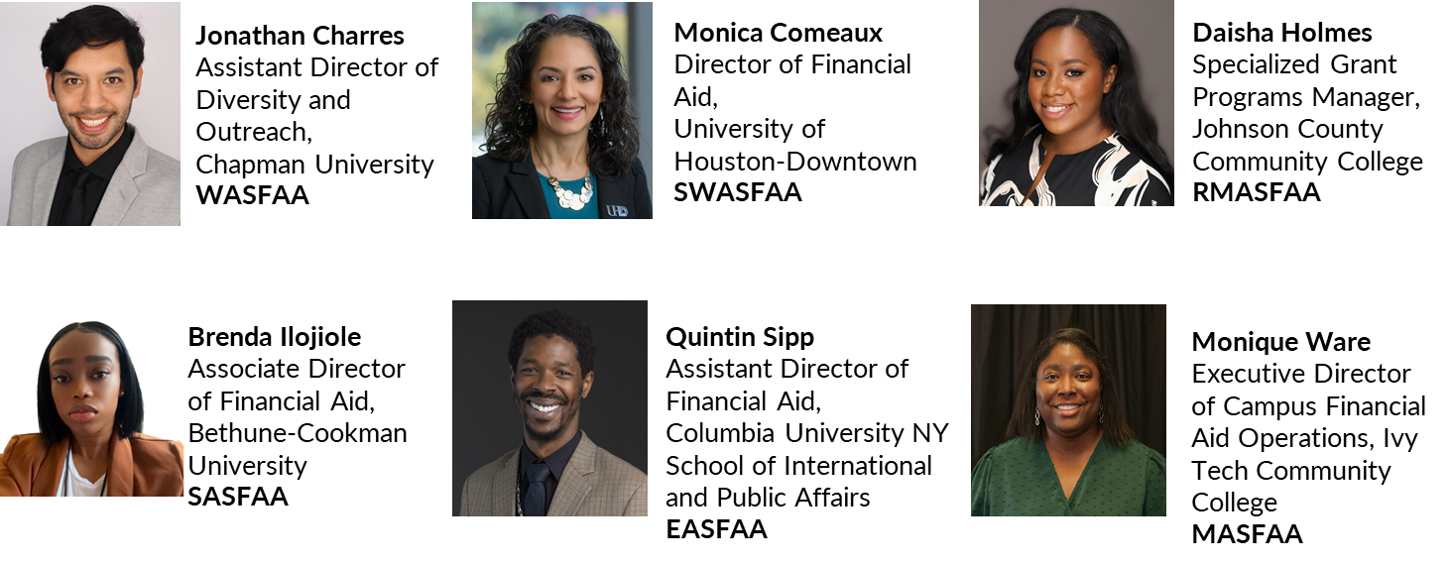
2024-25 Diversity Leadership Program Class

Slide 21
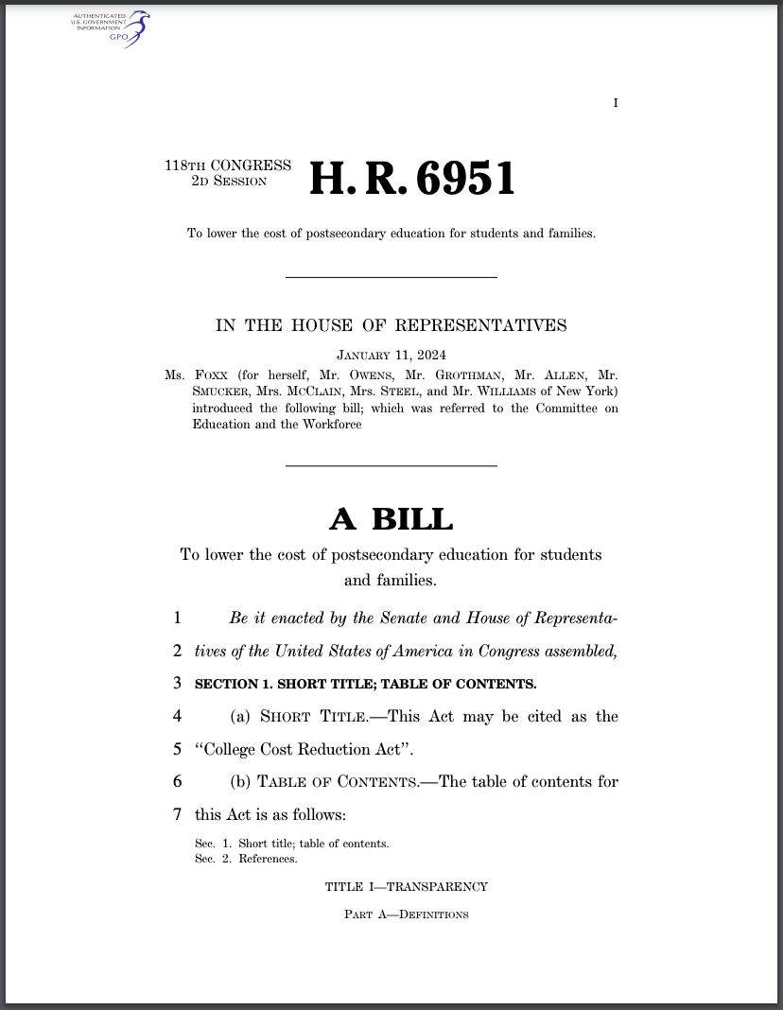
College Cost Reduction Act (CCRA)
Introduced by Rep. Virginia Foxx
Creates a standardized financial aid offer, and establishes new loan limits and loan repayment plans.
Creates a risk-sharing program centered around direct loans and would eliminate many of the recent regulations created during negotiated rulemaking.
Notes:
The next two slides are examples of piecemeal efforts to address certain areas of concern in the HEA without a comprehensive review or approach and represent partisan approaches by both sides. The College Affordability Act, introduced by Democrats in 2019 was the last time we saw an effort at true reauthorization. These sort of patchwork/piecemeal acts are becoming more and more common in an increasingly partisan environment where it’s difficult to achieve bipartisan compromise needed to pass a comprehensive reauthorization bill.

Slide 22
The Department
of Education

Slide 23
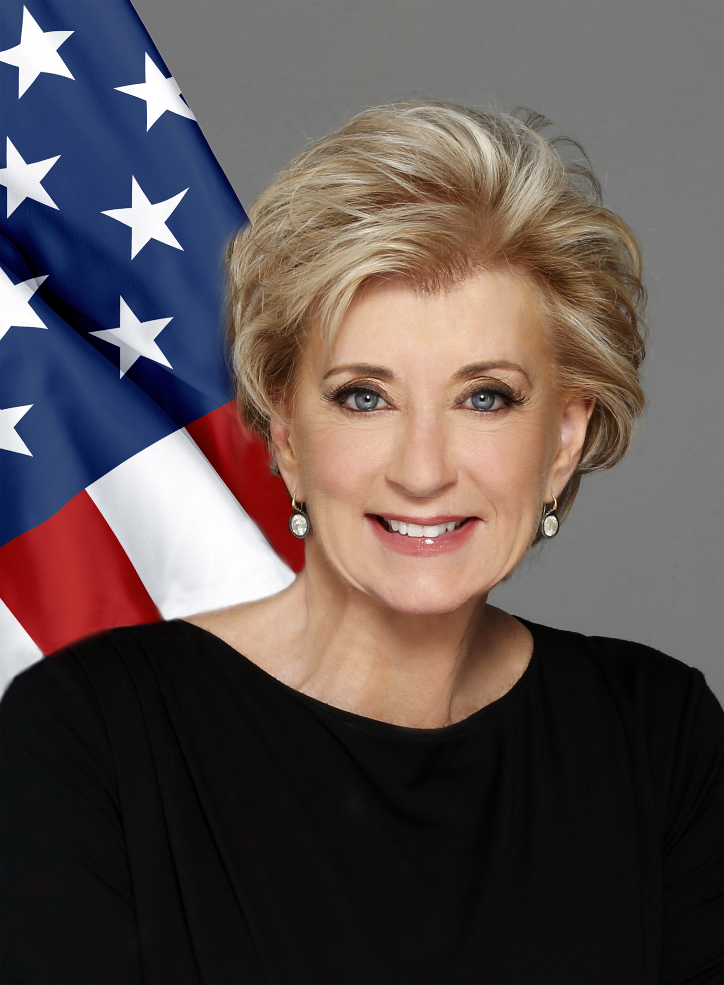
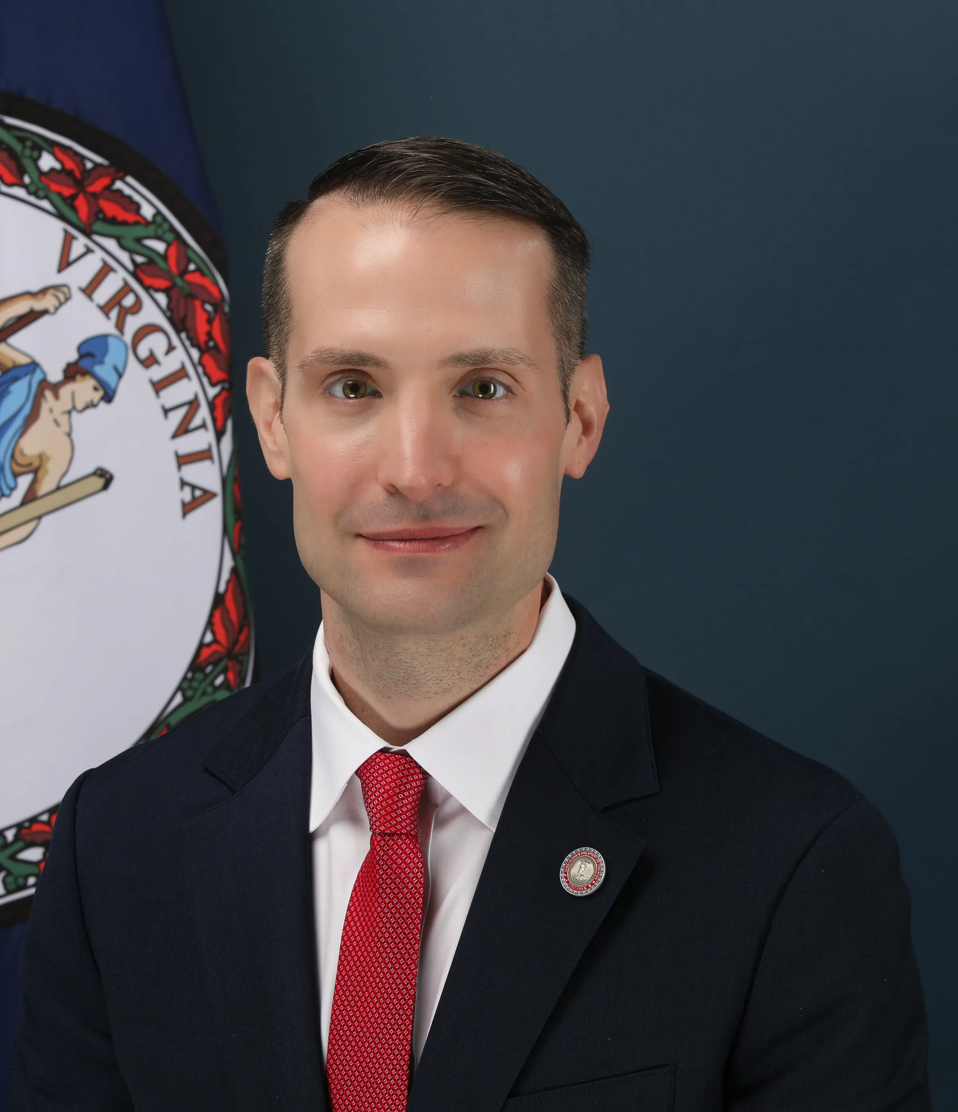

Faces of the 2025 Department of Education
Yes
Not yet confirmed
Secretary of Education Linda McMahon
Under Secretary of Education Nicholas Kent
Chief Operating Officer
TBD
Notes:
Linda McMahon: President-elect Donald Trump has nominated former wrestling executive Linda McMahon to lead the Department of Education. McMahon served during Trump’s first term as head of the Small Business Administration. In the education space, McMahon served on the Connecticut State Board of Education in 2009. Trump’s campaign noted that McMahon would spearhead the administration's efforts to “send education back to the states.” REQUIRES SENATE CONFIRMATION.
We don’t know who will be appointed Under Secretary and take James Kvaal’s spot. We don’t know if current Principal Deputy FSA Chief Operating Officer Denise Carter (who took over for Richard Cordray) will remain with ED until they fill this position.

Slide 24
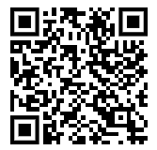
Mixed-Status Families
Public concerns that new administration will use FAFSA data for immigration enforcement
NASFAA is gathering facts to determine risks
Individual decisions for families as to whether they should complete FAFSA
Notes:
NASFAA has created a webpage for this topic: https://www.nasfaa.org/mixed_immigration_statuses_fafsa
I would suggest mentioning the webpage for where FAs can go to learn about the facts about FAFSA information collection as well as how to advise families who feel they may be affected by this.
QR code links to that webpage.

Slide 25
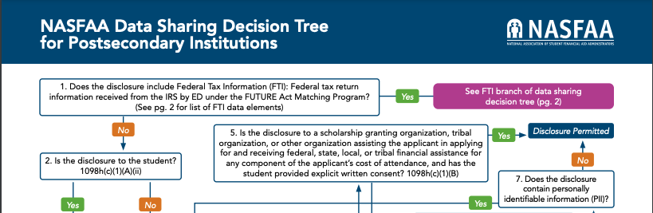
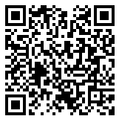
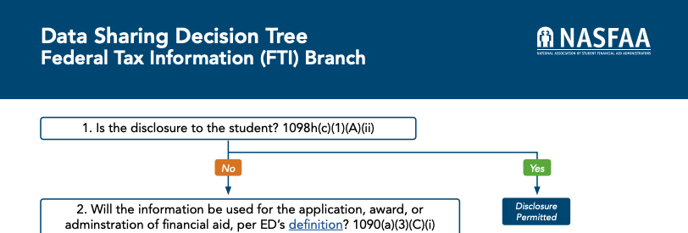
Data Sharing
NASFAA has updated the data sharing decision trees

Slide 26

Prison Education Program Web Center
Created to keep both financial aid community and prison education program administrators updated on tools, training, and news related to the implementation of financial aid in carceral settings
The webcenter features the following resources:
        PEP Reference Sheets: COA; SAP; Verification; and Pell LEU
        PEP Slack Community
        PEP AskRegs Related Questions
        PEP Webinar Information
nasfaa.org/pep

Slide 27


