Slide 1
Gainful Employment & Financial Value Transparency
Leigh Ann Hussey AVP for Enrollment and Financial Aid
University of West Georgia

Slide 2
What’s the Difference?
Gainful Employment - non degree program of at least one academic year that prepares students for gainful employment in a recognized occupation
Financial Value Transparency - includes all Title IV aid programs and is designed to provide more information to students in order to assist them make informed decisions.
“GE Light” (no sanctions)

Slide 3
Timeline
Negotiated rulemaking without consensus
2010 - GE final rule published effective 2011
2011 - GE rule vacated before effective date
Negotiated rulemaking without consensus (The Sequel)
2014 - GE final rule published effective 2015
2019 - GE rule rescinded
Negotiated rulemaking without consensus (Part III)
2023 - GE final rule published effective July 1, 2024
Added Financial Value Transparency
March 2024 - institutional reporting requirements moved from 7/31 to 10/1
Sept. 2024 - institutional reporting requirements moved to 1/15
Jan. 17, 2025 - reporting process reopened until 2/18
Feb. 14, 2025 - completers’ list and institutional reporting deadlines moved to 9/30

Slide 4
Two Measures Established

Slide 5
Debt to Earnings Ratio
Compares the median earnings of graduates w/ Title IV aid to the median annual payments for loan debt borrowed from the program
Two options to “pass”
Debt payments are no more than 8% of annual earnings, OR
Debt payments are no more than 20% of discretionary income
Formula: (Annual earnings) - (150% of poverty level for a single person)
2023 Poverty Level = $21,870; 150% = $32,805
Example using borrower with a $50,000 annual income
$50,000 - $32,805 = $17,195 (Discretionary Income)
20% of $17195 = $3,439
Debt payments can be no more than $3,439 annually ($286 monthly)

Slide 6
Data Sources
Program median earning levels for students on the completers’ list will be provided by the IRS.
Annual loan payments based on student loan debt and is capped at the lesser of either
Total amount of debt the student borrowed
(Tuition, fees, books, supplies, equipment) - (amount of institutional grants and scholarships)

Slide 7
Earnings Premium Test
Measures whether the typical program graduate is earning at least as much as the typical high school graduate in the labor force in their state between the ages of 25 and 34.
Uses IRS and Census Bureau data

Slide 8
Students Used in Calculation
Two Year Cohort - 30 or more completers
Four Year Cohort - Fewer than 30 completers in the Two Year Cohort AND has at least 30 completers in the Four Year Cohort
Rates not calculated for programs with fewer than 30 completers in the Four Year Cohort

Slide 9
Reporting

Slide 10
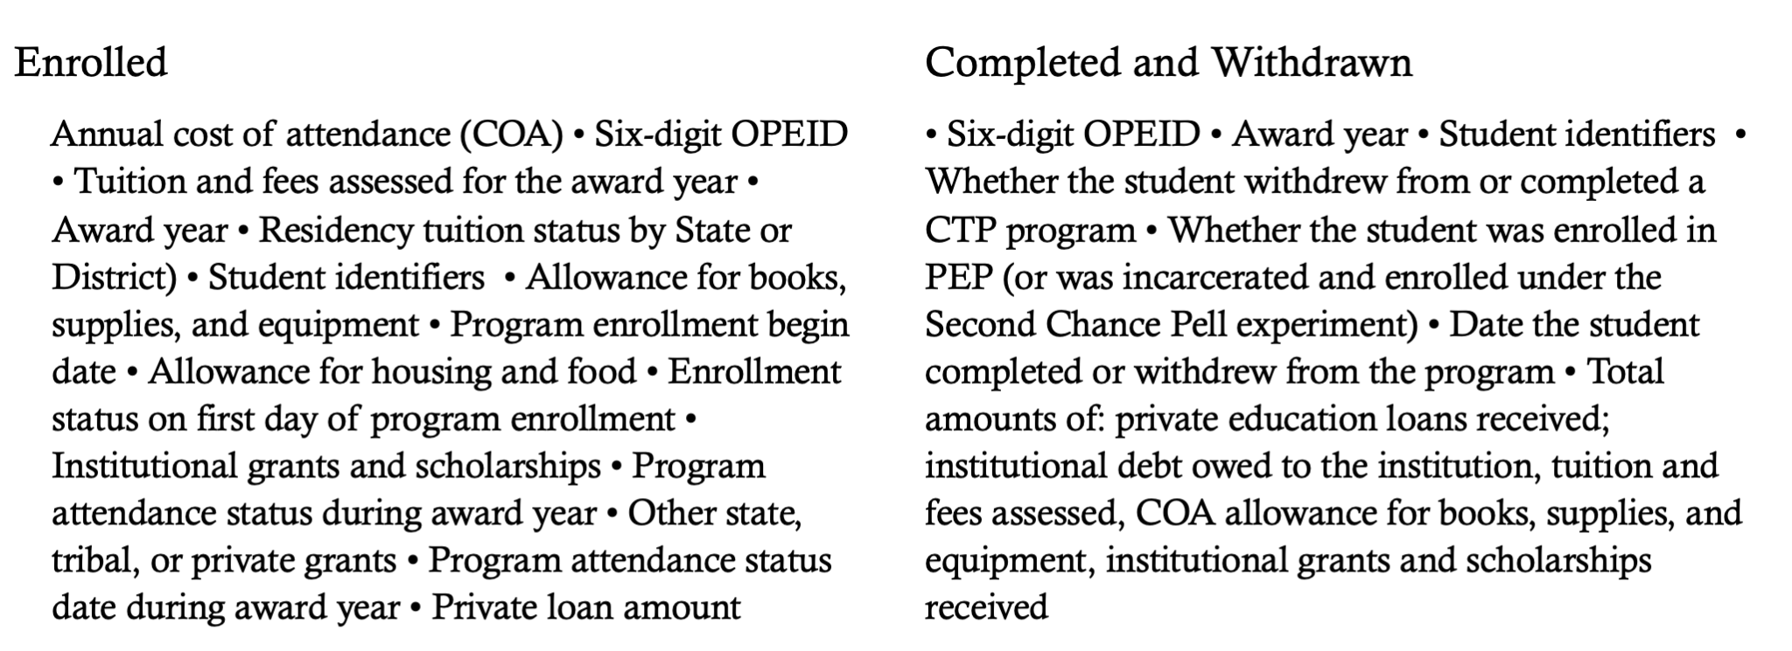
Student Specific Reporting

Slide 11
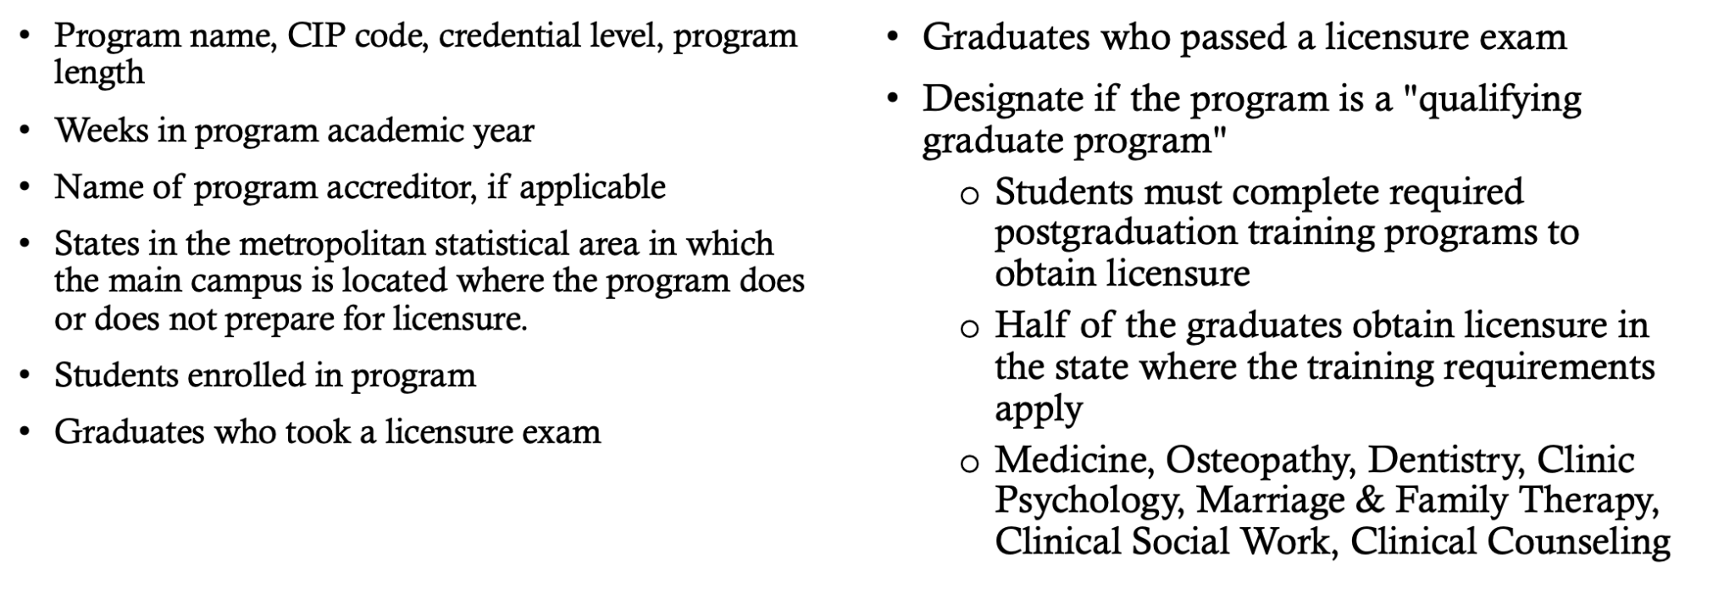
Program Specific Data

Slide 12
Who Do We NOT Report?
Approved Comprehensive Transition and Post-Secondary (CTP) programs
PostBacc teacher certification programs where the institution does not award a credential
Preparatory coursework for which eligible students may receive a direct loan
Approved Prison Education Programs

Slide 13
Standard or Transitional Reporting?
Standard
Most programs - 2nd through 7th prior award years
Qualifying graduate programs - 2nd through 8th prior award years
Transitional
All programs - 2 most recently completed award years
Choice must be made at the time of initial reporting
Transitional reporting used for the first six years
One six digit OPEID code = one choice
Can’t be changed!

Slide 14
Questions?

