Slide 1
Staffing and Succession: Doing more with less
Derrick Everhart, Director of Student Financial Services

Slide 2
M E E T O U R P A N E L I S T S
Maggie Bostic, Senior Assistant Director of Financial Aid
Western Carolina University
Lee Bray, Senior Director of Financial Aid, Veterans Affairs,
and Student Resource Centers
Pitt Community College
Nichole Buckner, Director of Financial Aid
Mars Hill University

Slide 3
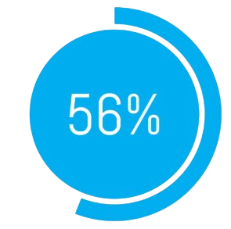
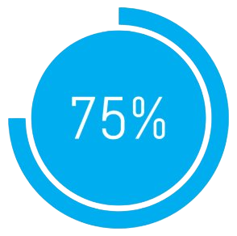
N A S F A A S U R V E Y
are concerned about their ability to adequately serve students with current staffing levels.
of regular staff operating during the relevant award period.

Slide 4
P A N E L D I S C U S S I O N
One major efficiency that you or your office has implemented since (or, as a result of) the COVID-19 pandemic?

Slide 5
"The challenges facing higher education are significant, but they also present an opportunity to fundamentally rethink how institutions can collaborate. The successful college of tomorrow won't be those that simply try to weather the storm through austerity measures, but those that reimagine their operational models by focusing on their core educational mission – the value-added part of their work – while shedding or partnering on processes common across all higher education." -Chronicle of Higher Education, 1/6/2025

Slide 6
P A N E L D I S C U S S I O N
Who has experienced delays or closures due to Hurricane Helene, and how has this natural disaster affected your office staff and/or staffing in general?

Slide 7
Administratively Capable
"It’s the Way We've Always Done It"
Awarding/Packaging Aid
ISIR Review
Loan Processing
Quality Controls
Compliance
Athletics
Broken
Set up
Not Enough Time
Staffing
Resources

Slide 8
P A N E L D I S C U S S I O N
What is one function, if any, that only one person in your office knows how to do?
What do you see as the most manual process in your office?

Slide 11
P A N E L D I S C U S S I O N
Describe the biggest strength and weakness of your office culture.
What do you see as the most manual process in your office?

Slide 13
P A N E L D I S C U S S I O N
Name the two most important job requirements of an open position...
What are you looking for in a potential team member?

Slide 14
P A N E L D I S C U S S I O N
What steps have you previously taken to find the right person for roles that are on your team?

Slide 16
P A N E L D I S C U S S I O N
If you have a documented succession plan for your whole office, can you talk a bit about the structure of it and how often it gets discussed with the entire staff?

Slide 17
P A N E L D I S C U S S I O N
Rate the following priorities for your office:
Efficiency
Updating Processes
Culture
Recruitment
Succession Planning

Slide 18
P A N E L D I S C U S S I O N
What are some of the challenges you currently face in your office when it comes to recruitment and succession planning?

Slide 19
P A N E L & A U D I E N C E Q & A
Maggie Bostic, Senior Assistant Director of Financial Aid
Western Carolina University
Lee Bray, Senior Director of Financial Aid, Veterans Affairs, and Student Resource Centers
Pitt Community College
Nichole Buckner, Director of Financial Aid
Mars Hill University

