Slide 1
Becoming a “Fearless” Director/Leader – Cultivating Your Staff and Managing Change
NCASFAA Director’s Summit
April 6, 2025

Slide 2
About Heather Boutell
Started as a Graduate Assistant at the University of Louisville
Has been in financial aid for 33 years
Majority of career was in Kentucky, last 6 years in Tennessee at Vanderbilt University School of Medicine
Just completed her Ed.D. in Learning Organizations and Strategic Change

Slide 3
Ideas to Cover Today
The Financial Aid Industry
Getting to Know Your Pie Choices
What Exactly is Leadership?
Characteristics That Matter
Discussion on What You See

Slide 4
The Financial Aid Industry Landscape
Report: Over 50% of Financial Aid Professionals Are Likely to Seek Other Employment Opportunities
(NASFAA, May 2024)
‘The Last Straw’ for Weary Financial Aid Officers (NASFAA, May 2024)
Financial Aid Offices Are Short-staffed – and Some Are “Drowning” As A Result (Chronicle, May 2022)
Staffing Shortages in Financial Aid Offices Reach Critical Levels Amid Pandemic (NASFAA, May 2022)
How to Close the Staffing Gap
(Chronicle, February 2023)
Colleges Outsource Financial Aid Offices Amid Staffing Issues (Inside Higher Ed, December 2023)
Half of Financial Aid Officers Want to Switch Jobs
(Inside Higher Ed, May 2024)
Financial Aid Officers are Burnt Out After FAFSA fiasco (Inside Higher Ed, May 2024)

Slide 5
Perception of Higher Education in America
Most notably, Gallup found in 2023 that only 36 percent of Americans have “a great deal” or “quite a lot” of confidence in higher education—down about 20 percentage points from 2015.

Slide 6
I Need a Fearless Leader….
Leadership Pizza Activity
What toppings does it take to make
your perfect leader pizza?
Think creatively!
Think of the leaders you respect
the most.
What is your crust?
Bigger slices mean more important

Slide 7
Sharing Your Slices….
Heather’s pizza
Crust: Knowledgeable
Slices: Trustworthy, Dedicated to Mission, Willing to recognize my Work, Humility
Finishing Touches: Fun, Family

Slide 8
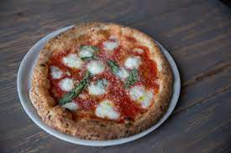
Pizza Takeaways
Enjoy the Journey!
Balance is Important
Focus on the Foundation
Adapt for Individuality
Variety is Key
Notes:
Heather
Variety is Key: We all have diverse perspectives and experiences. Leadership means something different to everyone. New combinations of pizza are exciting.
Focus on the Foundation: A good crust is essential for pizza. A solid foundation is essential for life.
Balance is Important: Too much of one topping can ruin a pizza.
Adapt for Individuality: Different people prefer different toppings. Leadership is all about flexibility and individuality.
Enjoy the Journey: “Take a slice at time” – every day is different!

Slide 9
What is Leadership?
Characteristics That Matter
Integrity
Delegation
Communication
Self-Awareness
Gratitude
Learning Agility
Influence
Empathy
Courage
Respect
“Leadership is not a title but an ability to inspire followership.”
Notes:
Kate

Slide 10
Modeling the Way
Find Your Voice
Affirming Shared Values
Who Are You?
“The key is not to prioritize your schedule but to schedule your priorities.”
- Stephen Covey
Notes:
Kate “Give People A Reason to Care”

Slide 11
Leaders who model the way -
Set a personal example of what they expect of others
Build consensus around a common set of values
Ask for feedback on their actions
Follow through on promises and commitments
In Financial Aid…
Are prepared to still jump in and do the work
Are aware of their weaknesses and shortcomings
Confront critical incidents – show continuous learning
Notes:
Kate “Forge Unity – don’t force it” (pg 65)

Slide 12
Inspiring Shared Vision
Future Vision
Historical lessons
Optimism and Enthusiasm
Shared aspirations
Emphasis on meaningful work and everyone contributing
Notes:
Heather “Give People A Reason to Care”

Slide 13
Leaders who inspire shared vision -
Talk about future trends
Appeal to others to share a dream of the future
Speak with genuine conviction about the purpose of their work
Follow through on promises and commitments
Ask others what they want
In Financial Aid…
Show positivity towards new processes
Attend graduation and student celebrations and encourage attendance from your staff
Reflect on past and use it to navigate future
Notes:
Heather Ex. – New Award letter processes

Slide 14
Challenge The Process
Seize initiative
Make Something Happen
Seek to Improve
Look outside your experience
Experiment and Take Risks
Notes:
Kate

Slide 15
Leaders who challenge the process -
Search for new and innovative ways to work
Identify milestones to keep projects going
Anticipate change
Respond to change
Aren’t afraid to speak up – or accept others’ opinions when they do
In Financial Aid…
Read NASFAA News – make sure staff gets it and discuss together
Keep staff informed, be informed of changes on the horizon
Set aside time to discuss proactive vs. reactive approaches
Challenge with purpose – not just for challenge’s sake
Notes:
Kate Pick your battles – don’t make everything a battle

Slide 16
Enable Others to Act
Actively listen to diverse points of view
Develop cooperative relationships among the people you work with
Treat others with dignity and respect
Involve people in the decisions that directly impact their job performance
Give people freedom and choice in deciding how to do their work
Ensure that people grow in their jobs by learning new skills and developing themselves
“We can’t do it alone is the mantra of exemplary leaders. We can’t make things happen by ourselves.”
- James Kouzes & Barry Posner
Notes:
Heather Create a Climate of trust
Facilitate Relationships

Slide 17
Leaders who enable others to act -
Develop relationships
Listen to diverse points of view
Give people freedom to do their jobs
Encourage professional development
Realize what others need to do their jobs
In Financial Aid…
Get involved in associations and allow time for staff to do so as well
Don’t micromanage
Ask what can be done to help make others’ jobs better
Allow staff to try new approaches
Notes:
Heather This one is almost exactly the same….

Slide 18
Encouraging the Heart
Maintain high expectations about what individuals and teams can accomplish.
Communicate your positive expectations clearly and regularly.
Create an environment that makes it comfortable to receive and give feedback.
Find out the types of encouragement that make the most difference. Don’t assume that you know.
Be creative when it comes to recognition. Be spontaneous. Have Fun.
Make saying “thank you” a natural part of your everyday behavior.
Notes:
Kate Practicing Gratitude and Appreciation. Fear and anger are the two primary inhibitors of successful leadership. Both fear and anger are secondary emotions – propelled by something else underneath.
But you can displace both by practicing gratitude. It is impossible to stay afraid or angry when you are identifying what you are grateful for.
When you practice appreciation, you are identifying good things in others or in the environment around you. This may often be something good, or wonderful, or just nice that doesn’t directly benefit you. But it’s there.
As you learn to appreciate you are teaching yourself to see what is “good.” As Zig Ziglar used to say, “Anyone can be a fault finder. I want to be a good finder.”
The more you can see good, and be grateful for the good that you experience, the easier it is for you to imagine future good for yourself and others. Future good = a potentially inspiring vision.
Identify three things, daily, that you are grateful for.
Tell someone something that you appreciate about them, daily.
These habits will shape your perspective, and you will more naturally be able to inspire a shared sense of vision.

Slide 19
Leaders who encourage the heart -
Praise their people
Share confidence in their staff
Creatively recognize others
Publicly recognize others
Get personally involved
In Financial Aid…
Have fun together – our work is hard!
Soak up the negativity
Notes:
Kate

Slide 20
What kind of leader
are you going to be?
Notes:
Kate

Slide 21
Notes:
Heather - Hoops and Yoyo Video – Sarcastic Wednesday

Slide 22
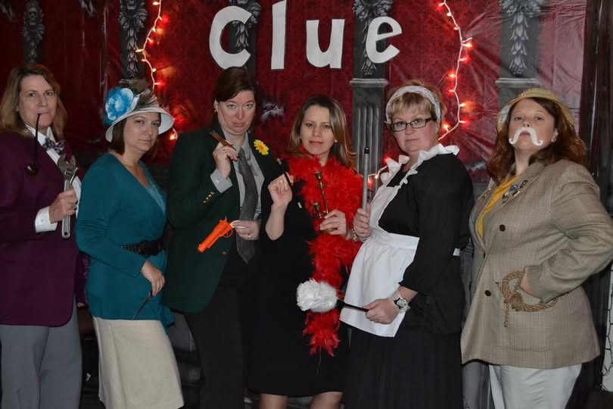
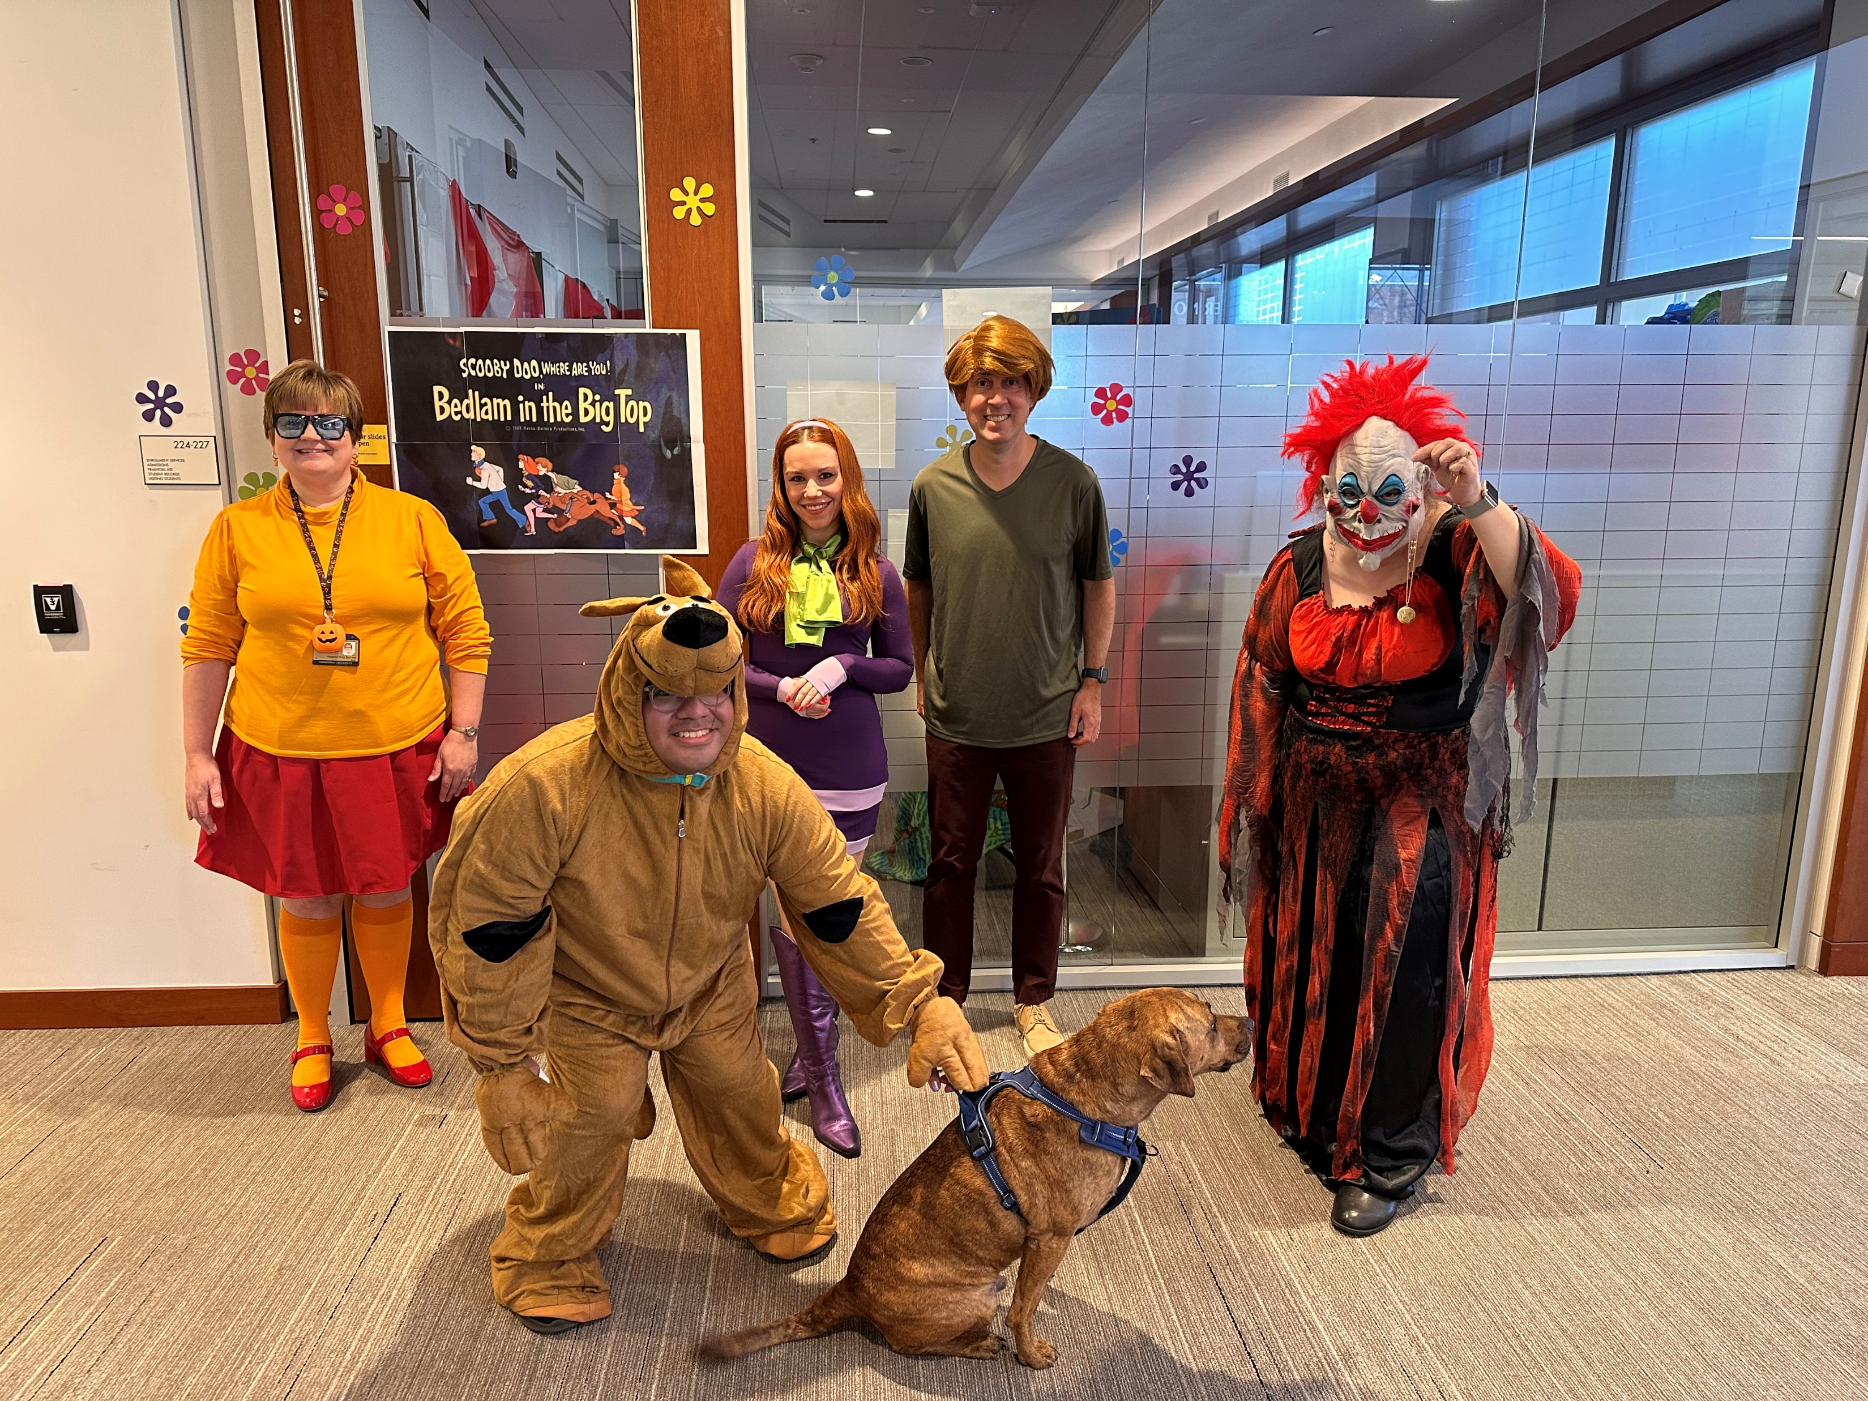
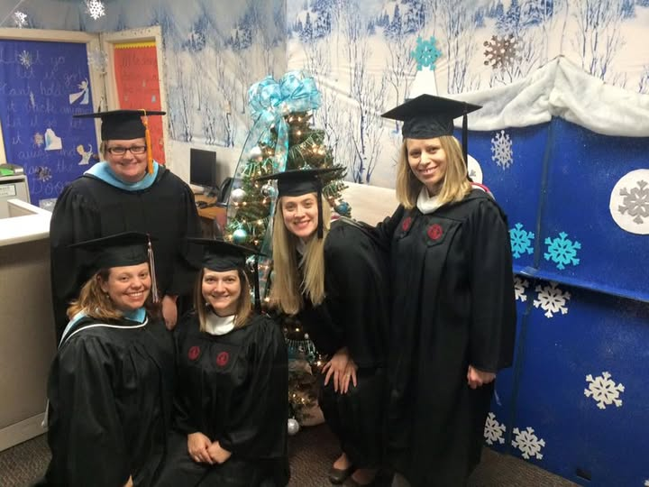
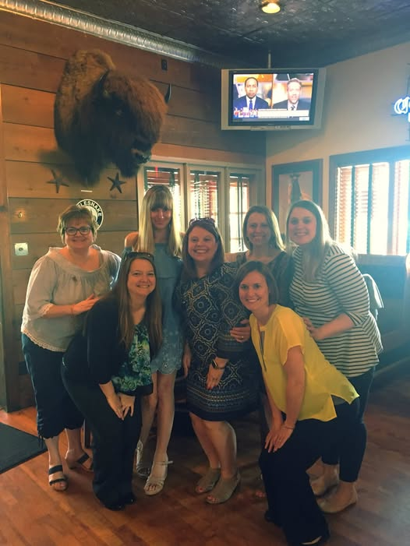
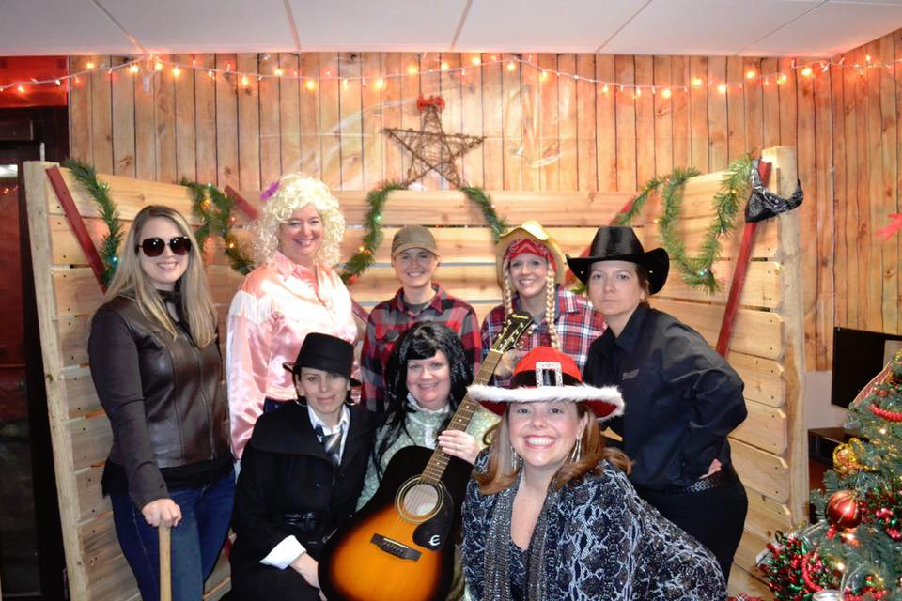
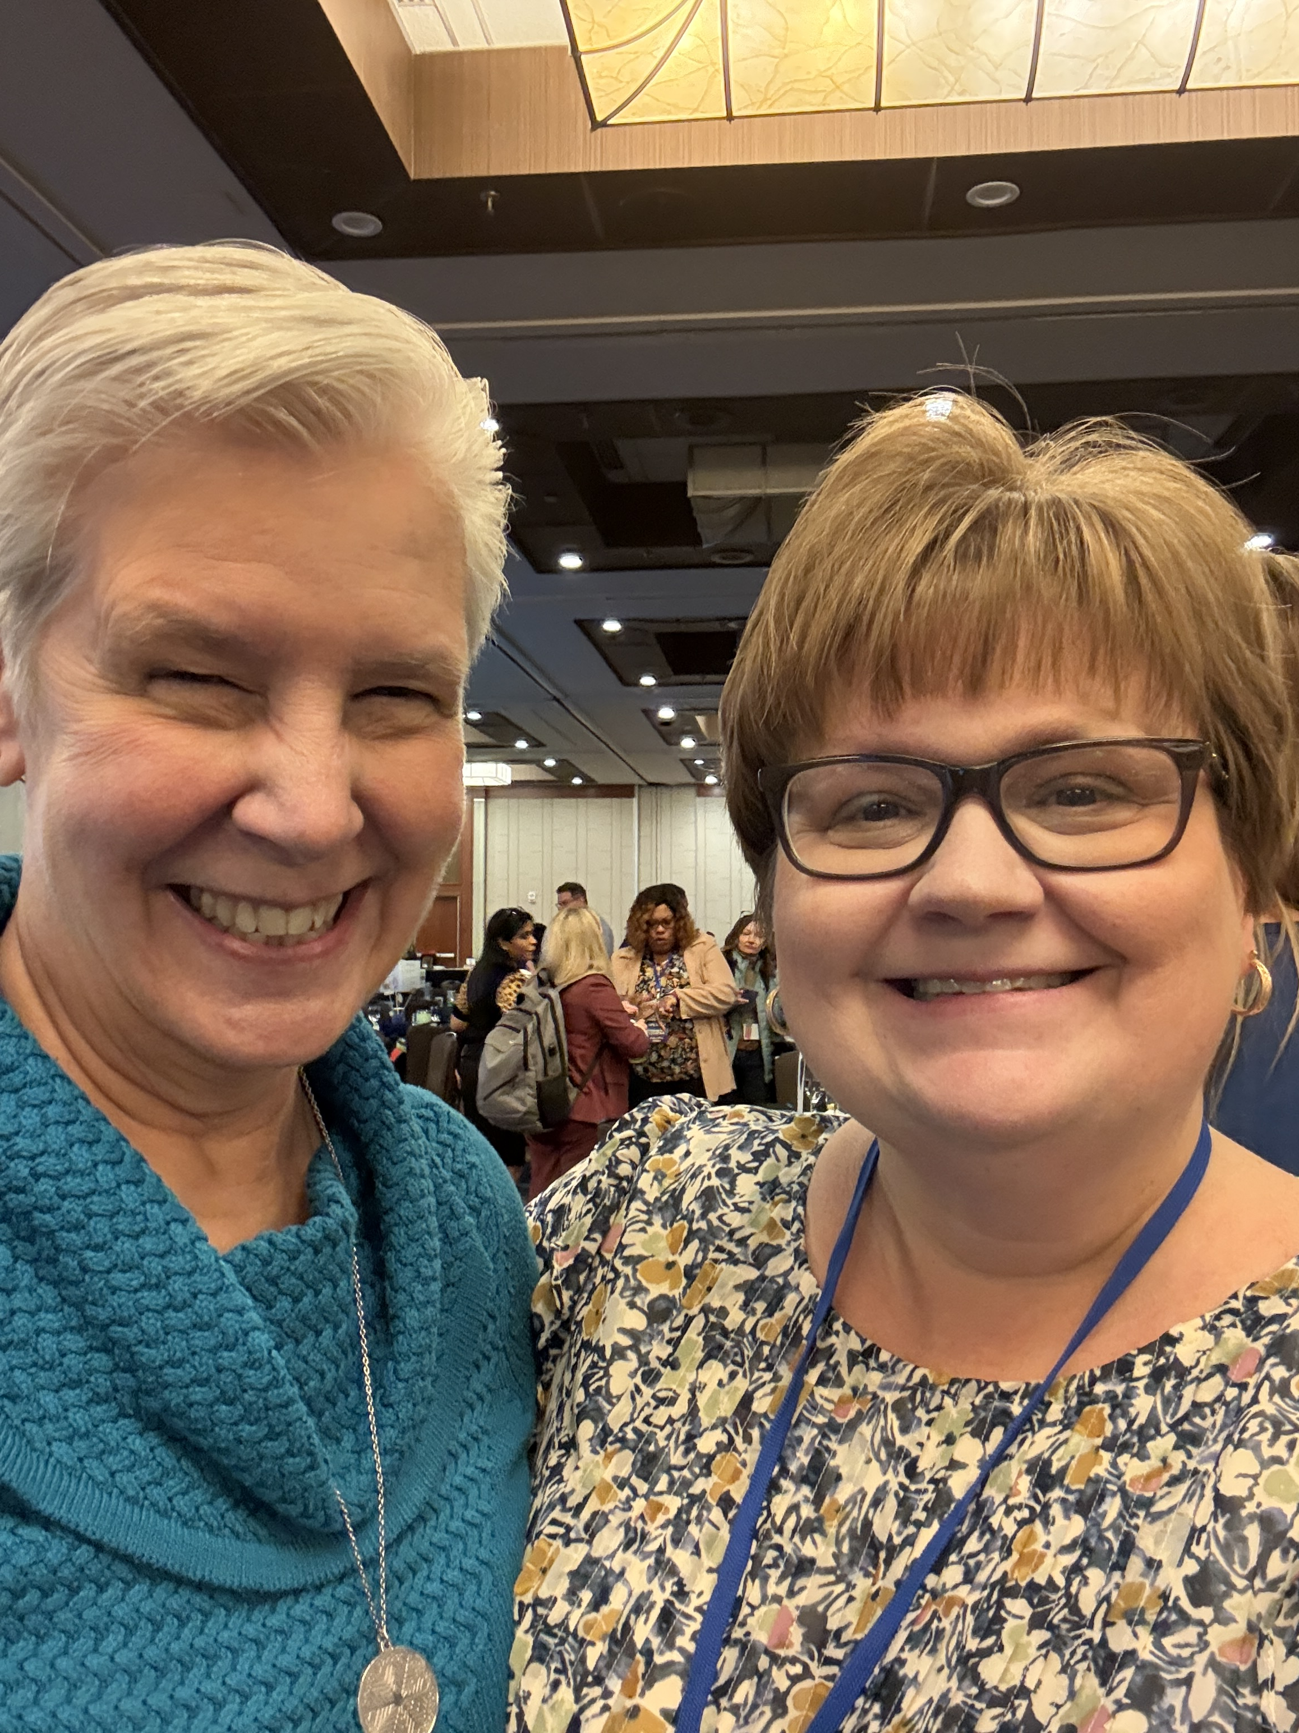
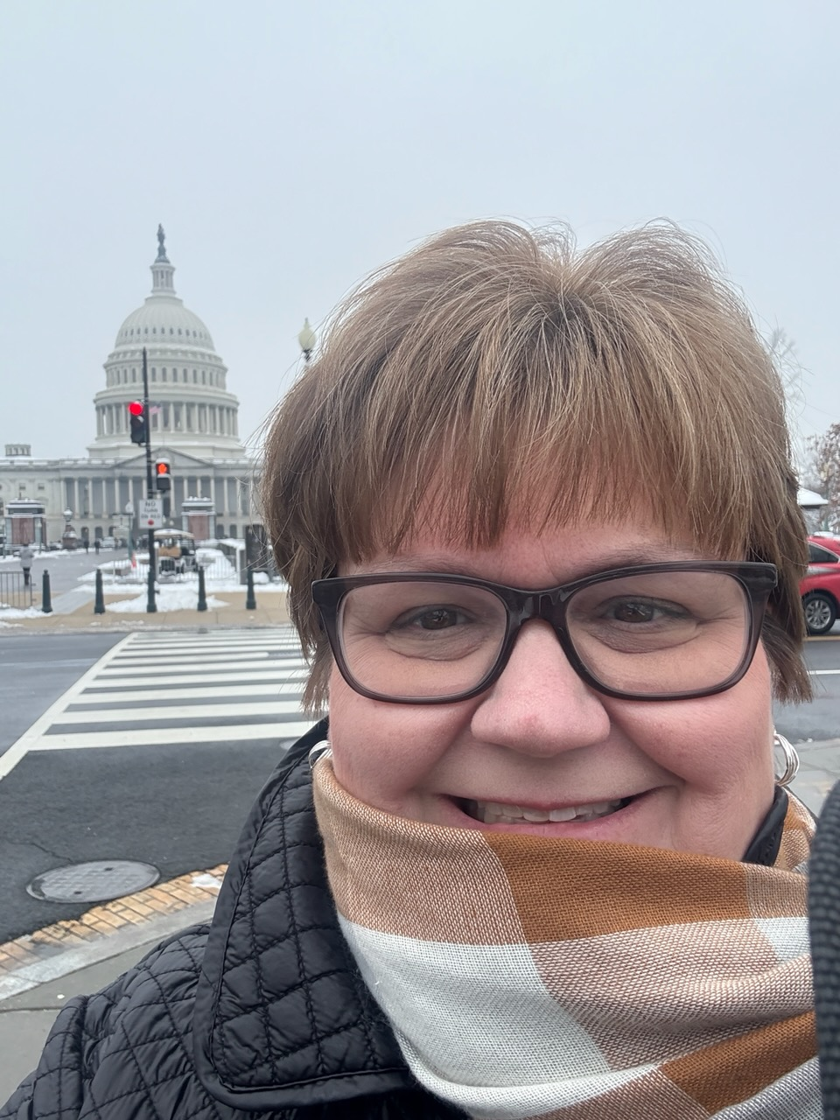
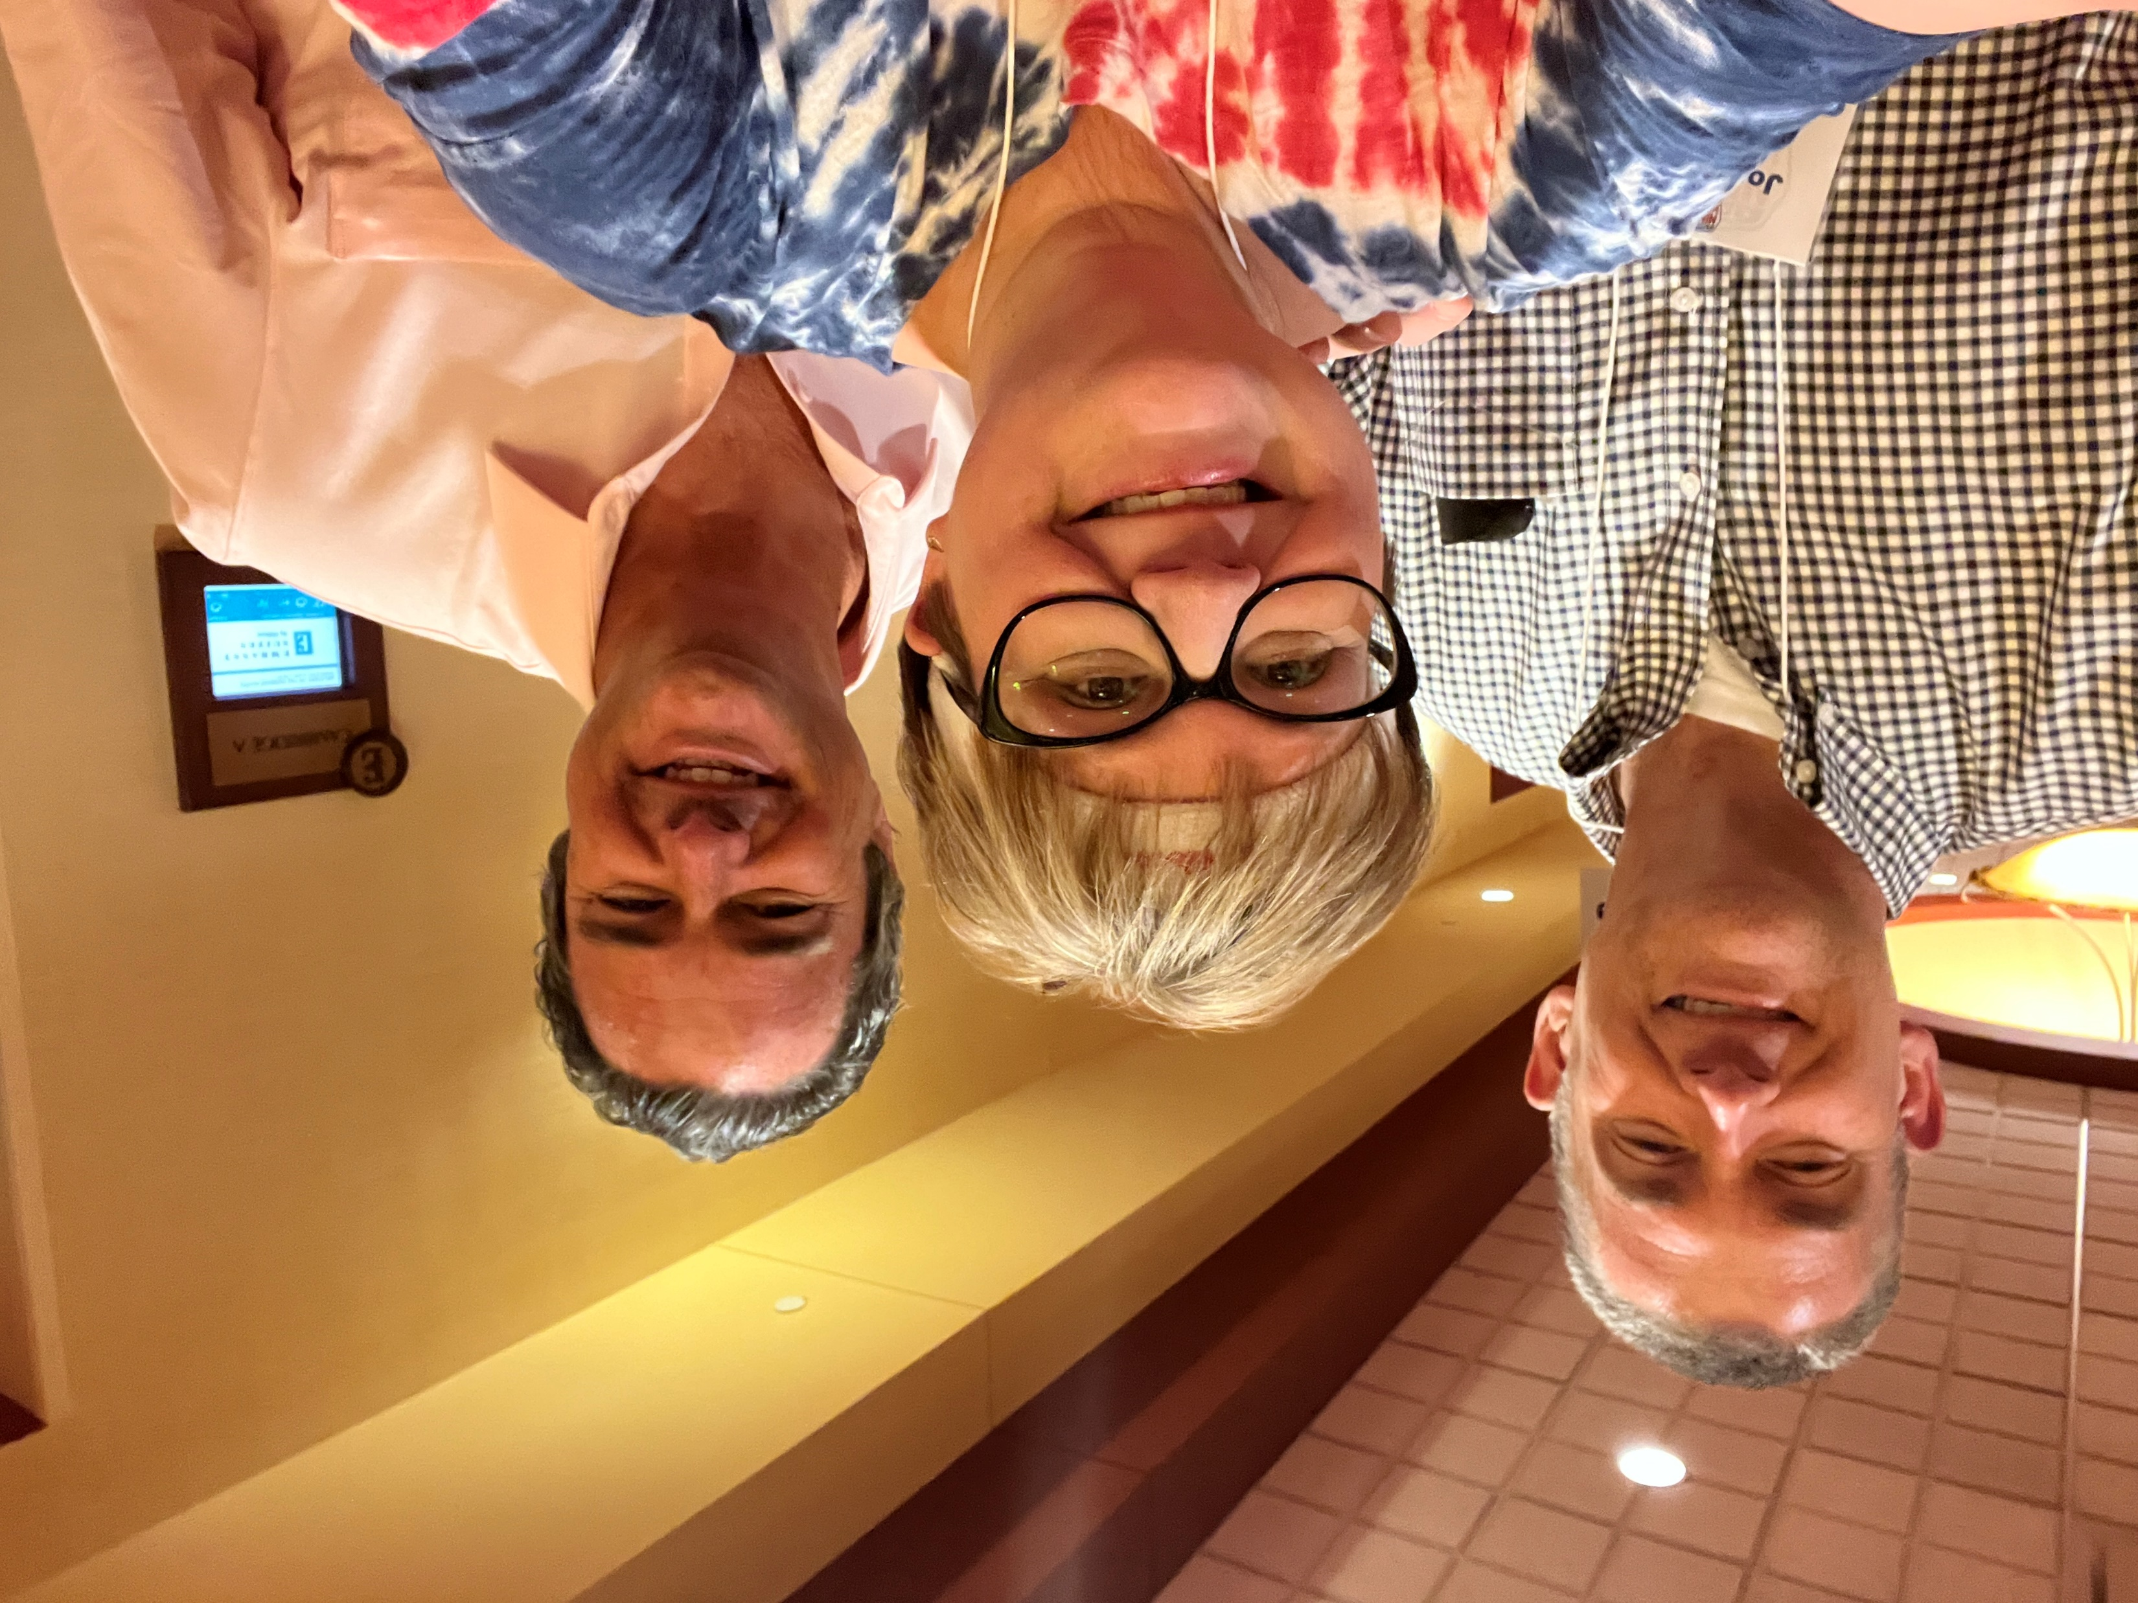
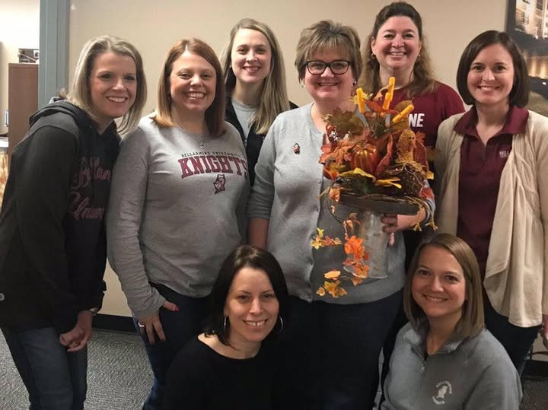
Notes:
Kate

Slide 23
Good Luck! Keep Your Pizza In Mind!
Heather Boutell, Ed.D.
heather.boutell@vanderbilt.edu
615-322-1792

