Slide 1
Homeless and Unhoused Students on Campuses: A Closer Look with SPOCs
April Query, Ed.D.
Assistant Vice President, College Access & Community Outreach
College Foundation of North Carolina
April.Query@cfi.org
Homeless youth are human beings who most of their lives still ahead of them…,they have boundless promise. Or rather, they have promise that is bounded only by our ability to help them find their way
- Impatient Optimists, January 16, 2013

Slide 2
Agenda
Why talk about this topic?
Understanding McKinney-Vento
Homeless Liaison roles
SPOC programs
Why SPOC programs are needed
Common barriers for students experiencing homelessness/UHY
CFNC’s involvement
Best practices
Resources

Slide 3
NAEHCY Information
Each year, 1 million students experience homelessness in the K-12 education system.
As a result of the McKinney-Vento Homeless Education Assistance Improvements Act of 2001, all public K-12 schools are funded for a district program that serves their homeless students. Most school districts have a homeless liaison tasked with serving all homeless students in their district.
College campuses may have resources in place to help these students, but the students in the most need may not know the resources exist.
Lack of resources as students roll out of McKinney-Vento and into a postsecondary environment.
SPOCs serve to bridge this disconnect and help these students once on their college campus.

Slide 4
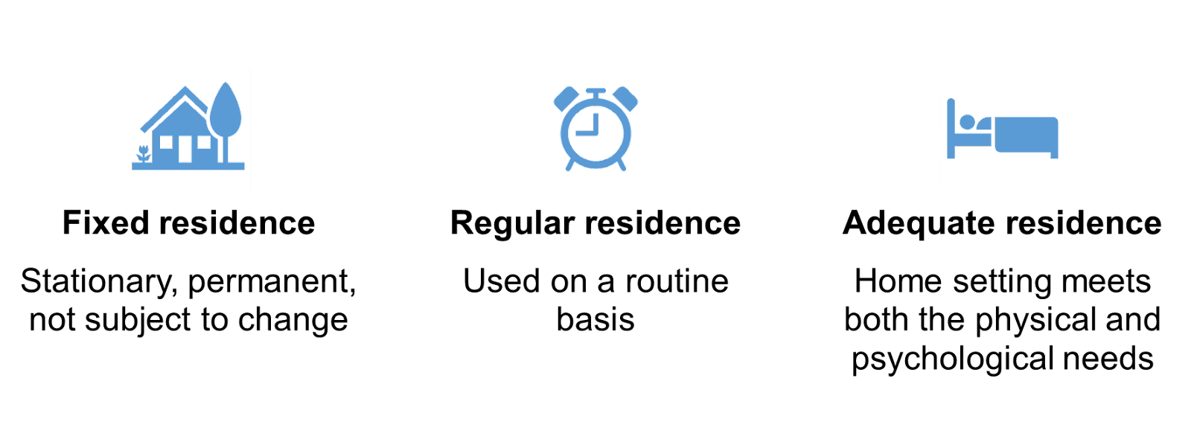
McKinney-Vento Definition of Homeless
Individuals who lack a fixed, regular, and adequate nighttime residence
Notes:
The McKinney-Vento Act is a federal law that was originally enacted in 1987, most recently re-authorized in 2015, that seeks to identify and remove barriers to enrollment, attendance, and academic success so that students experiencing homelessness have the same opportunity to attend and be successful in school as their stably housed peers. It is a federal law that supersedes local and state policies and laws.

Slide 5
Homeless Liaison Eligibility Determination
To determine eligibility, the homeless liaison must assess if the student can go to the -
Same place (fixed)
Every night (regular)
To sleep in a safe and sufficient space (adequate)
Notes:
You can see the main themes of the law on this slide. For the purpose of today’s session we want to focus on the components of the law that emphasize the identification of students experiencing homelessness and the requirement to collaborate with your community partners to best serve students experiencing homelessness.

Slide 6
Unaccompanied Homeless Youth
A youth who is not in the physical custody of a parent or legal guardian
AND
Lacks a fixed, regular, and adequate nighttime residence
Notes:
An UHY is one who is not in the physical custody of a parent or legal guardian and lacks a fixed, regular and adequate nighttime residence. They must be both homeless and unaccompanied to qualify as an UHY. •
•No lower age limit
•Upper age limit is defined by the state (i.e. in NC, the limit is 22 unless EC)
•No citizenship requirement

Slide 7
Homeless Liaison Main Responsibilities
Identify, enroll, and ensure academic success of eligible students
Referrals to community providers
Inform parents, guardians, and unaccompanied homeless youth of their rights and educational opportunities
Post educational rights and information
Oversees disputes at local level
Transportation services
Internal and external professional development, technical assistance, and collaboration
Data collection of students
Maintain an annual needs assessment
https://nche.ed.gov/needs-assessment/
Attend PD and required trainings
Oversee McKinney-Vento funding

Slide 8
Jacob (from NAEHCY)
Jacob is secretly coping with the reality that he has nowhere to lay his head tonight. Although it’s his first year of college and his focus should be on the next leg of his academic journey, newfound freedom, and campus life, his mind is stuck on trying to meet his basic needs. This situation is not new to him. He faced this same scenario in high school after fleeing abuse in his home. However, he never told his teachers, and he didn’t know that his school district had a McKinney-Vento liaison designated to help students experiencing homelessness. He was too ashamed and embarrassed to confide in his friends, and he’s still afraid that he won’t be accepted if he tells them now. With no shelter for young adults near his campus, he’s always bounced from various family members’ homes, abruptly leaving, never wanting to wear out his welcome. Now, he is once again faced with the challenge of finding a safe, stable place to sleep tonight. Homelessness is not his only concern; he is also dealing with food insecurity and doesn’t know when he will have his next meal. Jacob is unsure who on his campus can help him.
Jacob has big exams coming up and needs help with all of this so he can concentrate and pass.
Notes:
Let’s consider Jacob as we go through today’s presentation.

Slide 9
McKinney-Vento: Implications for Higher Education
McKinney-Vento Act: no federal-level equivalent in higher education
Students experiencing homelessness are accustomed to working with a homeless liaison
Need to bridge the experience from secondary to postsecondary settings
Opportunities for partnerships between secondary, postsecondary, and community settings

Slide 10
Which Leads us to SPOCs…
What is a Single Point of Contact (SPOC) program?
Designated safe and supported college offices and/or staff members committed to helping students experiencing homelessness to successfully navigate the college admissions and enrollment process, succeed while in college by providing supportive services, and connecting them to on-and off-campus resources.
They often assist students with:
Admissions
Financial aid
Academic advising
Student life
Community resources
Who in here has a designated SPOC at their institution?

Slide 11
SPOC Programs
Reduces the number of times a student has to repeat or relive situations that led them to being homeless
Having a staff member on campus that is knowledgeable of federal guidance and state laws impacting higher education access and success for UHY
While the folks who run programs like your food pantry may not be SPOCs, the SPOC would, for example, have a running list of programs like this to share with students experiencing food insecurities and homelessness.

Slide 12
Student Paths
Shelter policies that prohibit adolescent boys
Parent incarceration
Correlation between being in child welfare system & experiencing homelessness as an adult
School problems
Abuse/neglect
Family conflict
Pregnancy
Running away from placement
Aging out of the system
Sexual orientation
Parent illness/death
Substance abuse

Slide 13
Student Issues
Lack of access to parental financial information and support
Lack of financial means to live independently and safely
Inability to be financially self-sufficient once enrolled in college
Limited housing options, especially in small towns or rural areas
Failure to meet state residency requirements
Struggling to balance school
Lack of adult guidance and support
Lack of information about available support systems

Slide 14
What do SPOC Programs do?
Extend the work of the homeless liaison
Bridge secondary and postsecondary settings
Help youth navigate the college admissions and enrollment process
Connect students to campus-based resources and support services
Advocating to remove barriers
Providing direct services (financial counseling, housing voucher assistance, transportation support, food assistance, clothing closet, etc.)
What sounds familiar?
Which is your campus doing now?
What would you like to do in the future?

Slide 15
NC State – Food & Housing Insecurity Work
NC State has enacted a Steering Committee, and from their research in 2021, found that:
15% of students at NC State have experienced homelessness since the pandemic began.
Nearly 25% have experienced food insecurity in a 30-day period.
Student wellness has been poor during the pandemic, with many students indicating that they rarely feel cheerful, calm, or in good spirits; they are not rested and they lack vigor. These feelings are much more intense for students who are food or housing insecure and those who have experienced homelessness.
Learning has been impacted, with nearly 90% of students who have experienced homelessness reporting that their learning has been negatively impacted by their living situation.

Slide 16
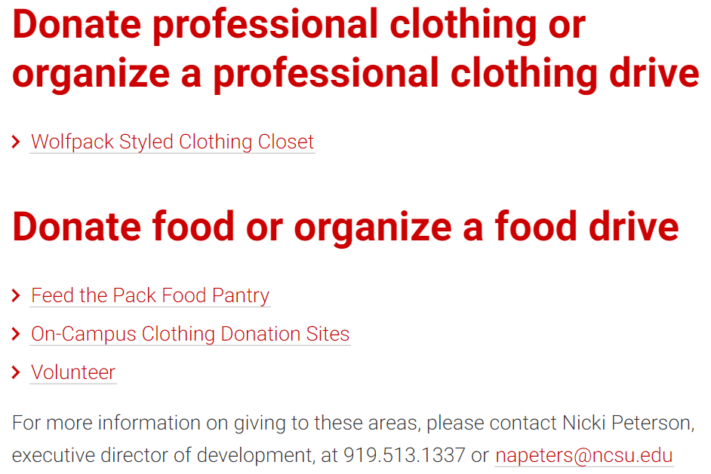
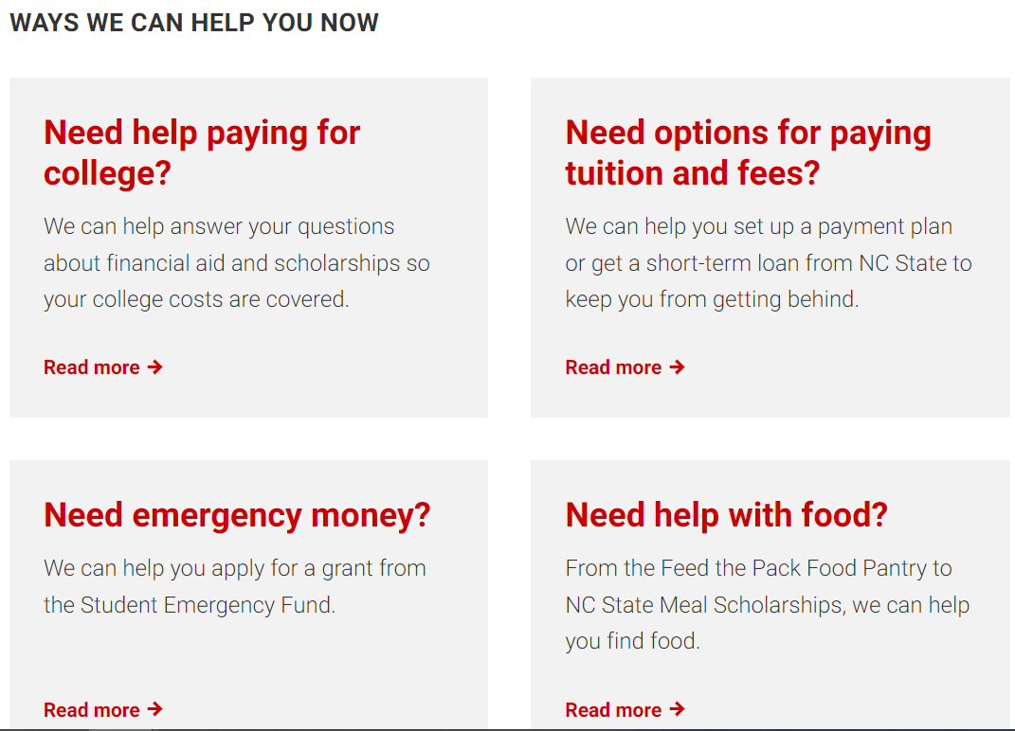
NC State

Slide 17
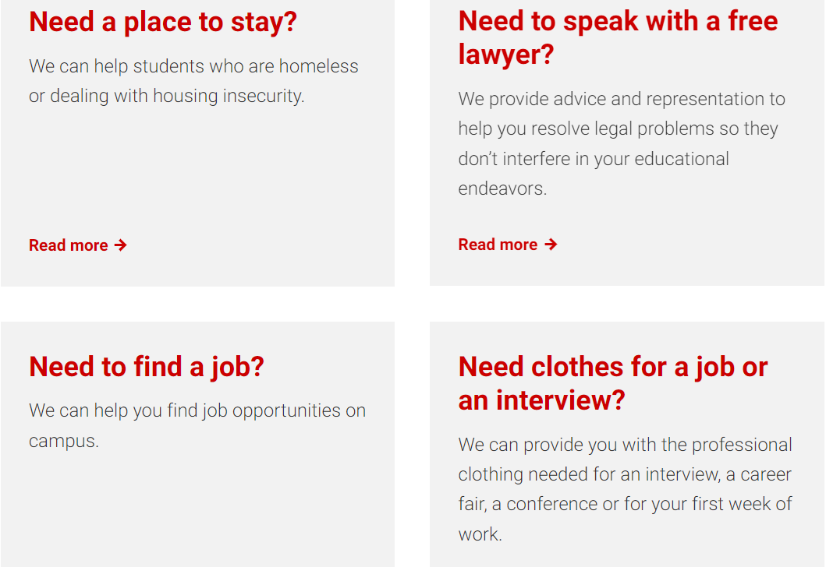
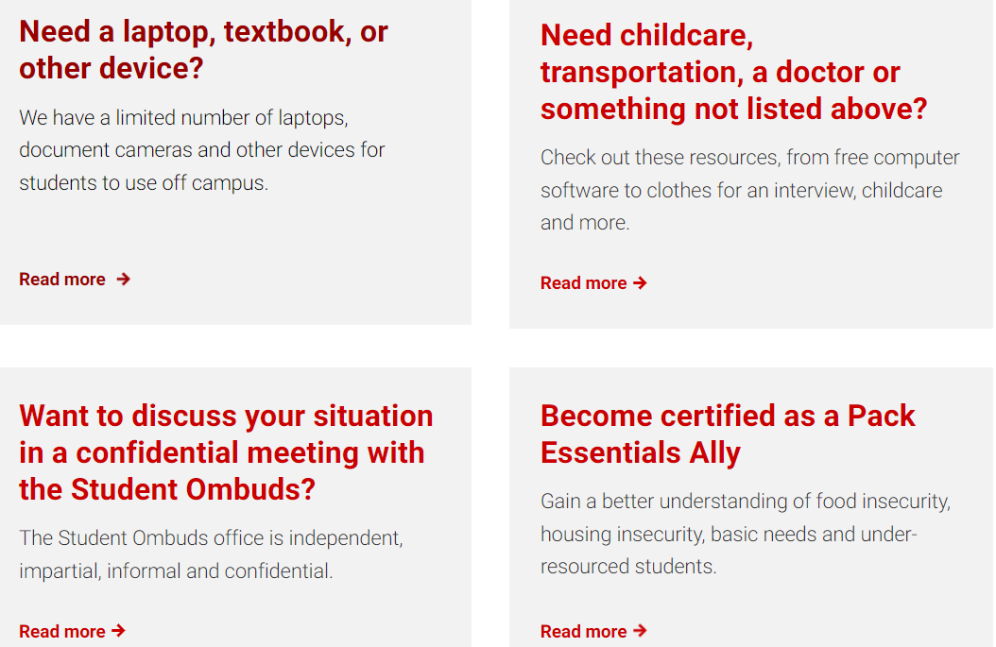
NC State
https://dasa.ncsu.edu/wp-content/uploads/sites/76/2024/03/Homelessness-and-Food-and-Housing-Insecurity-Among-NC-State-Students-March-2024.pdf

Slide 18
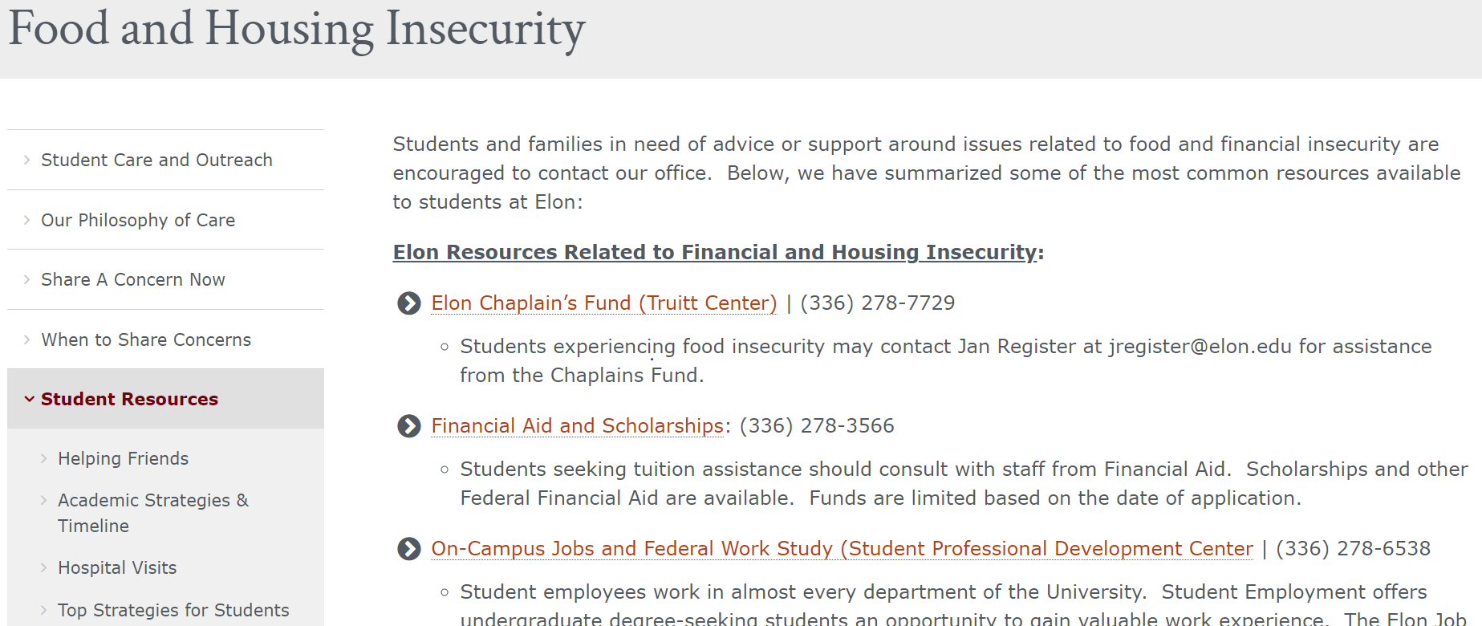
Elon University

Slide 19
Best Practices in High Schools
Focus on FAFSA completion
Inform UHY of college options as soon as they are identified as homeless
Make sure high school counselors know about the FAFSA policies for UHY
Arrange for students to visit local colleges and universities
Connect UHY to GEAR UP, Upward Bound, TRIO, etc. programs

Slide 20
Best Practices on College Campuses
Establish coordination between financial aid offices, student support services, and campus housing
Open a food and clothing bank on campus
Consider housing options for homeless students when dorms close:
Leaving one residence hall open
Allow UHY to stay in housing for international students
Provide a list of “host homes” in the community
Establish SPOCs in colleges/universities to help eliminate barriers to higher education access
Open communication on campuses, reduce shame

Slide 21
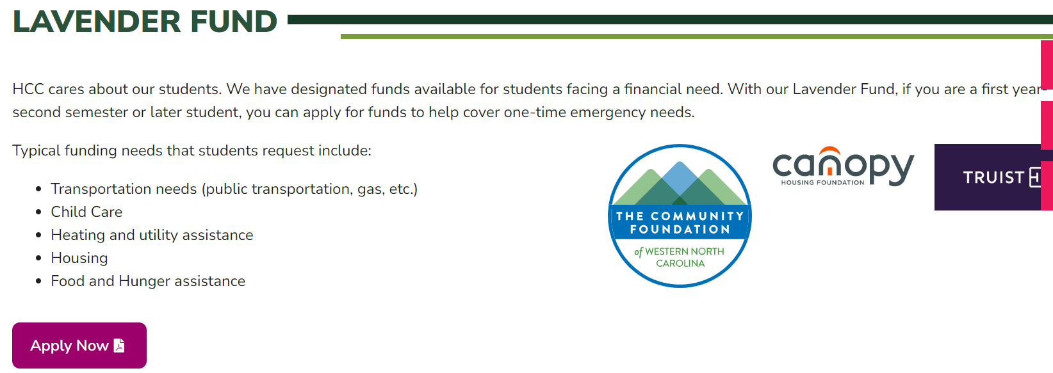
Haywood Community College Lavender Fund

Slide 22
Implementing Dynamic SPOC Programs
Are there SPOCs in the room?
What are examples from your campus for your SPOC program/contact?
Questions to consider:
Is there a solo administrator? Possibility for a new department/office?
Are there funds available? State or foundation funds?
Risk management concerns on campus?
How will the staff locate and outreach to homeless students on campus? How to outreach to other campus departments and academic units on campus?
How will confidentiality be maintained?
What criteria will be used to assess eligibility?
Who would handle press inquiries?
Who are your campus & community partners/assets?
What is your sustainability plan?

Slide 23
Implementing Dynamic SPOC Programs
What resources will the program offer?
Advocacy?
Referrals?
Case management?
Financial assistance?
Food pantry?
Clothing?
Others?
What do you already have on campus that this can be folded into or connected with?

Slide 24
Winston-Salem State University

Slide 25
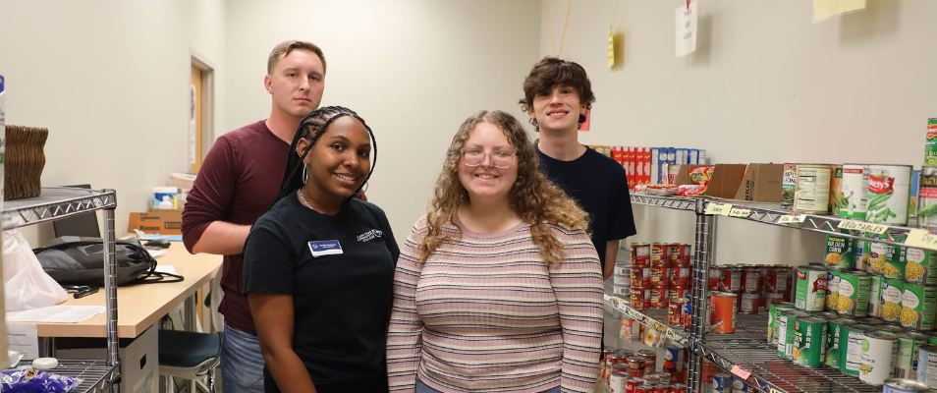
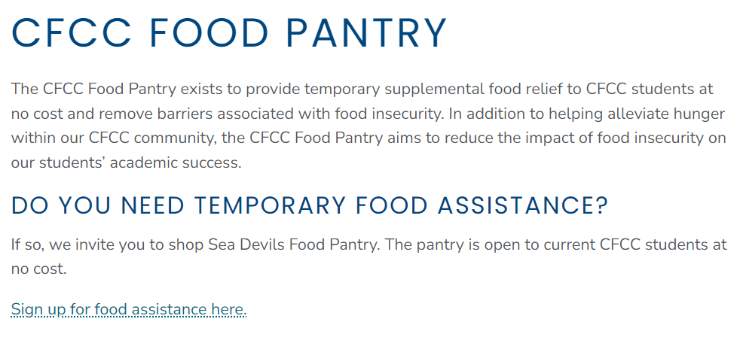
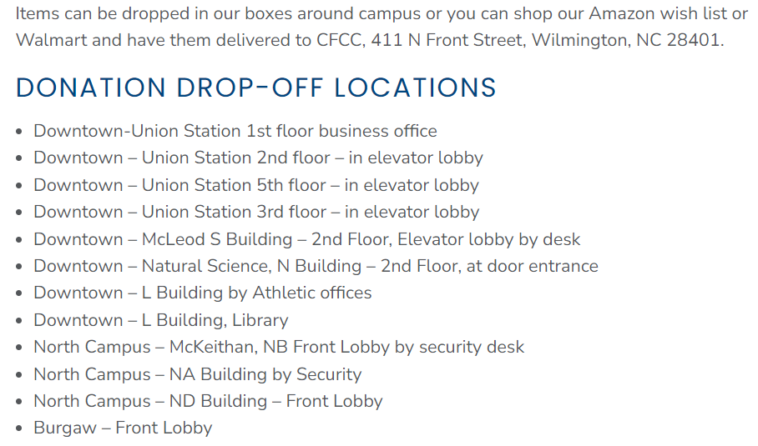
CFCC Food Pantry

Slide 26
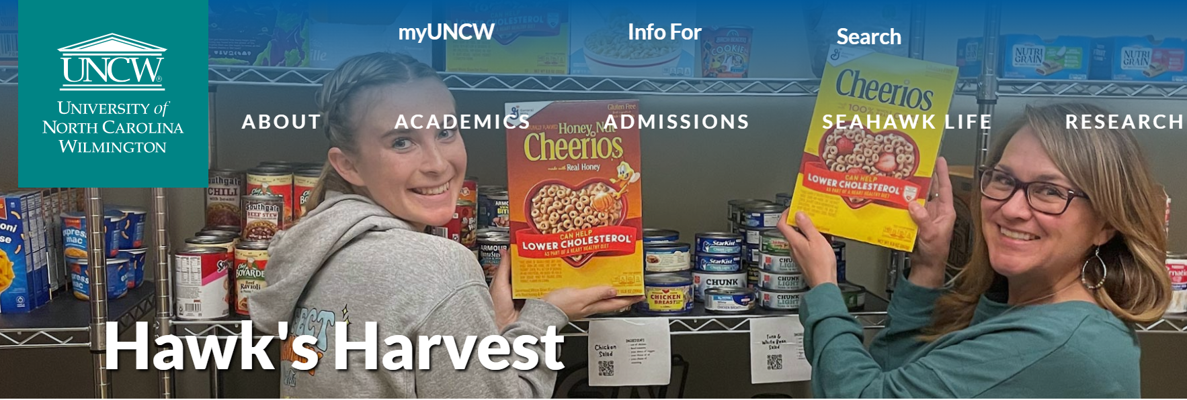
UNCW Hawk’s Harvest

Slide 27
Implementing Dynamic SPOC Programs - Other
Other aspects to consider –
Mental health support
Employment
Kennesaw State University’s FWS program set aside $10,000 in funding toward a temporary on-campus job placement program for recipients of the campus SPOC program, CARE Services. This offers a model for implementing a temporary work program that engages students through employment while addressing their current financial situation and giving them additional experiences to succeed after college (NSEA Journal, Summer 2017).
Consider conducting a campus needs assessment
Get other faculty and staff involved by establishing a faculty/staff-based Student Support Committee. This might include admissions, financial aid, counseling center, career center, advisors, advancement office, Bursary’s Office, student body members, etc.

Slide 28
Conducting a Needs Assessment on Campuses - Examples
Housing Insecurity
In the past 30 days (12 months), was there a rent or mortgage increase that made it difficult to pay?
In the past 30 days (12 months), did you not pay or underpay your rent or mortgage?
In the past 30 days (12 months), did you not pay the full amount of a gas, oil, or electricity bill?
In the past 30 days (12 months), have you moved two times or more?
In the past 30 days (12 months), did you move in with other people, even for a little while, because of financial problems?
In the past 30 days (12 months), did you “live with others beyond the expected capacity of the house or apartment”?
Notes:
Survey ALL students enrolled
Wording when conducting the survey is important – “effort to generally understand how students are doing”
Assessing – Do students who are food-insecure receive FA? Do they work? How often are homeless students finding that they are financially stressed?

Slide 29
Conducting a Needs Assessment on Campuses - Examples
Homelessness
Since starting college, have you ever been homeless?
2. In the past 30 days (12 months), have you slept in any of the following places? Please check all that apply
a. Campus or university housing
b. Sorority/fraternity house
c. In a rented or owned house, mobile home, or apartment (alone or with roommates or friends)
d. In a rented or owned house, mobile home, or apartment with my family (parent, guardian, or relative)
e. At a shelter
f. In a camper
g. Temporarily staying with a relative, friend, or couch surfing until I find other housing
h. Temporarily at a hotel or motel without a permanent home to return to (not on vacation or business travel)
i. In transitional housing or independent living program
j. At a group home such as halfway house or residential program for mental health or substance abuse
k. At a treatment center (such as detox, hospital, etc.)
l. Outdoor location such as street, sidewalk, or alley, bus or train stop, campground or woods, park, beach, or riverbed, under bridge or overpass
m. In a closed area/space with a roof not meant for human habitation such as abandoned building, car or truck, van, RV, or camper, encampment or tent, or unconverted garage, attic, or basement
Notes:
Student may be considered homeless if they responded YES to any one of questions 1 or 2d-2m.

Slide 30
Conducting a Needs Assessment on Campuses - Examples
USDA Food Security Survey Module: Six-Item Short Form
1. The food that I bought just didn’t last, and I didn’t have money to get more. Was that often, sometimes, or never true for you in the last 30 days (12 months)?
2. I couldn’t afford to eat balanced meals. Was that often, sometimes, or never true for you in the last 30 days (12 months)?
3. In the last 30 days (12 months), did you ever cut the size of your meals or skip meals because there wasn’t enough money for food?
4. [IF YES TO QUESTION 3, ASK] If using the 30 day version: In the last 30 days, how many days did this happen? If using the 12 month version: How often did this happen – almost every month, some months but not every month, or in only 1 or 2 months?
5. In the last 30 days (12 months) did you ever eat less than you felt you should because there wasn’t enough money for food?
6. In the last 30 days (12 months), were you ever hungry but didn’t eat because there wasn’t enough money for food?
https://www.bhcc.edu/media/03-documents/voicesofhunger/Basic-Needs-Insecurity-College-Students.pdf

Slide 31
Conducting a Needs Assessment on Campuses - Steps
Find a research partner
Identify the students who will be in the study
Conduct and monitor random assignment
Collect data
Analyze data
Share the results
https://www.bhcc.edu/media/03-documents/voicesofhunger/Basic-Needs-Insecurity-College-Students.pdf
Bunker Hill Community College Boston, MA

Slide 32
Where Does CFNC Fit in?
Update the SPOC list each year
Publish it on our website https://www.cfnc.org/media/1rmf5t5g/spoc-03-2023.pdf
Webpage that is dedicated to students with no fixed address https://www.cfnc.org/plan-your-future/plan-for-college/students-with-no-fixed-address/
Work with NCHEP more often
Help connect everyone
Providing resources
Building a bit as we go!

Slide 33
Next Steps…
Who is your SPOC on campus?
Is it the correct person to address the needs discussed today?
If not, let us know so we can update our SPOC list
Consider the needs of your students experiencing homelessness and UHY.
Do you currently offer what’s needed?
Do you have a comprehensive list to give students in need?
Should you conduct a needs assessment?
Connect with NCHEP, us, NAEHCY, or your local homeless liaison to plan, get resources, and learn more.
Stay tuned for future presentations with this topic.

Slide 34
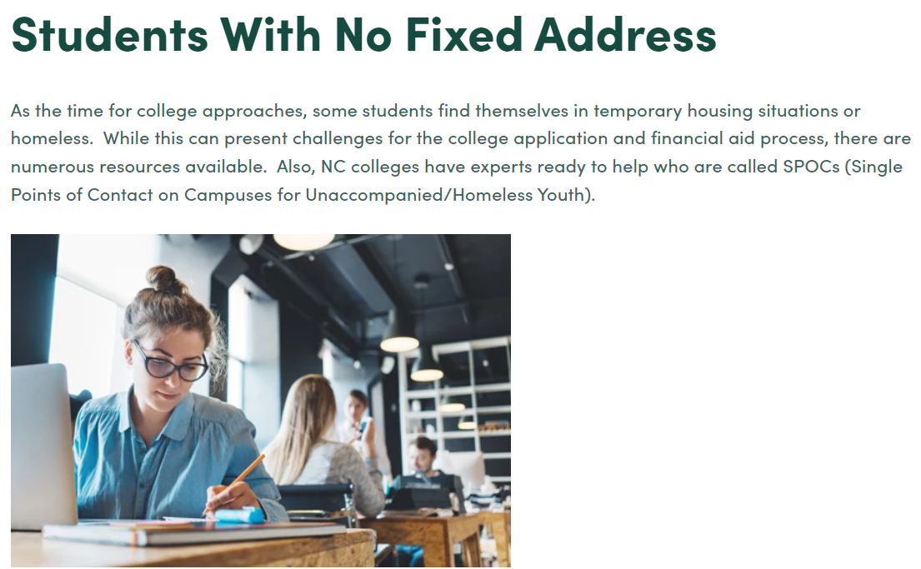
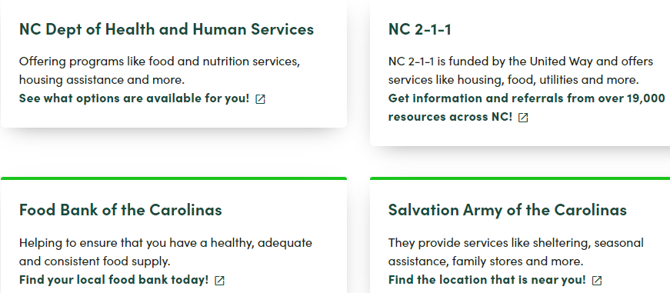
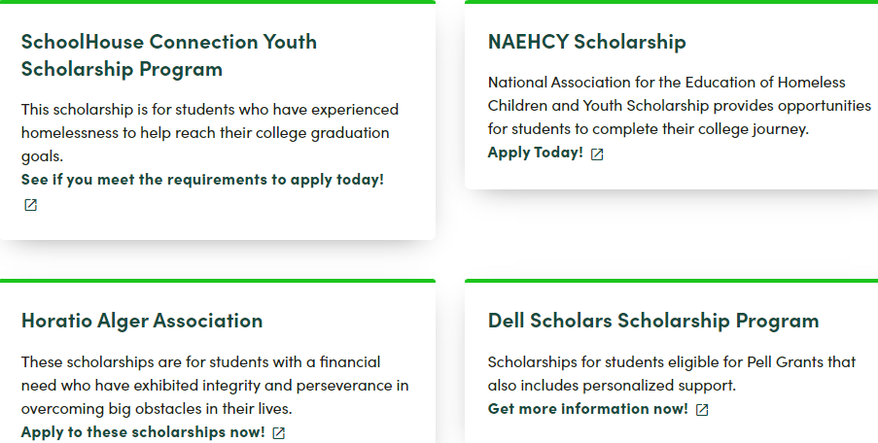
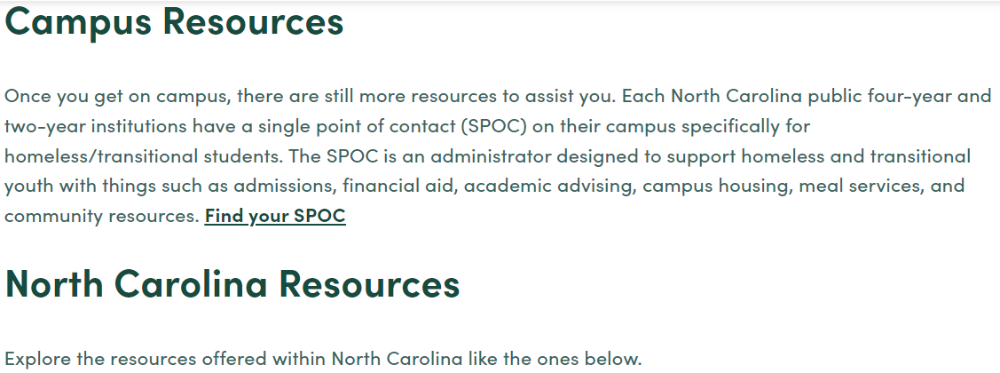
Student Page on CFNC.org

Slide 35
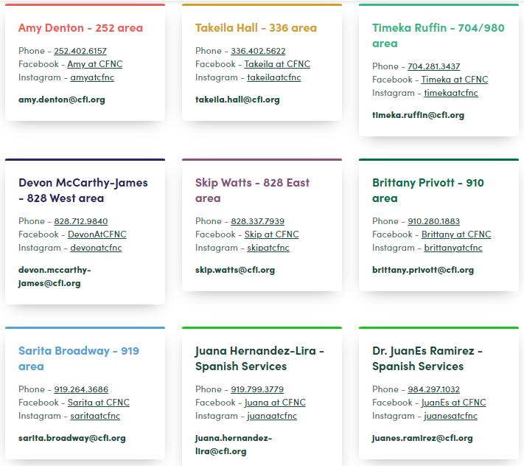
CFNC Regional Representatives and Spanish Services

Slide 36
Links & Resources
National Center for Homeless Education (NCHE)
1-800-308-2145
https://nche.ed.gov
*Upcoming webinar with Danny Jordan thru NCASFAA
CFNC
www.cfnc.org
NEACHY Higher Education
https://naehcy.org/higher-education/
The National Association for the Education of Homeless Children is a national nonprofit, member association. Their vision is that every child and youth experiencing homelessness is successful in school, from early childhood through higher education.
https://naehcy.org/wp-content/uploads/2018/08/SPOC-Model-Revamp-FINAL.pdf

Slide 37
Links & Resources
NAEHCY
Processing Financial Aid for Homeless Youth https://0vab42.a2cdn1.secureserver.net/wp-content/uploads/2018/05/Processing-Financial-Aid-for-Homeless-Youth.pdf
College student perspective https://0vab42.a2cdn1.secureserver.net/wp-content/uploads/2018/06/NAEHCY-Article-Abdullah.pdf
Higher Education Opportunity Act: Homeless and Foster Youth https://0vab42.a2cdn1.secureserver.net/wp-content/uploads/2017/12/hea_summ.pdf
Excerpt from study, Hunger on Campus: The Challenge of Food Insecurities for College Students https://0vab42.a2cdn1.secureserver.net/wp-content/uploads/2018/06/NAECHY-Higher-Ed_article-for-June.pdf

Slide 38
Questions?

