Slide 1
Meditation For Fidgety Skeptics
A Book Report That Could
Change Your Life
Presented by Kevin Holman, College Ave
4.7.25

Slide 2
“
If you had told me as recently as a few years ago that I would someday become a traveling evangelist for meditation, I would have coughed
my beer up through my nose.
”
Dan Harris
ABC News Anchor
#1 New York Times Bestselling Author
Notes:
This is the very first line of chapter 1, and it’s how I knew I had finally found a book about meditation that I might actually read. The purpose of this session is to introduce you to the practice of mindful meditation in a way that doesn’t scare you off or put you to sleep. I am DEFINITELY not an expert on the subject and had nothing to do with the creation of this book. This is simply a thorough book report meant to give you all the benefits, without having to spend the time reading it yourself. Although I HIGHLY recommend you do so anyway!

Slide 3
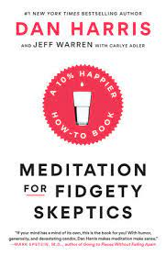
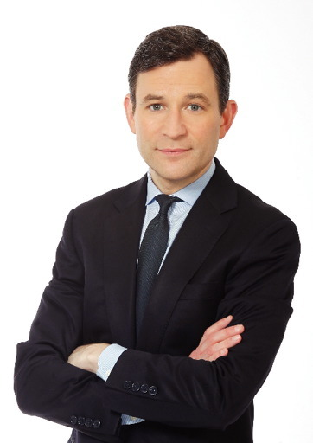
Notes:
This is Dan Harris, the ABC News anchor and author of this book. After having a very public panic attack live on the air, he was forced to make some serious lifestyle changes which led him to embrace a practice that he had always dismissed as ridiculous.
It’s funny, honest and relatable. I laughed out loud several times as he describes his inner voice, his struggle to “do it right” before finally accepting there is not a right or wrong way to meditate.

Slide 4
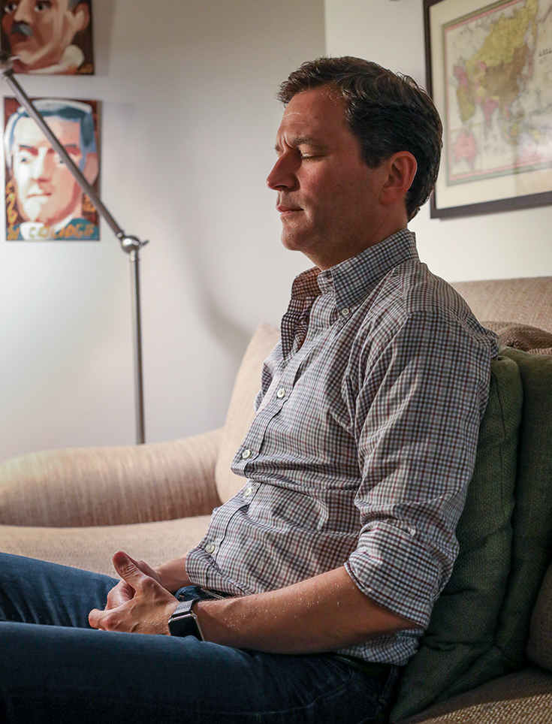
Table of Contents
The Case for Meditation
“I Can’t Do This”
“I Don’t Have Time for This”
“People Might Think I’m Weird”
“Meditation Is Self-Indulgent”
Pandora’s Box
“If I Get Too Happy, I’ll Lose My Edge”
“_________ Is My Meditation”
“I Can’t Keep It Going”

Slide 5
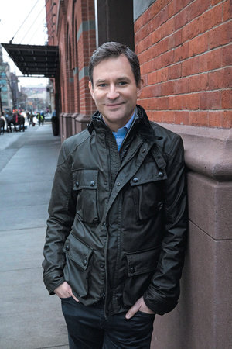
The Case for Meditation

Slide 6
This is Science!
Reduce blood pressure
Boost recovery after the release of the stress hormone cortisol
Improve immune system functioning and response
Slow age-related atrophy of the brain
Mitigate the symptoms of depression & anxiety
Boost productivity in the workplace
Notes:
There were two reasons that Dan was able to make the case to himself to seriously try meditation…
The first was science:
In recent years there’s been an explosion of research into meditation, which has been shown to ( read slide)
It is also known to reduce violence in prisons and improve both behavior and grades for school children.
Recently found it can rewire key parts of the brain involved with self-awareness, compassion and resiliency.

Slide 7
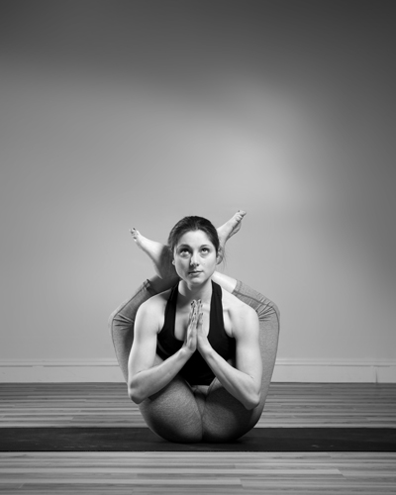
Does Not Entail Weird Stuff
You do not have to:
Fold yourself into a pretzel
Join a group
Wear a special outfit
Chant out loud
Notes:
The second thing Dan learned that changed his mind about meditation was that it does not entail weird stuff like he was afraid it did.
The word meditation is like the word sports – there are hundreds of varieties. This book focuses on Mindful Meditation. It is simply exercise for your brain, by focusing on your breath and redirecting your thoughts when they start to wonder.

Slide 8
Mindfulness: the ability to see what’s happening in your own head at any given moment, so that you don’t get carried away by it.
Notes:
The goal is not to clear your mind but to focus your mind. Each time you catch yourself wandering and redirect your attention back to your breath, its like a biceps curl for your brain.
It sounds easier than what it is! We all have an internal narrator or voice in our head, and it is usually:
Fixated on the past or future, at the expense of whatever is happening right now
Insatiable – unfortunately, the mental condition for too many of us is dissatisfaction
Unrelievedly self-involved – we are always starring in “the story of me”
Within a few weeks, Dan began to notice 3 primary benefits – Calm, Focus, Mindfulness

Slide 9
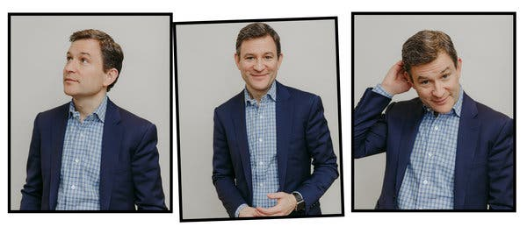
“I Can’t Do This”
Notes:
.

Slide 10
I can’t sit still
My nose itches
My mind won’t stop wondering
I feel ridiculous
My back hurts
This is a waste of time
I’m doing it wrong
Notes:
Chapter 2 addresses the very common sentiment of most people, which is “I can’t do this”
We are quick to dismiss the practice of meditation solely based on what we THINK it is, not what it actually is

Slide 11
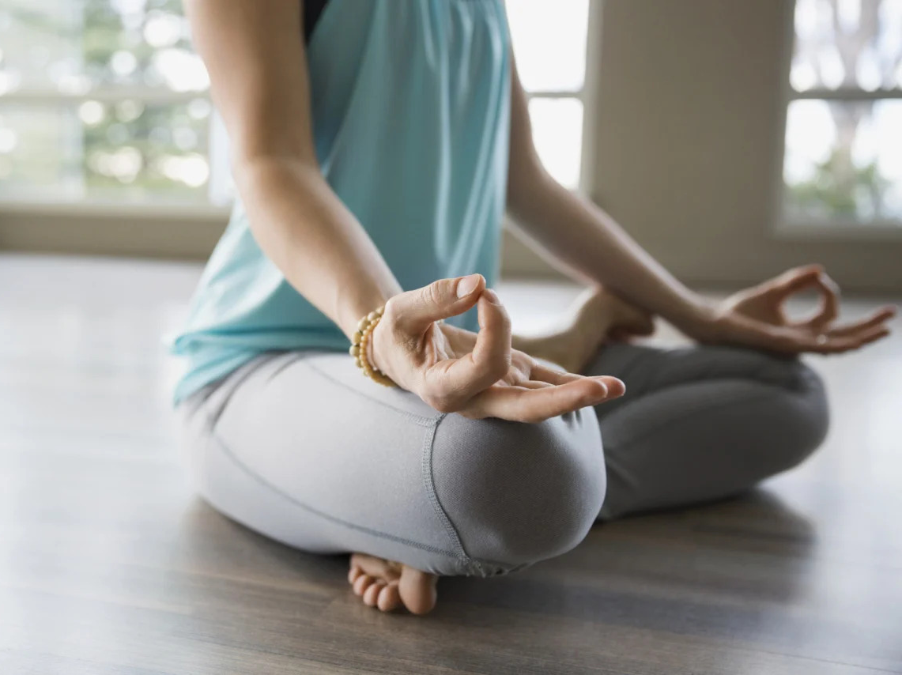
Myth – You must clear your mind
Myth – There is a right and a wrong way to meditate
Notes:
Meditation does not require you to stop thinking – the entire point is to redirect your thoughts.
It doesn’t change your circumstances, rather it changes your reaction to those circumstances.
The goal is to let your experience be what it is, without trying to fight it and negotiate it. Its like an inner smoothness. When you notice your inner voice is running the show, acknowledge it and say “Welcome to the party”
Create a name for your inner voice – Dan calls his inner voice Robert Johnson, after his gruff and constantly complaining grandfather. Mine is _______ and here’s why ________.

Slide 12
FAQ: Meditation Basics
Where should I meditate?
Somewhere quiet, with minimal distractions
Do my eyes need to be closed?
Up to you
How should I sit?
In a way that allows you to be still, comfortable & alert
Can I move at all?
Stillness is the ideal
What if I’m in pain?
You can gently move or investigate the pain

Slide 13
FAQ: Meditation Basics
How do I know when I’m done?
Use a timer – do not peak at your watch/phone
How long should I meditate?
Shoot for 5 -10 minutes daily, but 1 minute absolutely
Is it helpful to listen to soft music?
Not ideally, unless you find it helpful to concentrate
I’ve heard about mantras – do I need to have one?
Not for mindfulness meditation, but you can if it helps you focus
So, all we do is … pay attention to our breath???

Slide 14
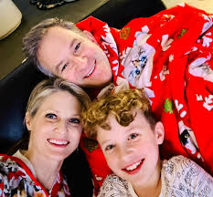
“I Don’t Have Time For This”
Notes:
.

Slide 15
“
Everyone should meditate once a day. And if you don’t have time to meditate, you should do it twice a day.
”
Dr. Sanjiv Chopra
Professor of Medicine at Harvard Medical School
Bestselling Author

Slide 16
You. Have. Time.
Notes:
You have time – it literally takes 5 minutes. And even one minute a day is beneficial. How long do you spend on social media or watching TV a day? Or complaining to your spouse/friends/kids? You have time – do not let this be an excuse.

Slide 17
Pro Tips on How to Make it a Priority
Think strategically about your schedule
Reward yourself
Give yourself permission to fail
Even ONE minute counts
Adopt an attitude of “daily-ish”
Notes:
The truth is that even though we know that technically we have more than enough time to fit in 5 – 10 minutes a day, we won’t do it unless we make it a priority. Old habits keep us stuck in our routine and anything new has to be given extra effort. Here are a few tips to help make it a priority:
Think strategically about your schedule – look at your overall schedule and see where you can fit in 5 min a day – after your morning coffee, while you brush your teeth, during your shower, as soon as your head hits your pillow, waiting in the parking lot for your kids to get out of practice (you know, the one that ALWAYS goes over)
Reward yourself. Grit won’t do the trick – you need rewards – find something that works for you. Mine is __________________
Give yourself permission to fail. It’s impossible to overstate the importance of giving yourself the freedom to experiment, fail, and try again. We are hard-wired to fail at this!
One minute counts! 10 deep breaths – that’s it. Once you’re there, why not do a little more?
Adopt an attitude of “daily-ish”. If you are overly rigid about deadlines that might backfire. Missing a day or two does not make you a failure – it makes you human.

Slide 18
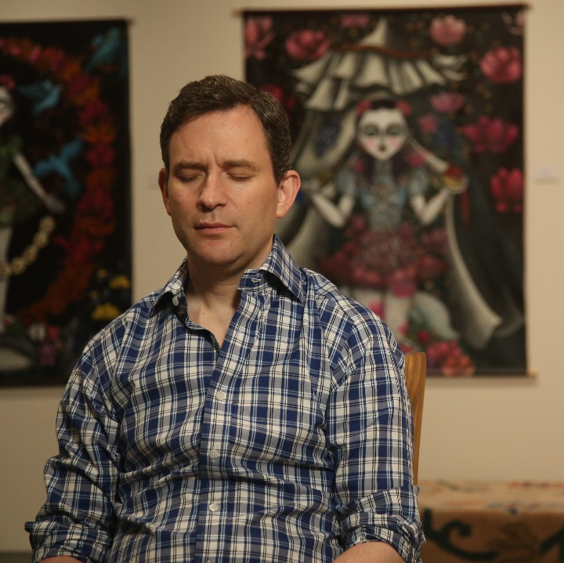
“People Might Think I’m Weird”
Notes:
.

Slide 19
Even though most of us spend an inordinate amount of time worrying about how we appear to others, the hard truth is that they really don’t care that much about you.
Notes:
Yeah, maybe… do you really care?
Even though most of us spend an inordinate amount of time worrying about how we appear to others, the hard truth is that they really don’t care that much about you.
This has nothing to do with religion – it is science. The brain needs exercise the same as our body.
Virginia Military Institute – cadets are taught meditation – increased resilience to PTSD – people make fun of what they don’t understand. Shows their weakness. Part of being a warrior is going against the stream
Phil Jackson, Kobe Bryant, Steve Jobs, 50 Cent, multiple professional athletes
Unfortunate stereotype of white, upper-middle class Whole Foods shoppers – not that there’s anything wrong with Whole Foods shoppers ☺

Slide 20
Russell Simmons
Oprah Winfrey
Jeff Weiner
Steve Jobs
Kobe Bryant
Bill Gates
Michael Jordan
Clint Eastwood
Jerry Seinfeld
LeBron James
Lady Gaga
Ellen DeGeneres
Katy Perry
Angelina Jolie
Hugh Jackman
Derek Jeter
Arianna Huffington
Notes:
Many famous people credit meditation for their success - these are just a few…

Slide 21
“Meditation Is Self-Indulgent”
Notes:
.

Slide 22
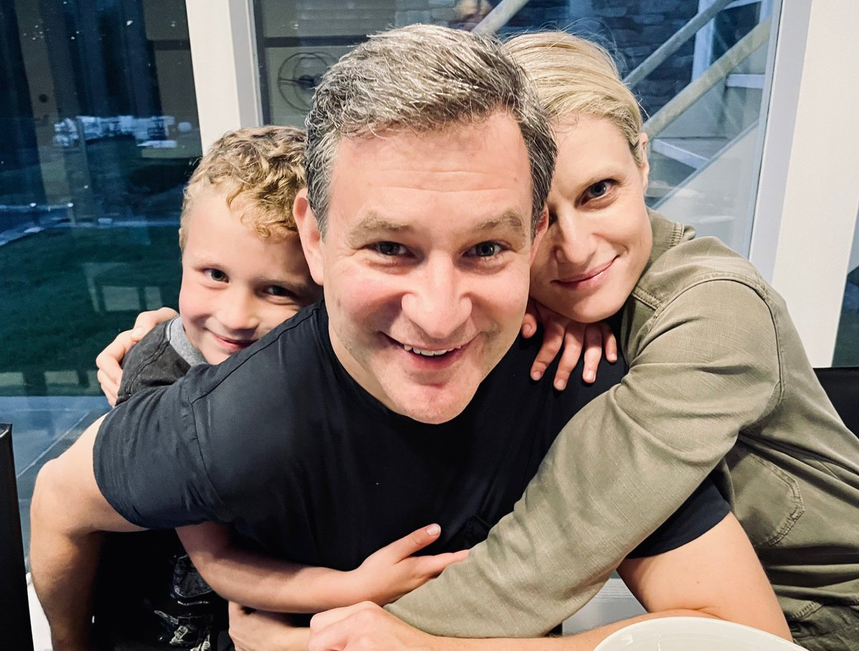
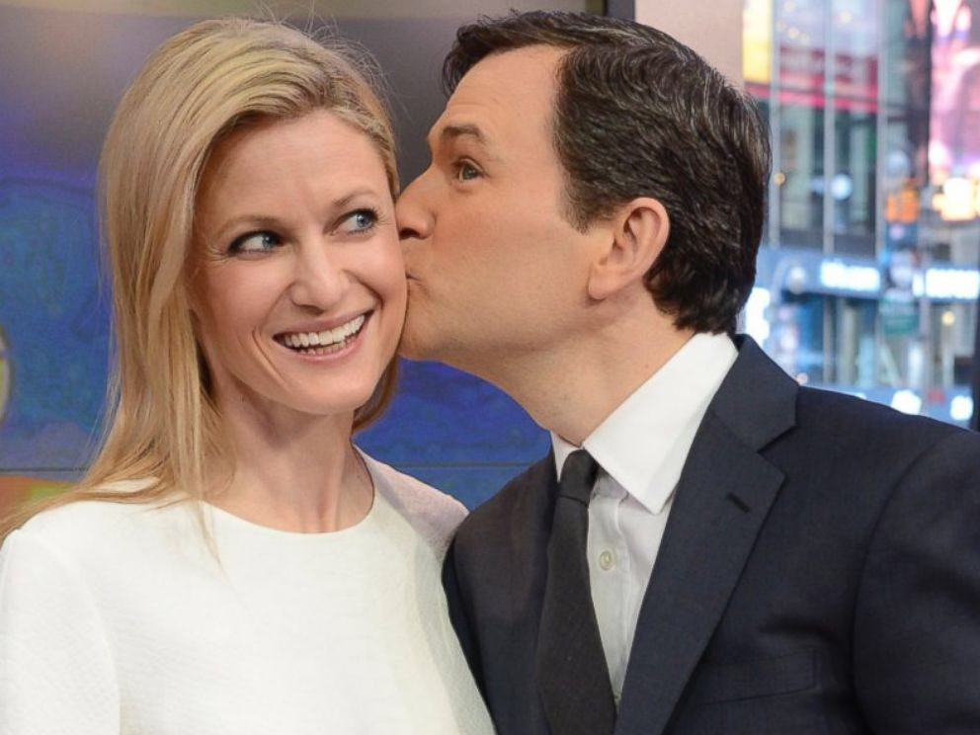
“If you want to take care of other people, you simply cannot do so effectively if you are not taking care of yourself. Period.”
Notes:
The whole point of the practice is to prepare you to be of service.
Research has shown it reduces burnout in health professionals
This falls into the same category of self-care. When are we going to learn?
If you want to take care of other people, you simply cannot do so effectively if you are not taking care of yourself. Period.
Tell a personal story.

Slide 23
Pandora’s Box
Notes:
.

Slide 24
If we look inside, we might open a Pandora’s box of debilitating emotions – we are much more comfortable with running from them.
Notes:
People are afraid to be alone with how they feel.
Researchers from the University of Virginia Department of Psychology asked subjects to sit in a lab room for 15 minutes with only their thoughts. There were no phones allowed, and no other people around. However, the room was equipped with a button that subjects could push and give themselves an electric shock if they wanted. The results were astonishing; many of the people , including two-thirds of the men, were so uncomfortable sitting quietly alone that they opted to zap themselves.

Slide 25
Sound familiar?
“Opening yourself up to vulnerability is hard. It’s scary.”
“Some days I just don’t really care for being in my own head.”
“I’m afraid of what I’ll find if I actually let everything out.”
Notes:
Emotions are not facts– meditation helps us to acknowledge them and respond, not react without thinking (easier said than done).

Slide 26
“If I Get Too Happy, I’ll Lose My Edge”
Notes:
.

Slide 27
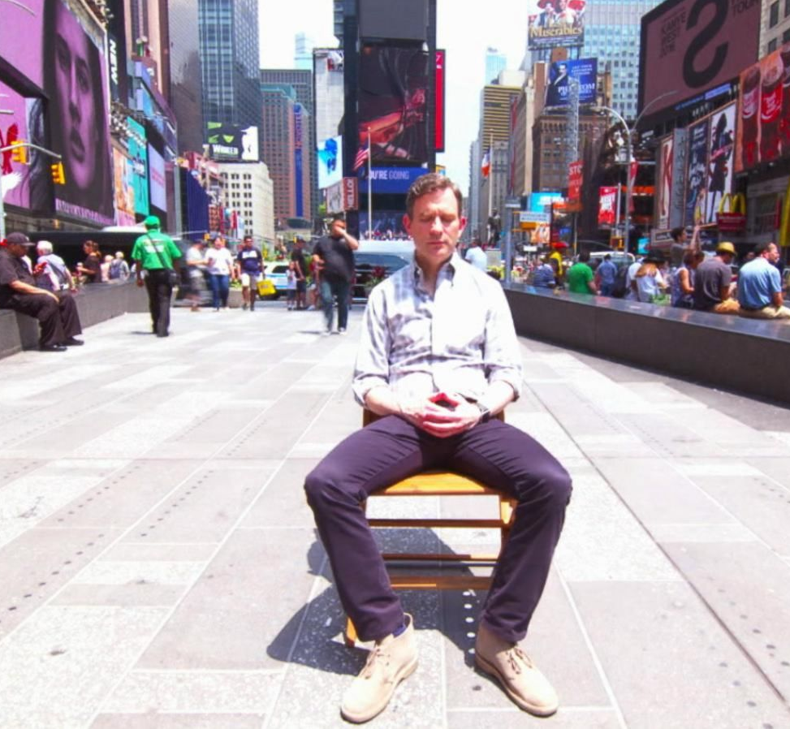
It’s science, remember?
Research shows:
improved working memory
reduced release of the stress hormone cortisol
quicker recovery times after high-pressure events
Notes:
There is definitely a stigma around meditation.
People are afraid it makes you soft, lazy, or not care as passionately – but it actually does the opposite. A police chief in Tempe, AZ argues it makes his officers more tactically sound. It helps to reset during and after stressful events, not take anxiety and anger from one situation to the next. Although we may not be in the direct line of fire literally, it certainly might feel like it sometimes. It is crucial for us to reset between interactions with confused students, frustrated parents, and worn-out co-workers so that we don’t bring our own set of negative emotions into the next conversation.
Tell a personal story.

Slide 28
“ ______ Is My Meditation ”
Notes:
.

Slide 29
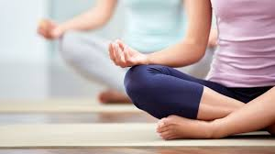
Notes:
People often say “I don’t need to meditate - running is my meditation.” (gardening, cooking, etc) While these are massively beneficial activities – exercise has well-demonstrated antidepressant effects - they are not the same as meditation.
Bottom line – it’s not mindfulness meditation unless you are knowingly paying attention to whatever you’re doing, and then, when you inevitably get lost, beginning again and again and again.

Slide 30
“I Can’t Keep It Going”
Notes:
.

Slide 31
Pro Tips to Keep it Going
Cut yourself some slack
Just begin again
Set realistic, achievable goals
Continually re-up your motivation
Don’t overcomplicate things
Just put your body there
Tune in to the benefits
10 Percent Happier App

Slide 32
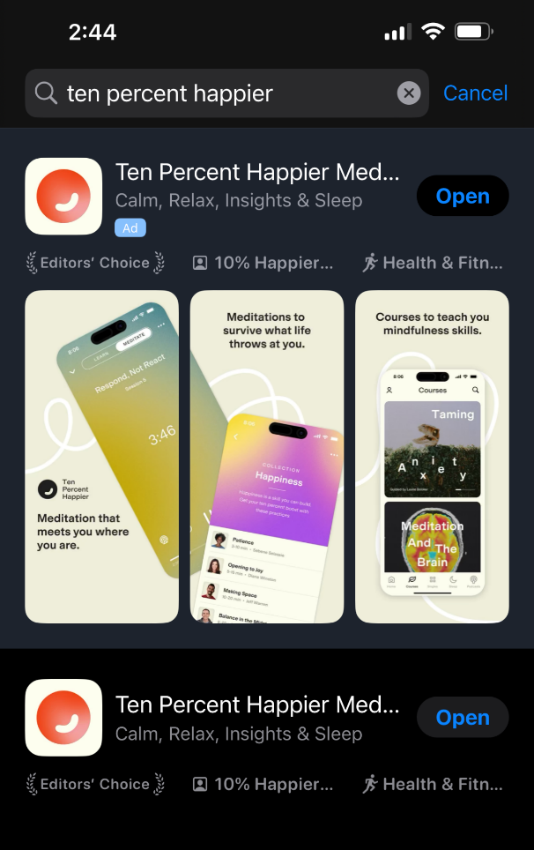
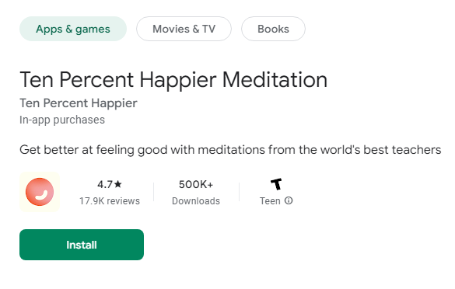
Pro Tips to Keep it Going
Get the Ten Percent Happier App
Apple App Store
Google Play Store

Slide 33
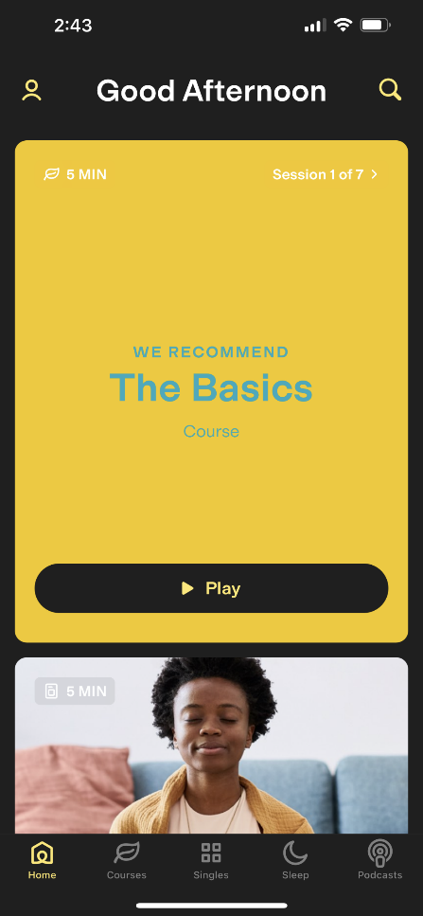
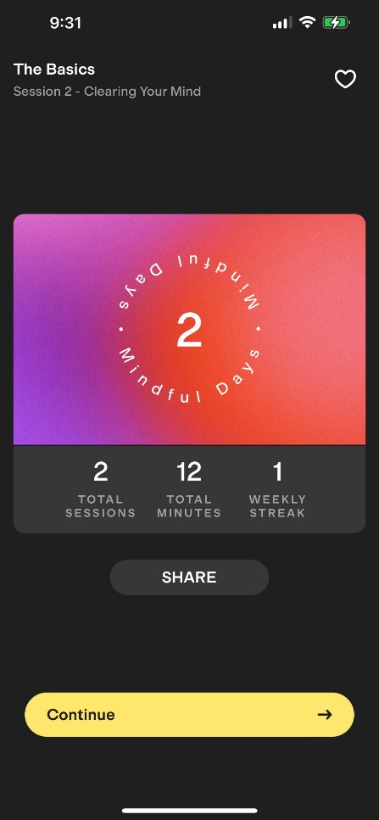
Pro Tips to Keep it Going
Sign up for free and follow EVERYDAY!
Give YOURSELF 5 mins… You deserve it!

Slide 34
Let’s Do It Now!!!

Slide 35
Thank You & Good Luck!

