Slide 1
Federal Work-Study Program
Understanding Funding, Eligibility, and Regulations

Slide 2
Overview of Federal Work-Study
A campus-based, need-based financial aid program.
Funding is allocated to schools each academic year.
Helps students earn money for educational expenses.

Slide 3
Funding Process
Schools must complete Part V of the FISAP annually.
ED uses this data to determine funding amounts.
Tentative and final funding is found on COD self-service.

Slide 4
Transfer of Funds
Up to 25% can be transferred to SEOG, but must be spent cannot be carried forward
Up to 10% can be carried forward or back one year.

Slide 5
Matching Requirements
• Schools must match 25% of final allocation (unless waived).
• Matching must be from nonfederal sources.
• Special matching rules apply for different organizations.

Slide 6
Waivers for Matching
Automatic waiver based on IPEDS data.
Schools can appeal by annual deadline (e.g., April 7).
Letters confirming waivers are available post-appeal.

Slide 7
Awarding Federal Work-Study
Not required to be based on exceptional need.
Must be documented in policies and procedures.
Must fit into student’s budget (Need)
7% must be used for community service positions.
Notes:
7% must be used for community service positions
the job must be in an area that is open, accessible, and used by the community at large
One or more students must be employed as tutors or family literacy program
Can request a waiver of this requirement – on COD by annual deadline

Slide 8
FWS Position Guidelines
Must pay at least minimum wage.
Cannot replace regular employees.
Cannot involve religious activities or construction.
Students may earn academic credit along with pay.
Cannot work during class time
Job Descriptions
Timesheets signed by supervisor
Hours worked must be trackable unless a Grad student. Can be paid a stipend.
Notes:
** side note may make FWS payments to disaster-affected students for the period of time (not to exceed the award period) in which the students were prevented from fulfilling their FWS obligations

Slide 9
Hiring Paperwork
Paperwork completed by HR or FA
Student cannot work until all paperwork in complete

Slide 10
Tax Considerations
FICA taxes do not apply if enrolled in a course of study.
Governed by Treasury Decision 9167 (2004).
Schools must comply with IRS regulations.
This Photo by Unknown Author is licensed under CC BY-SA

Slide 11
Methods of Payment
• Direct check or EFT to a designated account.
• Can be credited to student’s account with authorization.
• Garnishment of wages is prohibited.

Slide 12
On-Campus Employment Rules
Positions must relate to student services.
Students may work during non-attendance periods if enrolled for next term.
Earnings must be used for upcoming enrollment expenses.
Notes:
Difference between proprietary and non proprietary school position
Must be student services related
34 CFR 675.2(b
Students may work during a period of non attendance
Must be planning to enroll for the next period of enrollment
Earnings must be used to cover expenses for next period of enrollment (has need)

Slide 13
Off-Campus Work-Study Agreements
• Must specify cost-sharing terms with employers.
• Define hiring, supervision, and payroll responsibilities.
• Outline liability for on-the-job injuries.

Slide 14
Offices Involved
HR or payroll services
Financial Aid
All supervisors
Career Services

Slide 15
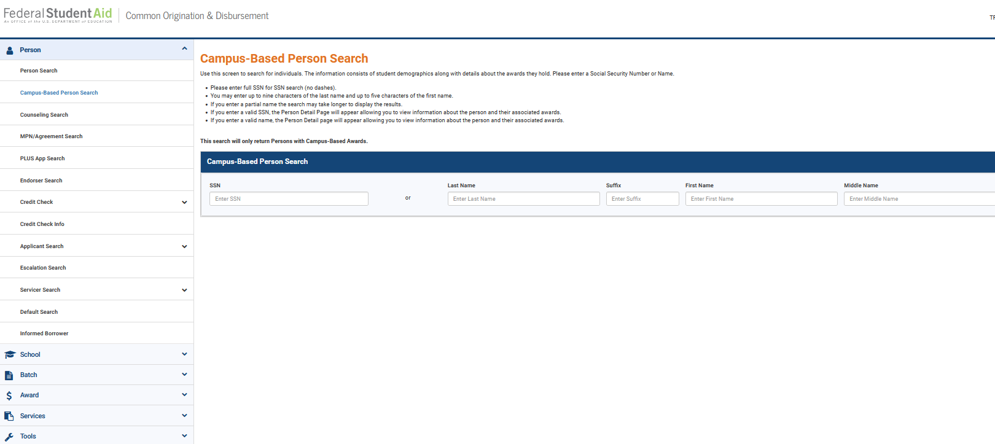
Annual Reporting
Reported by CALENDAR YEAR for each student
Reported on COD via batch or directly on COD website
Due October 1st for previous year
Notes:
Info Needed: Last name, DOB, SSN, CPS Trans #, Total earnings, Calendar year.
Both institutional and Federal share- gross amount
Paid, not worked during the calendar year

Slide 16
Questions?
Thank you!

