Slide 1
You Can’t Say That!
FERPA & Financial Aid Data Sharing
Amanda Buchanan, Financial Aid Director
Blue Ridge Community College
2021-2022 NCASFAA Vice President

Slide 2
FERPA Overview
Background
Annual Notification
Education Records
Directory vs. Private Information
Exceptions
School Officials
Verifying Identity
Financial Aid Data Sharing
Higher Education Act (HEA)
Privacy Act
Your Role as a Data Manager
Best Practices
Tools & Resources

Slide 4
What is FERPA?
The Family Educational Rights and Privacy Act of 1974 (FERPA) is a federal law that protects the privacy of student education records.
applies to all schools that receive funds from the US Department of Education
enforced by the US Department of Education
FERPA is also meant to provide these rights to students:
to inspect and review their education records
to correct inaccurate and misleading data
to control some of the disclosure of information

Slide 5
Why is this important?
It is important that every person who works with student education records understands:
What an education record is
What information within that record may be disclosed
To whom and under what conditions that information may be disclosed

Slide 6
Annual Notification
Schools are to provide an annual notice to students of their rights under FERPA to:
inspect and review their education records
request an amendment to their education records
request that the institution does not disclose their directory information

Slide 7
Annual Notification
The Annual Notification also informs students of the following:
Who will be considered school officials
What information from education records school officials can obtain without obtaining prior written consent
Examples of permissible disclosure of education records without the student’s consent
What information the school has designated as public or directory information (policy!)

Slide 8
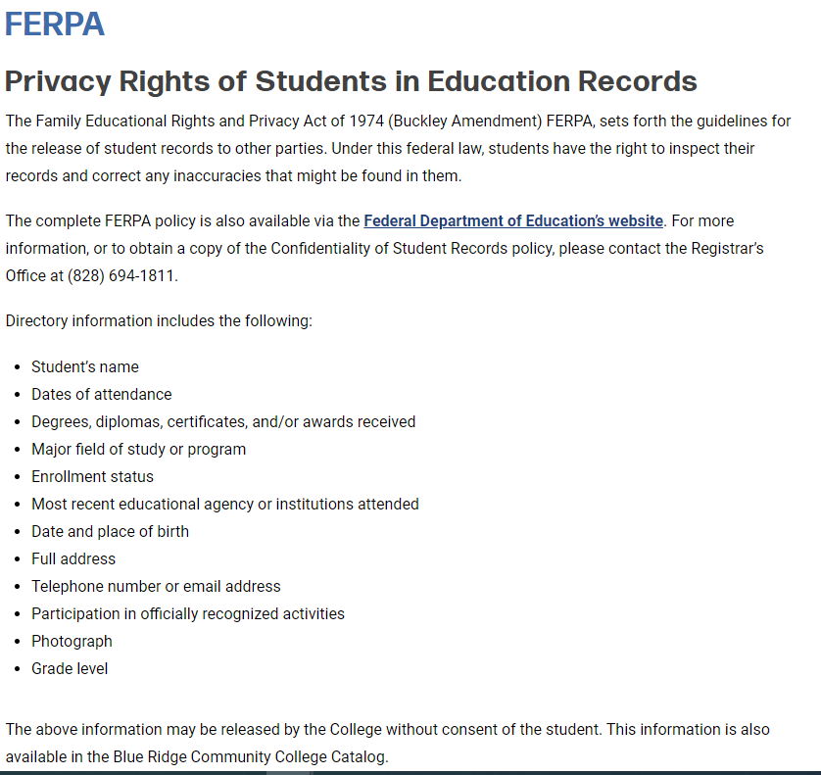

Slide 9
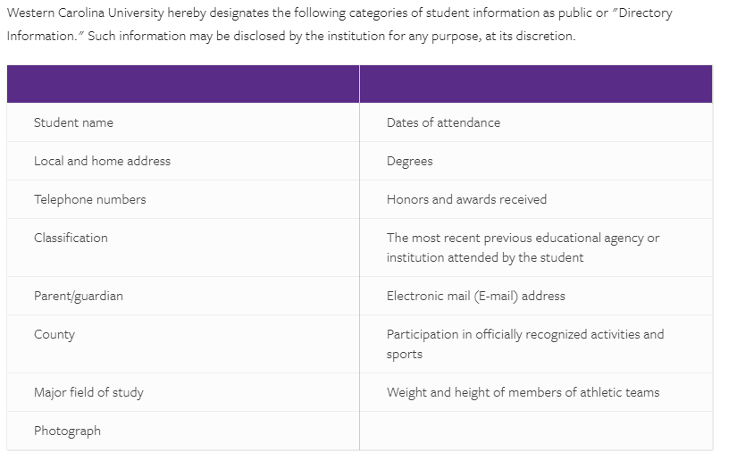

Slide 10
Education Records
Education records are defined as records that contain information directly related to a student and that are maintained by the institution or its agent on behalf of the institution.
What does an education record include?

Slide 11
Education Records
Education Records Include:
Education records DO NOT Include:
Graded papers
Exams
Transcripts
Student’s current class schedule
Computer screen displaying student information
Database containing PII
Email containing information about the student
Sole possession records
Peer graded papers
Law enforcement unit records
Employment records (unless employment is based on student status, i.e. FWS)
Medical records
Alumni Records

Slide 12
What is Directory Information?
FERPA defines directory information as information contained in an education record of a student that would not generally be considered harmful or an invasion of privacy if disclosed.
(34 CFR § 99.3.)
FERPA provides that a school may disclose directory information if it has given public notice of the types of information which it has designated as “directory information”, the parent or eligible student’s right to restrict the disclosure of such information, and the period of time within which a parent or eligible student has to notify the school in writing that he or she does not want any or all of those types of information designated as “directory information”. (34 CFR § 99.37(a))

Slide 13
Including...
Name
Address
E-mail address
Phone number
Major
Dates of attendance
Admission or enrollment status
Class Standing
Degrees and Awards
Activities
Sports and Athletic Information
Student ID Photos

Slide 14
Personally Identifiable Information
Most of us know this as ‘PII’ and it includes information that can be used to distinguish or trace an individual’s identity either directly or indirectly through linkages with other information.
What information is considered Personally Identifiable?

Slide 15
Some PII Examples
Social Security Number*
Date of Birth
Grades
Hours Completed
GPA
Current Class Schedule
Parent Name and Address
Race/Ethnicity
Gender
Country of Citizenship
*Directory Information does not include a student’s Social Security Number nor can the SSN be used to confirm directory information!

Slide 16
Permitted Disclosures*
School officials
Schools to which a student is transferring
Specified officials for audit or evaluation purposes
Appropriate parties in connection with financial aid to a student
Organizations conducting certain studies for or on behalf of the school.
Accrediting organizations
Appropriate officials in cases of health and safety emergencies
State and local authorities, within a juvenile justice system, pursuant to specific state law
To comply with a judicial order or lawfully issued subpoena
*Permitted disclosure means the information can be, but is not required to be, shared without individual authorization.

Slide 17
School Officials
Examples of a school official include:
A person employed by the college in an administrative, supervisory, academic, research or support position (including law enforcement health staff)
A person or company with whom the college has contracted (attorney, auditor, collection agent, third-party vendor)
A person serving on the Board of Trustees
A student employed by the college in a position that requires access to student records

Slide 18
Exceptions
Legitimate educational interest/need to know
Lawfully issued subpoenas
Various authorized representatives of government entities
Parents of dependent students
A person for whom the student has taken appropriate steps to release information

Slide 19
Verifying Identity
Authenticate identity of student, parent or authorized user before giving personal answers or information.
Know your institution’s appropriate identification verification questions.
How does your institution verify identity?

Slide 20
Financial Aid Data Sharing
The laws regarding financial aid information include more than just FERPA.
We must also be aware of the Higher Education Act (HEA) and the Privacy Act.

Slide 21
Higher Education Act
FAFSA Data can only be used for the application, award and administration of financial aid from federal, state, institutional or other eligible institutions or programs.
PII from NSLDS data is prohibited from being used for non-governmental research, policy analysis and marketing purposes regardless of student consent.
Financial Aid Offices must keep FAFSA data separate from other data collected to guarantee it is only used for awarding and administering financial aid.

Slide 22
FAFSA Data
Any answers on the FAFSA required to calculate EFC
Any information on the ISIR used to determine award eligibility
Any financial aid awarding and disbursement data resulting from the FAFSA, EFC, and ISIR answers and information

Slide 23
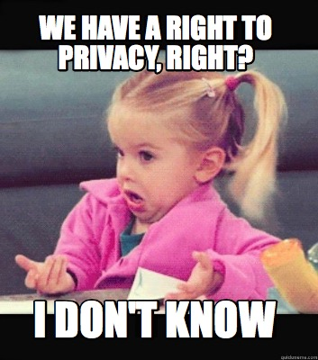
Privacy Act
The Privacy Act of 1974 establishes a code of fair information practices that governs the collection, maintenance, use, and dissemination of information about individuals that is maintained in systems or record by federal agencies.

Slide 24
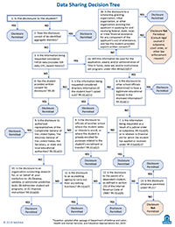
Who is Eligible?
NASFAA’s Data Sharing Decision Tree to determine if a disclosure of information is allowable.
From NASFAA: The language in the HEA, requires that FAFSA data only be used for the application, award, or administration of federal, state, or institutional aid, or aid awarded by other entities as designated by ED.
Note that institutions are still not allowed to make disclosures of FAFSA data for other uses, even with the student’s written consent.
(NASFAA Statement, 2018, based on FY 2018 Spending Bill passed on March 23, 2018)

Slide 25
Your Role as a Data Manager
Do you share student information with internal or external individuals on behalf of the school?
Do you manage a department system containing student information?
If you handle student information,
you have a data management role!

Slide 26
Best Practices
Use secure tools provided by the institution
Do not send restricted information via email (i.e. SSN)
Do not store student education data on personal computers, flash drives, etc.
Use VPN for secure access
Access only the information needed to do your job
When in doubt, ask!

Slide 27
References
https://www.cdc.gov/phlp/publications/topic/healthinformationprivacy.html
https://studentprivacy.ed.gov/faq/may-educational-agency-or-institution-disclose-directory-information-without-prior-consent
https://www.blueridge.edu/services-support/consumer-information/ferpa/
https://www.wcu.edu/learn/academic-services/registrars-office/transcripts/ferpa.aspx
https://www2.ed.gov/policy/gen/guid/fpco/ferpa/index.html
https://nces.ed.gov/pubs97/web/97859.asp
https://studentprivacy.ed.gov/frequently-asked-questions
www.nasfaa.org

Slide 28
Questions?
Amanda Buchanan
(828) 694-1806
a.buchanan@blueridge.edu

Slide 29
Platinum Level Supporters

Slide 30
Gold Level Supporters

