Slide 1
Enrollment Management Impacts on Higher Education Amid Declining Student Populations
Dana Kelly, NASFAA

Slide 2
Objectives
Understand the drivers behind enrollment decline.
Explore the strategic impacts on institutional operations.
Identify effective enrollment management responses.

Slide 3
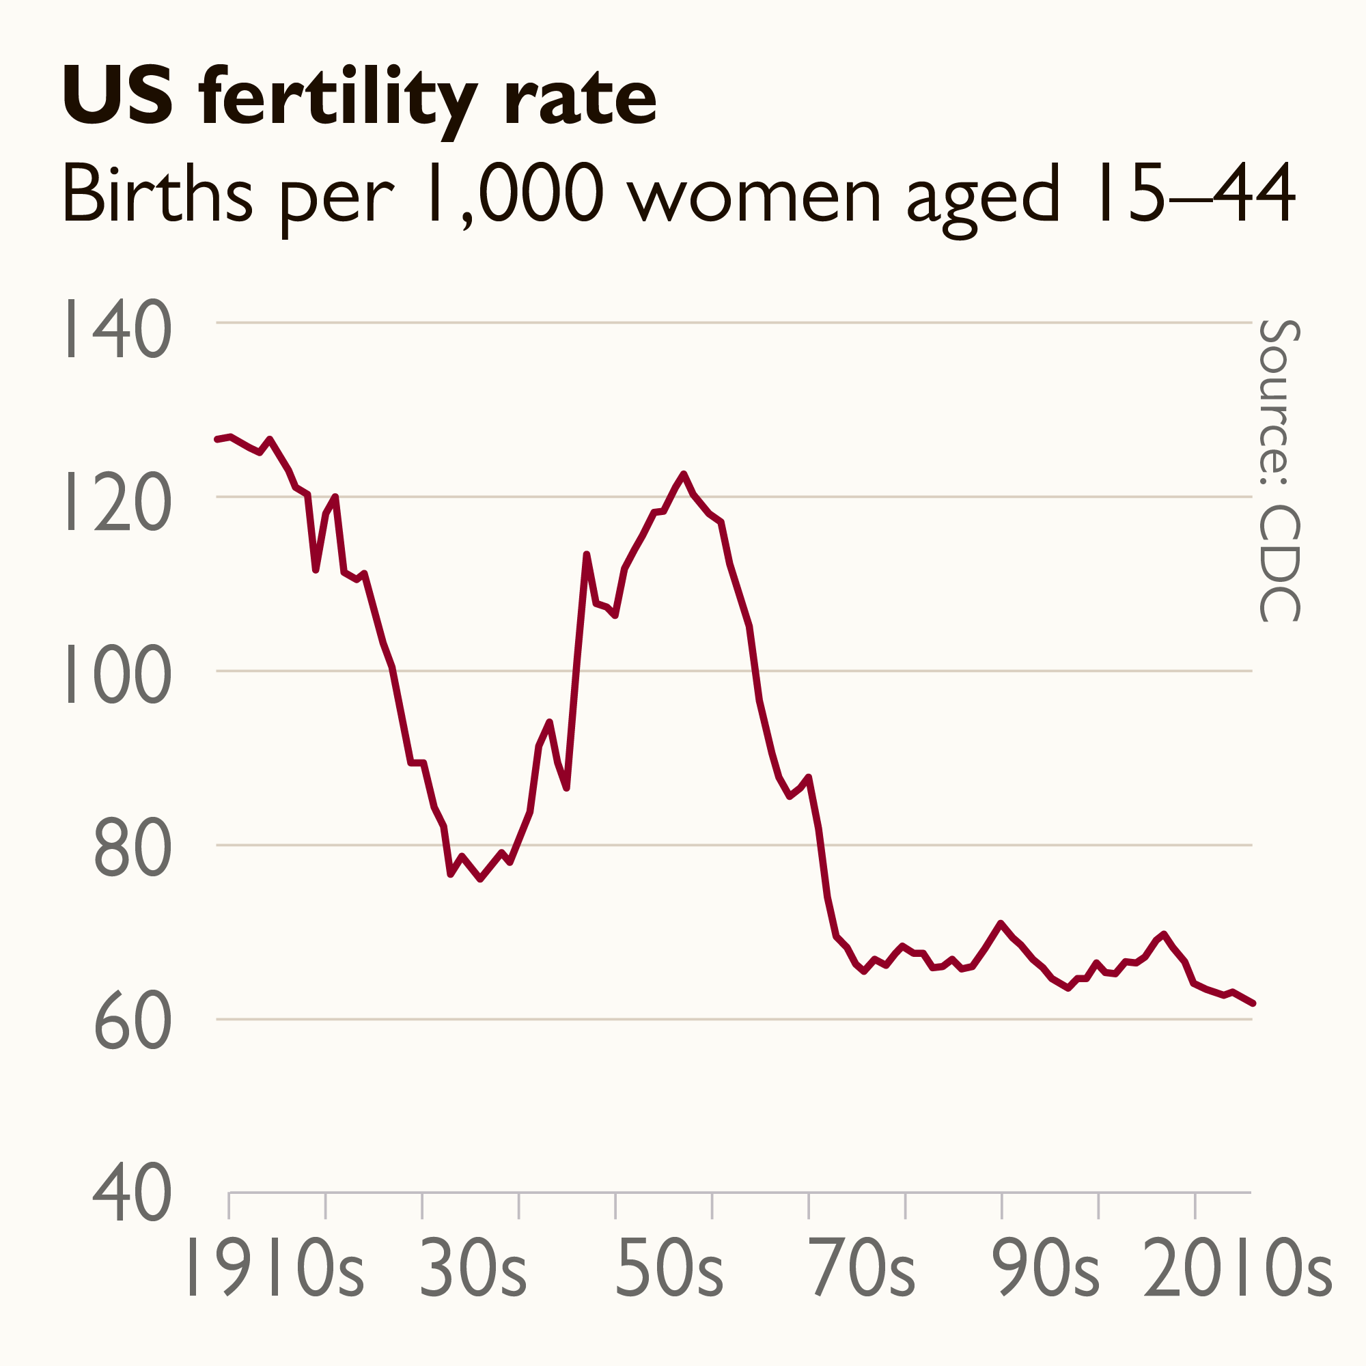
US Demographic Trends
Birth rate decline
Regional population shifts

Slide 4
Enrollment Declines: National Data (IPEDS, NSCRC)
Freshman Enrollment Decline: In the fall semester of 2024, there was a 5% decrease in 18-year-old freshman enrollment compared to the previous year. Public and private non-profit four-year colleges experienced declines exceeding 6%. ​
Demographic Disparities: Highly selective institutions saw a 16.9% drop in Black freshman enrollment, indicating significant demographic shifts. ​
Gender Differences: The decline was more pronounced among men (6.4%) than women (6.0%), exacerbating existing gender disparities in higher education.
Racial Variations: White freshman enrollment decreased by 11.6%, while Black enrollment declined by 6.1%. Hispanic and Asian enrollments saw smaller reductions of about 1% each.

Slide 5
Economic & Cultural Factors
Rising skepticism about higher ed ROI
Increased competition from alternative credentials

Slide 6
Future Forecast
THE ENROLLMENT CLIFF

Slide 7
What’s the crisis?
⬇ Declining Birth Rates: U.S. birthrates have been falling since 2008, peaking impact in 2025 when fewer high school grads begin to reach college age.
🧑‍🎓 High School Graduate Peak: ~3.8 million in 2025 → gradual decline projected to continue into the 2030s.
📊 Regional Impact: Northeast and Midwest to see largest enrollment drops due to sharper population declines.
🏫 Risk to Institutions: Smaller colleges and tuition-dependent schools face closures, mergers, or program cuts.

Slide 8
Budget, Financial Aid & Institutional Consequences
Tuition dependency
Aid leveraging & discounting trends
Program consolidation or sunsetting
New program innovation
Impacts on marginalized student populations
Hiring freezes, role realignments

Slide 9
Is your institution planning for future demographic impacts?

Slide 10
Strategic Enrollment Management (SEM)
A comprehensive, institution-wide process designed to help colleges and universities achieve and maintain optimal enrollment. It involves aligning recruitment, retention, marketing, financial aid, academic planning, and student services with the institution's mission, goals, and resources.

Slide 11
SEM Pillars
Recruitment
Retention
Financial aid optimization
Student success initiatives

Slide 12
SEM Common Practices
Data-Driven Decision Making: Using research and analytics to guide enrollment strategies.
Student-Centered Approach: Supporting student success from prospect to graduation.
Cross-Functional Collaboration: Involving academic affairs, student services, admissions, marketing, and financial aid in a coordinated effort.
Long-Term Planning: Looking beyond annual enrollment goals to align with institutional sustainability and growth.
Mission Alignment: Ensuring enrollment strategies support the institution's values and educational objectives.

Slide 13
In essence, SEM helps institutions attract not just more students but the right students—and support them in succeeding.

Slide 14
Strategic Questions
Who are our future students?
Are we over-reliant on specific demographics?
Are we adapting our value proposition?

Slide 15
Aligning SEM with Institutional Mission
Examples?

Slide 16
SEM Common Practices
Data-Driven Decision Making: Using research and analytics to guide enrollment strategies.
Student-Centered Approach: Supporting student success from prospect to graduation.
Cross-Functional Collaboration: Involving academic affairs, student services, admissions, marketing, and financial aid in a coordinated effort.
Long-Term Planning: Looking beyond annual enrollment goals to align with institutional sustainability and growth.
Mission Alignment: Ensuring enrollment strategies support the institution's values and educational objectives.

Slide 17
Action Planning Framework
Clearly state the overarching SEM goal (e.g., increase first-year student retention by 10% over 3 years).
Break down the goal into specific, measurable, achievable, relevant, and time-bound (SMART) objectives.
Identify broad approaches or methods to achieve each objective (e.g., enhance academic advising, implement early alert systems).
List concrete steps or activities under each strategy
Assign ownership for each action to individuals or departments.
Set deadlines or milestone dates for progress and completion.
Identify financial, human, or technological resources required.
Define how progress will be measured and evaluated.
Build in regular check-ins and refinement based on data and results.

Slide 18
EXAMPLE
Goal | Objective | Strategy | Action | Responsible | Timeline | Metrics
Increase retention | Improve advising | Strengthen support structures | Hire 2 advisors | Advising Dept | Q1 2025 | Advisor-to-student ratio

Slide 19
Open Discussion and Q&A
Initial prompt: What are some specific issues around enrollment currently in your aid offices? How does today’s discussion compound them?

