Slide 1


Overview of Satisfactory Academic Progress
A NASFAA Authorized Event*
Presented by
Dana Kelly, NASFAA
NCASFAA 2025 Spring Conference
kellyd@nasfaa.org
*For training purposes only; not for credential preparation

Slide 2
Agenda
SAP Requirements
Evaluating SAP
Loss of Eligibility
Appeals, Probation and Academic Plans
Additional SAP Policy Elements

Slide 3
SAP General Policy Requirements
For all categories of students
Same As or Stricter Than
Quantitative
Qualitative
Other factors
Evaluation Components
Warning
Probation
Appeals
Assessment

Slide 4
Consumer Information Requirements
Prospective Students | Currently Enrolled Students
Readily available in paper or electronic format
Accessible to the public | Easily accessible to students
Describe standards for maintaining and re-establishing Title IV aid eligibility
Not via restricted Intranet | If online, provide exact URL
 | Annual notice of SAP policy
 | SAP evaluation results, if eligibility is affected

Slide 5
Evaluation
Frequency
Timing
SAP Evaluation Policy

Slide 6
Quantitative Component
Maximum Timeframe
Undergraduate:
150% of published length of program in credits or calendar time
Graduate:
Defined by the school, based on length of program

Slide 7
Quantitative Component
Pace:
Cumulative credit hours successfully completed Cumulative credit hours attempted
Credits by specific date needed Maximum timeframe

Slide 8
Quantitative Component
Graduated quantitative standard (optional)
Transfer students
  Credits accepted count in both completed and attempted hours

Slide 9
Example: Henri
POLICY
Number of Attempted Credits | Pace
0 - 15 | 60%
16 - 30 | 65%
31 or more | 70%
Graduated Standard
HENRI
Term | Completed Credits | Attempted Credits | Pace
Fall 2025 | 9 | 15 | 60%
Spring 2026 | 11 | 15 | 67%
Summer 2026 | 6 | 9 | 67%

Slide 10
Qualitative Component
Quality of the student’s work
  Grade Point Average
  Comparable Qualitative Measure
  Graduated Standard
Equivalent of a “C” or better

Slide 11
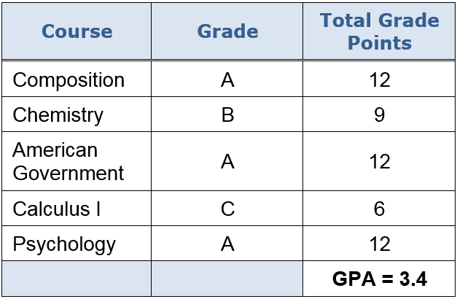
Example: Bailey
Cumulative GPA of at least 2.0
SAP review after each semester
Met GPA requirement

Slide 12
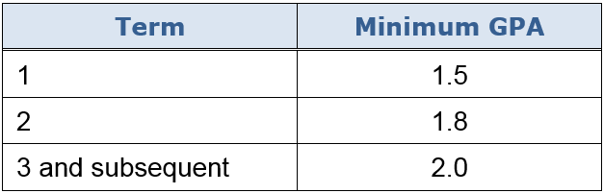
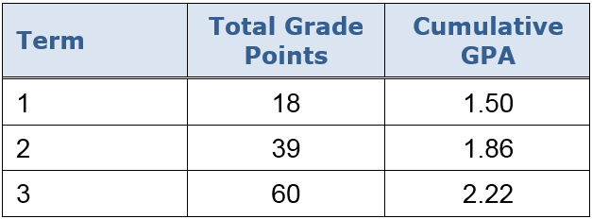
Example: Mateo
POLICY
Graduated Standard
MATEO

Slide 13
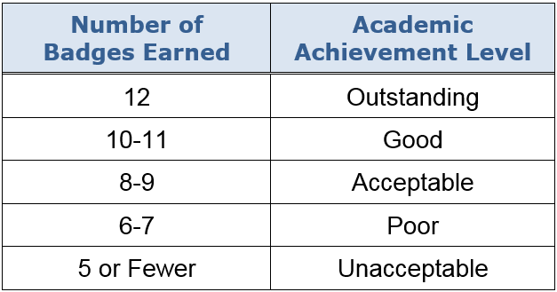
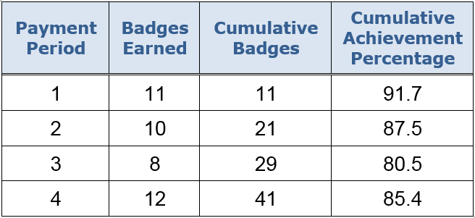
Example: Josiah
POLICY
Comparable Measure
JOSIAH

Slide 14
Loss of Eligibility
Failure to make SAP results in immediate loss of Title IV aid eligibility
Eligibility may be regained if:
  Pay for classes without federal financial aid
  Successfully appeal
School decides whether to allow appeals

Slide 15
SAP Appeals
Conditions and Circumstances
No regulatory limits on appeals
Documentation
Student’s circumstances
Processing SAP Appeals
Making appeal decisions
Actions taken on an appeal
Define acceptable reasons
Steps to follow

Slide 16
Financial Aid Probation
Appeal
Review after one payment period
Meeting SAP requirements
Academic plan or ineligible
Academic Plan
Appeal
Periodic review against plan
Meeting plan requirements
Ineligible

Slide 17
Financial Aid Probation
May be granted only after successful appeal
May follow or replace financial aid warning
School may choose to limit number of times
One payment period only
  Potential must exist for student to make SAP by end of the payment period
  If still failing, student is ineligible unless subsequent appeal results in academic plan

Slide 18
Academic Plans
Long-range plan for success
  Tailored to the student’s unique needs
  Appropriate checkpoints and milestones
  Specific point in time for meeting SAP standards
  May extend beyond 150% maximum timeframe
May be granted only after successful appeal
May follow or replace financial aid warning or probation

Slide 19
Academic Plans
School reviews progress after first payment period
Subsequent reviews may align with school’s SAP review cycle or happen more often
Failure to follow the plan and not otherwise meet SAP standards results in loss of Title IV eligibility

Slide 20

Re-Establishing Eligibility
SAP policy must describe how to re-establish eligibility
  Financial aid warning
  Appeal, if available
  Attend without Title IV aid
Students must be notified
  School policies and procedures
  Consequences of failure
  How to re-establish eligibility

Slide 21
Additional SAP Policy Elements
Withdrawals and nonattendance
Incomplete courses or grades
Repeated coursework
Transfer hours
Grade changes
W
I
G
R
T

Slide 22
Additional SAP Policy Elements
Audited Courses
Pass-or-Fail Courses
Remedial Coursework
English as a Second Language
Continuing Education or Enrichment Courses
Comprehensive Transition and Postsecondary Program
Subscription-Based Program
School policy required

Slide 23
Additional SAP Policy Elements
School must determine SAP treatment
Multiple Degrees or Credentials
Double Majors
Change of Program
Academic Amnesty

Slide 24
How does your school’s SAP policy address incomplete grades?
Does your school use the financial aid warning and/or financial aid probation statuses? If so, how does your school structure its appeal process? Does your school have an Appeals Committee, or is only written documentation permitted?
Should all schools be required to evaluate SAP after each payment period?

Slide 25
Any lingering questions?

