Slide 1
NASFAA Update
NCASFAA Annual Conference
November 8, 2021

Slide 2
About NASFAA
Our Mission
NASFAA provides professional development and services for financial aid administrators; advocates for public policies that increase student access and success; serves as a forum on student financial aid issues, and is committed to diversity throughout all activities.
Who We Are
Member institutions serve 9 out of every 10 undergraduates in the US.
22,000+
Financial Assistance Professionals
at
3,000
Colleges, universities, and career schools
Our Vision
Shaping the future by creating by promoting student access and success in higher education.
Shaping the future by promoting student access and success in

Slide 3
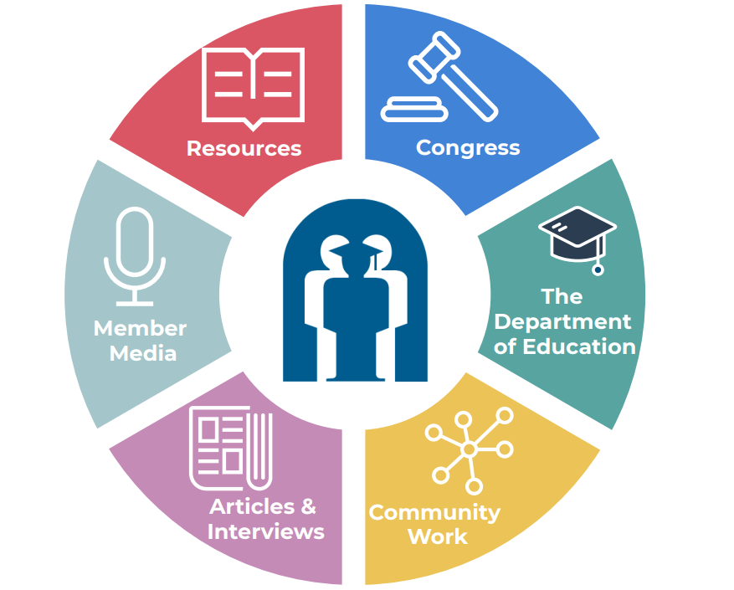
NASFAA’s Covid Response
https://www.nasfaa.org/covid19

Slide 4
Coronavirus (COVID-19) Web Center
NASFAA Articles and Statements
NASFAA Webinars
“Off the Cuff” Podcasts
AskRegs Q & A
HEERF Reference Page
*Many resources of this page are open to the public thanks to a grants and NASFAA member support.

Slide 5
NASFAA Compliance Tools
Helping you manage the administration of Title IV aid.

Slide 6
NASFAA Compliance Tools

Slide 7
Why use NASFAA Tools?
Increase Collaboration
Reduce Time
Limit Risk
Increase Efficiency
Streamline Process

Slide 8
The Compliance Engine
Self-Evaluation Checklists

Slide 9
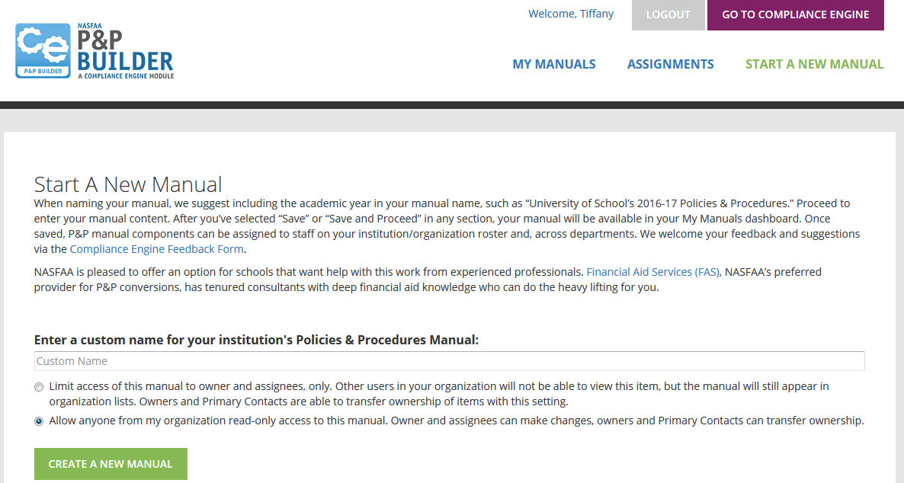
P & P Builder

Slide 10
Add an existing manual into the tool.

Slide 11
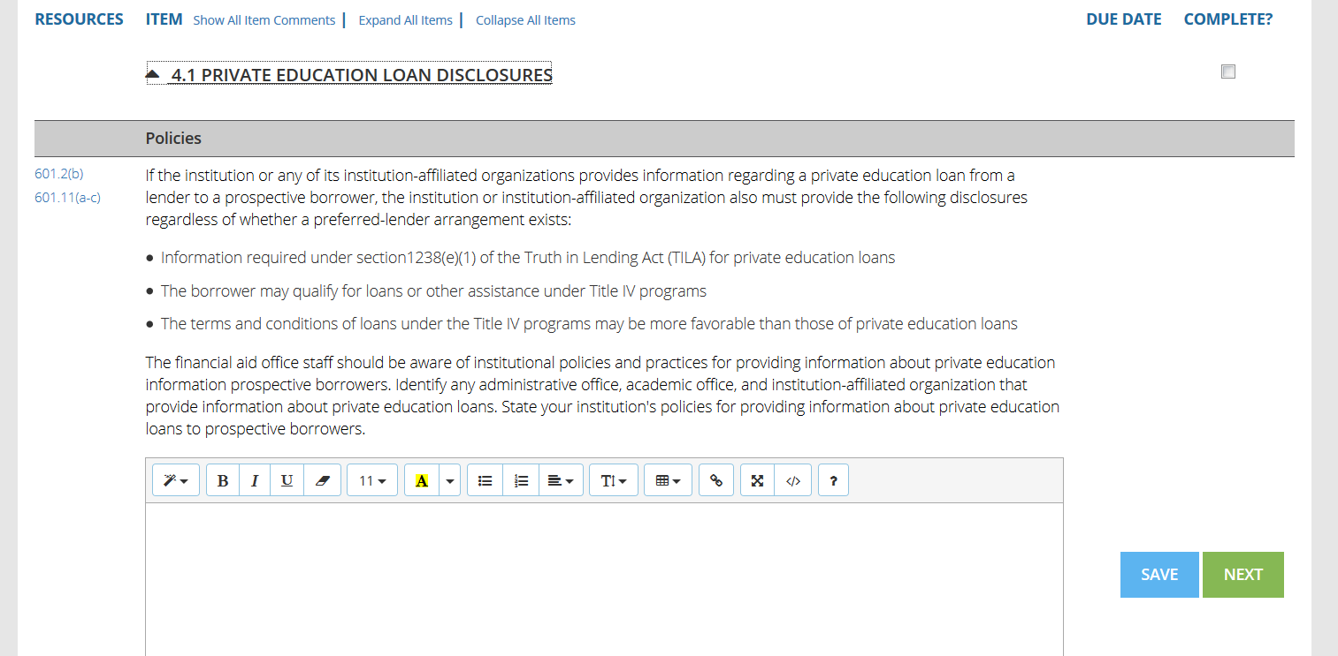
Notes:
Click 1 – resources – direct links to compiled regulations and other resources
Click 2 – goes away
Click 3 – enter content into template

Slide 12
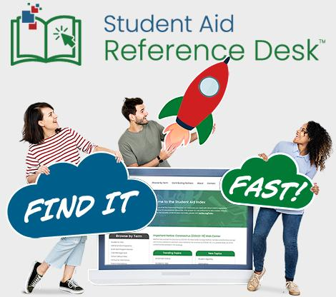
The Ref Desk
A comprehensive index developed by NASFAA and other education partners that has open access for aid professionals. Find it fast!

Slide 13
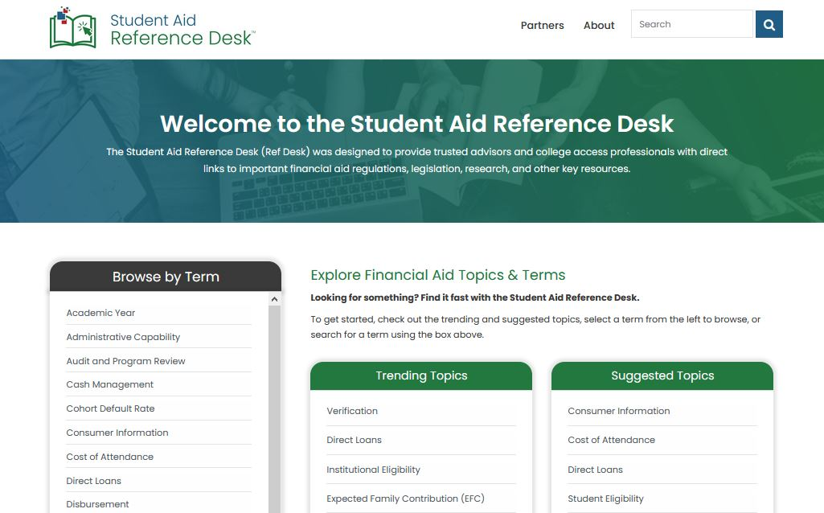
Search for your topic.

Slide 14
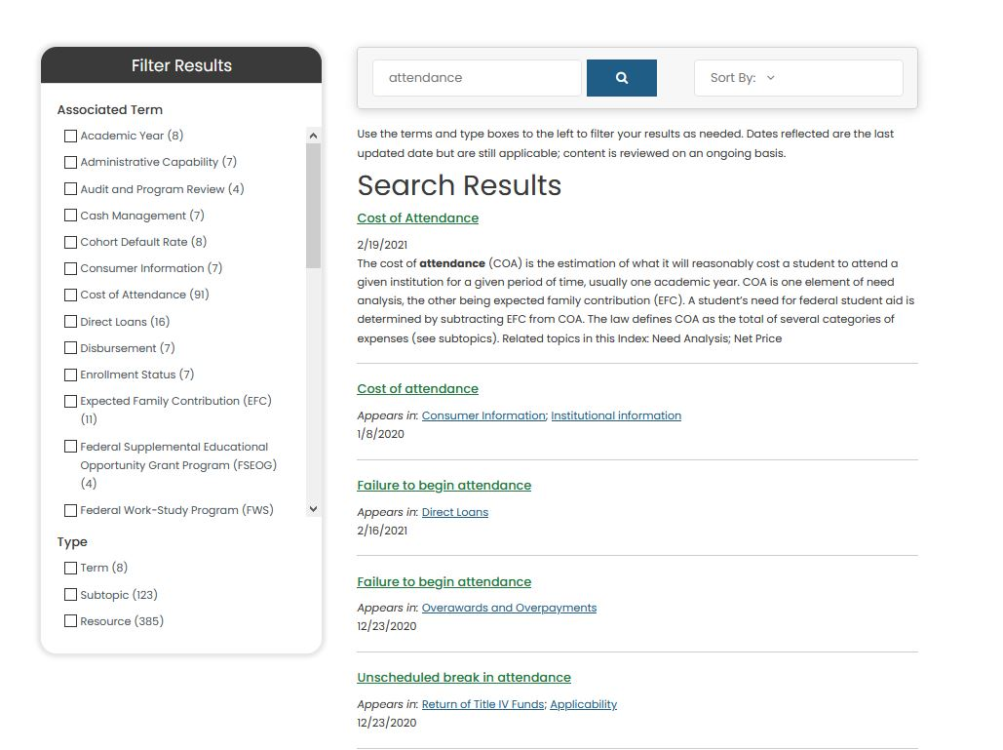
Narrow results or explore all facets of your topic.

Slide 15
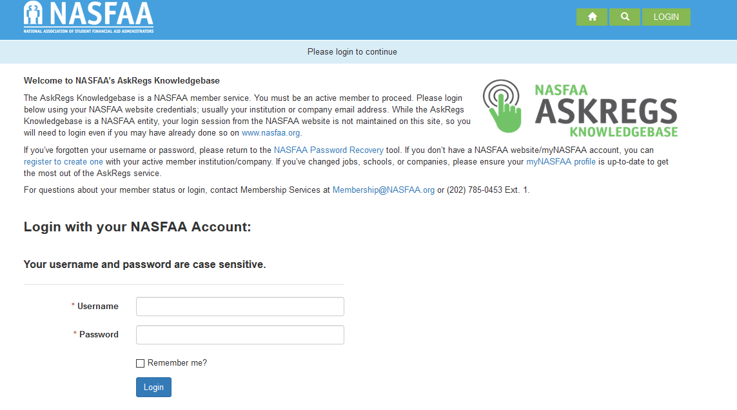
ASKREGS
A searchable database of “real world” questions and answers.
Or
Ask a question of NASFAA’s Training & Regulatory Assistance Team

Slide 16
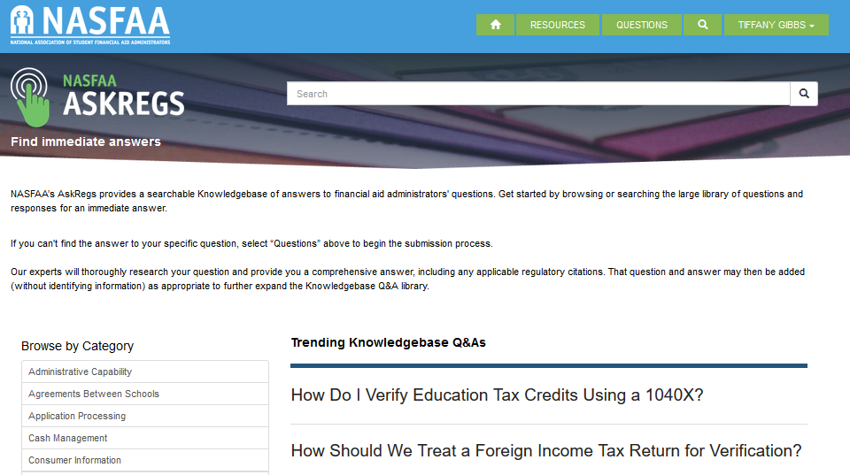
See what’s trending or search by topic.

Slide 17
21-22 Webinar Schedule
(Live and On-Demand)
Panel Discussion: Cohort Default Rates
Always Never the Same - What’s New with SAP and Return of Title IV
FAFSA Update: 22-23
Recognizing and Eliminating Bias in Aid Administration
Economics of Financial Aid - A Conversation
NASFAA Policy Updates
Homeless Youth
Panel Discussion: 21st Century Skills for Aid Administrators
NASFAA Quiz Show
Resolving Frequently Assigned Comment & Reject Codes and Flags
Summer Aid Issues
Hot Topics

Slide 18
NASFAA U Online Courses
In Depth Instruction
Practicing Adjuncts
Video Tutorials
Live and On demand classes
Downloadable Resources
Active Assessment
Complementary Professional Credential Testing Access
Topics for 21-22:
Fundamentals of Student Financial Aid (certificate course)
Return of Title IV Funds (credential course)
Higher Education Loans (certificate course)
Academic Calendars (certificate course)
Cash Management (credential course)
Student Eligibility (credential course)
Application Process (credential course)
And more!

Slide 19
NASFAA Board of Directors
UPDATE

Slide 20
We are committed!
Ethics
Statement of Ethical Principles
Code of Conduct
nasfaa.org/ethics
Notes:
Code of Conduct:
Prescriptive; enumerates specific expectations for conduct;
NASFAA members are required to comply as a condition of membership;
Reported violations may trigger an investigation and/or result in sanctions.
Statement of Ethical Principles:
Aspirational; should guide policies and behaviors;
NASFAA members shall endeavor to fulfill these principles.

Slide 21
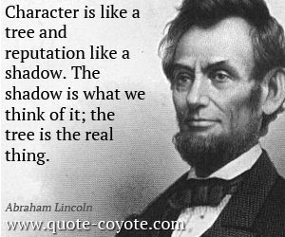
Reputation
And
Character

Slide 22
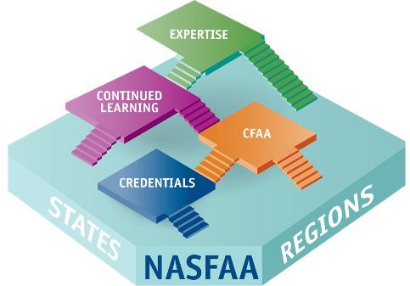
Certified Financial Aid Administrator ® Program
It’s more than just an exam…
Make it part of your professional development ecosystem!
Credential Quality Standards achieved!
Rigorous assessment against industry standards
Affirms quality and defensibility of the certification program
April 2021

Slide 23
The DLP Program
Aligns with NASFAA’s commitment to diversity and inclusion.
Creates a pipeline for support and access to mentors.
Under-represented groups within the aid community gain access to leadership opportunities.
Provides participants with important professional development.

Slide 24
Implicit Bias Toolkit
NASFAA invites you to reflect and consider that as financial aid administrators, we directly influence the trajectory of our students' lives through our work.
NASFAA, in conjunction with our member task force, created this toolkit to assist aid offices with awareness and suggestions to assist in eliminating bias from institutional policies and procedures.

Slide 25
NASFAA Business Services
Notes:
NASFAA Business Services includes Blue Icon Advisors and the Standards of Excellence Review Program.
Launched June 2019, Blue Icon Advisors, NASFAA consulting, offers customized services for the financial aid community to meet the unique needs of each school.
Projects include operational evaluations, customized training, leadership coaching, program review preparation and assistance, interim staffing, and policies and procedures development.
For more than 20 years, SOE has been providing objective, confidential peer reviews on all aspects of Title IV program administration. The reviews highlight strengths, identify compliance exceptions, and recommend improvements.
Starting July 2021, Blue Icon is the administrator of the SOE program.
Visit the website for more information!

Slide 26
NASFAA Update

Slide 27
Advocacy Opportunities
INTERACT WITH CONGRESS
VOLUNTEER
Advocacy Pipeline
Read NASFAA’s Today’s News and Policy and Advocacy pages on nasfaa.org
Share your advocacy efforts with NASFAA so we can support and assist you
Every two years in Congress means new states in the mix!
Policy Task Forces
STAY INFORMED!
Get Students Involved!

Slide 28
Policy Task Forces & Working Groups
Ongoing
Recently Published Report
Previous
State Advocacy
Advocacy Network
Rapid Response Network
FAFSA Simplification Implementation Working Group
Pell Restoration for Incarcerated Students Working Group
September 2020 - Exploring Ways to Enhance FAFSA Efficiency Paper Series
October 2020 - An Analysis of Existing Short-term Postsecondary Programs
July 2021 - An Evaluation CARES Act Funding for Postsecondary Institutions
July 2021 - Implicit Bias Toolkit
HEA Reauthorization
Reimagining Aid Design & Delivery
Student Indebtedness
Public Service Loan Forgiveness
Campus-Based Aid Allocations
Consumer Information
Loan Servicing
R2T4
FAFSA Working Group
Innovative Learning Models
Dynamic Loan Limit Working Group
One Grant, One Loan
Graduate-Specific Financial Aid Data
Consumer Information & Law Student Indebtedness
Tuition- and Debt-Free College
PPY Implementation
Graduate/Professional Loan Limits
Cost of Attendance Working Group
Campus-Based Aid in One Grant, One Loan
Accountability in Higher Education
Examining Competency Based Education

Slide 29
Policy Grant-funded Work
In 2021, NASFAA hit the $3 million dollar mark in grant-funded projects
Current grant work:
Evaluating CARES Act funds
Reimagining the college admission process to better serve students
Fixing verification for students, colleges, universities, and taxpayers
Developing policy recommendations for student loan repayment

Slide 30
Online Resources
nasfaa.org/legislative_tracker nasfaa.org/capitol_recap
nasfaa.org/otc
Notes:
NASFAA Legislative Tracker
Comprehensive list of all student aid-related legislation introduced in this session of Congress
Organized by subject area
The Capitol Recap
Monthly series in Today’s News that lists and summarizes newly-introduced legislation
Off the Cuff Podcast
Weekly podcast with NASFAA staff and colleagues on student aid policy

Slide 31
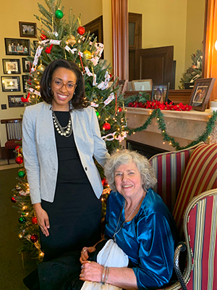
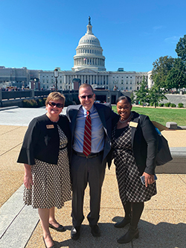
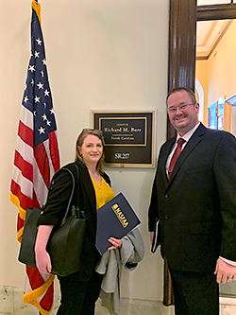
Advocacy Pipelines
Notes:
Volunteer!
Advocacy Pipeline
Task Force or Working Group
Write and Visit Your Member of Congress
Share your advocacy efforts with NASFAA, so we can support and assist you in your efforts.
New education committee members means new states in the mix

Slide 32
State Advocacy Toolkit
NASFAA first published the State Advocacy Toolkit in August 2020 to provide resources and materials to support state-level advocacy for regions, states, institutions, and individuals interested in becoming more engaged in state-level student aid policy. NASFAA will continue to update the toolkit with new resources.
The toolkit features the following resources:
User Guide that includes advocacy tips, instructions on how to contact your state representatives, and more!
Letter and email templates that can be customized with your information before sending to your state lawmakers.
Talking points that outline and give examples of the importance of state financial aid programs.
Student Advocacy Manual that provides resources for students to support their advocacy efforts.
nasfaa.org/state_advocacy_toolkit

Slide 33
advocacy
The act or process of supporting a cause or proposal; the act or process of advocating something.
advocate
A person who argues for or supports a cause or policy.
Notes:
Why does advocacy matter?
With Congress consistently caught in gridlock, it’s more important than ever to make sure your voice is heard in policy debates, especially on issues that could affect you on a daily basis.
Members of Congress and their staff are most interested in the day-to-day concerns of their constituents in their state or district.

Slide 34
5 Effective Advocacy Tips
Keep it local.
Keep it personal.
Keep their position in mind.
Keep it factual.
Keep in touch.

