Slide 1
FAFSA Simplification
National Association of Student Financial Aid Administrators
Dana Kelly
February 2022
Notes:
notes

Slide 2
Introducing…
The largest change in Title IV administration in 30 years!

Slide 3
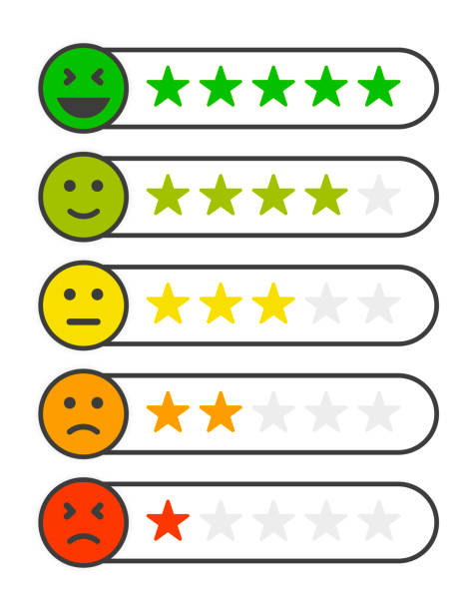
How are you feeling?

Slide 4
2020 Year End Legislation
The “Coronabus”
Fiscal Year 2021 appropriations
$73.5 billion in discretionary funding appropriated for ED
$150 increase to the maximum Pell Grant award
New maximum for 2021-22 award year is $6,495
$25 million increase for campus-based aid programs
Additional COVID-relief funds
$23 billion for institutions of Higher Education
FAFSA simplification and other student aid provisions
“Mini HEA”

Slide 5
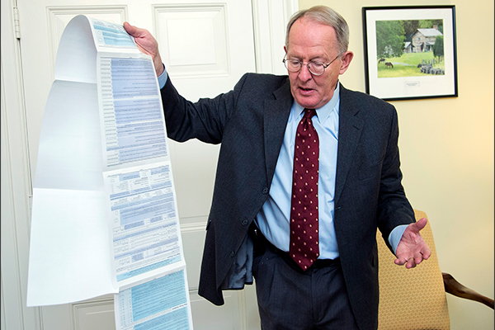
On the Horizon…
The omnibus, passed on December 21st, incorporated elements of Sen. Alexander’s previous FAFSA simplification legislation
ED will employ a delayed, phased implementation of the changes made to federal methodology and the FAFSA
The statutory deadline was amended to award year from July 1, 2023, to July 1, 2024, with optional implementation for some items in 2023-24.

Slide 6
2024-2025
Take deep breaths
Sit back in chair
Relax shoulders
Do easy yoga pose
Listen to calm music

Slide 7
Need Analysis & Pell Grant Eligibility
Expected Family Contribution (EFC) is now Student Aid Index (SAI)
SAI can be as low as -$1,500
SAI determines eligibility for all Title IV aid except maximum and minimum Pell grant awards.
Student is considered for max Pell first
Based on # of parents in hh and AGI vs. poverty
If no qualification for maximum Pell:
[Maximum Pell amount - SAI = Pell amount]
still rounded to nearest $5
still subject to statutory minimum
If no max Pell and no Pell award from the SAI calculation, student is considered for minimum Pell
Based on # of parents in hh and AGI vs. poverty

Slide 8
Maximum Pell Grant Eligibility
Nonfilers
Independent student (and spouse, if applicable) tax nonfilers
Dependent children of nonfiling parent(s)
Children of certain deceased veterans and public safety officers
Students under age 33 whose parent died serving in the armed forces after Sept. 11, 2001
Students under age 33 whose parent died in the line of duty as a public safety officer
Low income students:
Independent students who are single parents and whose student AGI is below 225% of the poverty level
Dependent children of a single parent whose parent AGI is below 225% of the poverty level
Independent students who are not single parents whose student AGI is below 175% of the poverty level
Dependent students with parents who are not single parents whose parent AGI is below 175% of the poverty level

Slide 9
Other Formula Changes
Fewer untaxed income items factored into FM formula
Child support received now reported with assets
Change to who is reported as parent in cases of divorce/separation
State/other tax allowance removed
Small business/family farm exclusion eliminated
No SAI split for number in college
No asset questions for:
Means-tested benefits recipients
AGI < $60K and no lettered tax schedules
AGI < $60K and only Schedule C, provided Schedule C gain/loss < $10K

Slide 10
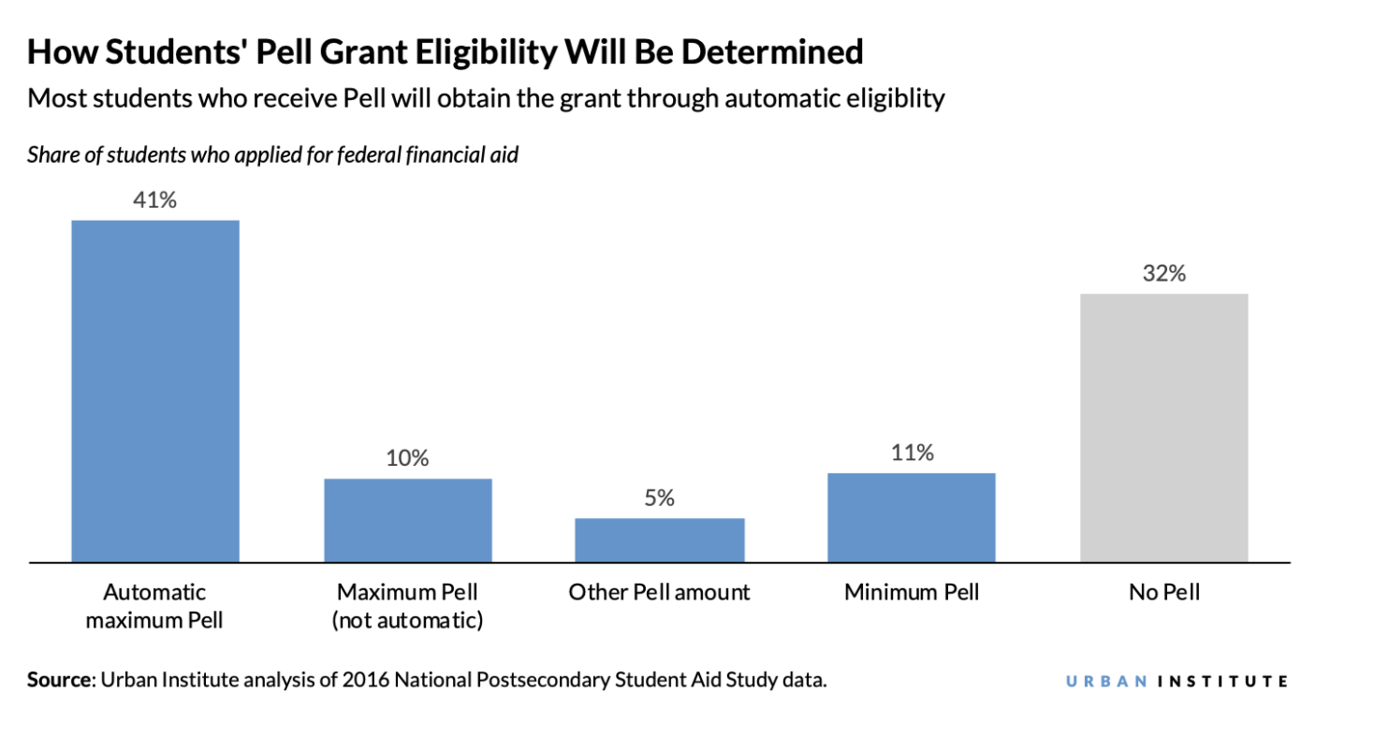
How Will the New Pell Grant Formula Affect Students?

Slide 11
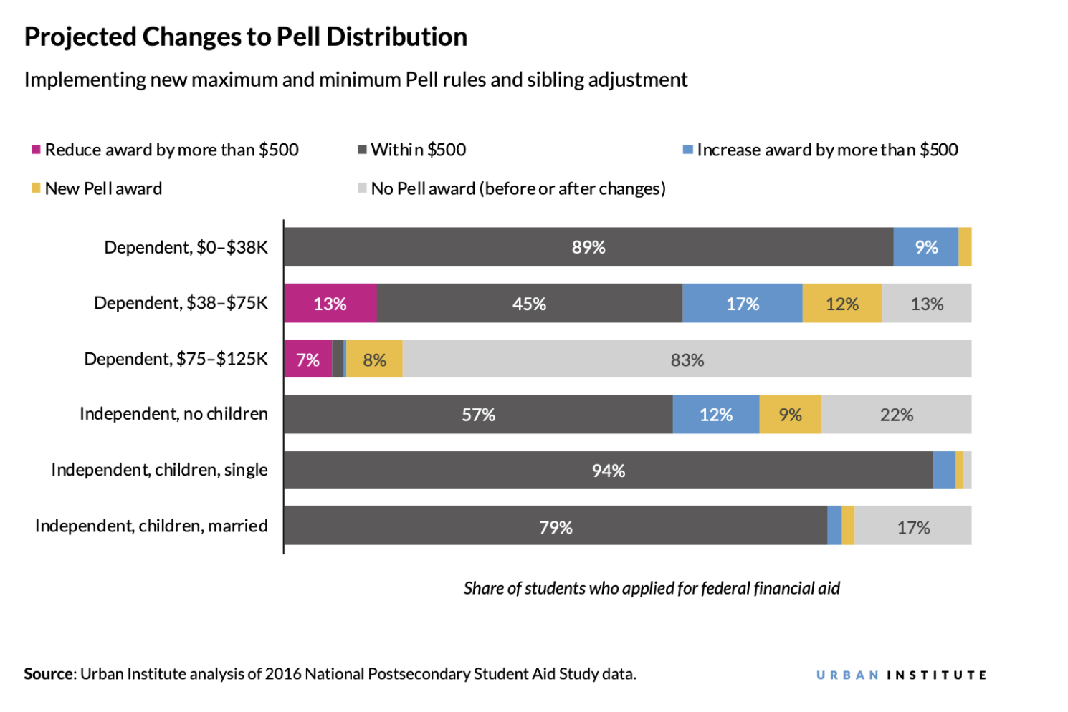
How Will the New Pell Grant Formula Affect Students?

Slide 12
NASFAA’s SAI Modeling Tool
This tool allows institutions to model how the recent changes to the FM EFC formula — which has been renamed the Student Aid Index (SAI) and will be fully implemented for the 2024-25 award year — this will impact student need and institutional financial aid budgets
The model will also estimate the student's Pell Grant award under the provisions of the FAFSA Simplification Act.
Available to NASFAA members: https://www.nasfaa.org/sai_modeling_tool

Slide 13
Progress on FAFSA Simplification: FUTURE Act
In December 2019, Congress passed and President Trump signed into law the FUTURE Act, which contained text from the FAFSA Act previously supported by NASFAA.
The bill allows for direct cross-agency data sharing between IRS and ED, and will:
Transfer all items currently brought over from the DRT and applicants’ filing status.
Allow students currently unable to use the DRT, including both non-tax-filers and tax filers of all filing statuses, to experience a simpler FAFSA process.
Address verification burden
Permit sharing of taxpayer information between ED and IRS for the purpose of determining eligibility for income-driven repayment plans.

Slide 14
Other FAFSA Simplification Changes
Drug Conviction & Selective Service (already implemented)
Subsidized Usage Limit Applies (already implemented)
Pell for Incarcerated Students
Scheduled for 23-24 if Final Rules issued by 11/1/22.
Restore Pell Grant eligibility for incarcerated individuals
Only available to eligible prison education programs

Slide 15
Other FAFSA Simplification Changes Eligible for Early Implementation
Professional Judgment
Prohibit institutions from maintaining a policy of denying all professional judgment requests.
Qualifying emergency leeway for income earned from work.
Upon implementation, only requires financial aid administrators to document one of two circumstances for unsub.
Current law requires that a financial aid administrator determine that the student’s parent initiated an end of support AND that the parent refused to fill out the FAFSA.
Provisional Independent Status
Institution required to request documentation and make practicable determination soon after receipt.
Presumption of continued Independent status for future award years

Slide 16
Other FAFSA Simplification Changes
Cost of Attendance (COA)
ED authority to regulate all COA components except tuition and fees.
Requires the food allowance for on-campus plans or off-campus meals to provide the equivalent of at least three meals per day.
Requires Housing differentials for students with dependents on campus
Eliminates average loan fees, requires actuals and excludes all private loan fees (Removed in technical amendments!)
A one-time cost of obtaining the first professional licensure a required component of COA for affected students.
Institutions are required to make publicly available a list of all the elements of the COA & disclose those figures on any portion of the website describing tuition and fees.

Slide 17
Other FAFSA Simplification Changes
Pell Grant Eligibility Restoration Restores Pell if student impacted by an institution closing, who were falsely certified as eligible to receive federal financial aid, or whose loans were discharged in a successful borrower defense claim.
Data Sharing
Adds consent to the FAFSA for IRS (FUTURES Act) and others who administer public benefits.
Unaccompanied Homeless Youth
Allows a financial aid administrator to accept documentation of a financial aid administrator at another institution from a prior award year.

