Slide 1
R2T4: Return of Title IV Funds
Dan Sanchez
Sr. Financial Aid Counselor
UNC Wilmington
New Aid Officers Training

Slide 2
Agenda
Basic Principles
Definitions
Anatomy of an R2T4
Applicable Deadlines
Practical Do’s and Don’ts
Case Studies & Questions
*Credit Hour
Programs
*Standard Terms

Slide 3
R2T4 Basic Principles

Slide 4
R2T4 - Basic Principles
Return of Title IV Funds (R2T4/Return): The calculation required when a recipient of Title IV aid withdraws from an institution during a payment period/period of enrollment in which the recipient began attendance.
Title IV funds are awarded to a student under the assumption that the student will attend school for the entire period for which the assistance is awarded.
If a student ceases attendance prior to the ending date of that period, the student may not be eligible for the full amount of Title IV funds he/she was scheduled to receive.

Slide 5
R2T4 - Basic Principles (cont’d)
Students earn Title IV aid equal to a quantifiable amount of attendance in a payment period/period of enrollment.
Percentage of aid earned is equal to the percentage of the period completed (Days Attended ÷ Days Scheduled to Attend).
If a school has disbursed more aid than the student has earned, Title IV aid must be returned to the programs.
If a school has disbursed less Title IV aid than the student has earned, a post-withdrawal disbursement (PWD) is calculated and must be offered.

Slide 6
R2T4 - Definitions
Official Withdrawal: Student (or school) actively initiates withdrawal process
Unofficial Withdrawal: School finds that student ceased attendance, without providing official notification
Withdrawal Date: Date of Withdrawal, Last Date of Attendance (LDA), or Last Date of Participation in an Academically-Related Activity
Date of Determination: Date School Determined Student Withdrew

Slide 7
R2T4 - Definitions (cont’d)
60% Mark: Point after which the student is considered to have earned 100% of Title IV aid through attendance.
Mid-Point: 50% mark in the term. For unofficial withdrawals, schools not required to take attendance have the option to use this in R2T4 calculations. (Note: school systems may have a policy that only permits this in certain cases)

Slide 8
Withdrawals Defined
Official:
Semester
Attended
LDA
60% Mark
Semester
Attended
Earned 100%
LDA

Slide 9
Withdrawals Defined
Unofficial:
Semester
Attended…
All F’s, etc.
LDA
60% Mark
Schools Not Required To Take Attendance
Can Use Mid-Point (50%) for Unofficial WD’s
(Be Mindful of State and System Policies)

Slide 10
Varun begins attendance in the Fall semester. This is his first semester taking classes in his Education major. By the fourth week, he realizes that teaching is not his cup of tea. He is considering taking the rest of this semester off to find a new major.
He withdraws through the school’s online portal on September 30^{th.}
Date of Determination?
Withdrawal Date?

Slide 11
Cassandra is excited to start her online program. On Monday (the first day of class), she dusts off and boots up her Compaq Presario notebook. Thankfully, it still works, but her Netscape browser is on the fritz and she is not able to access the Internet.
Finally on Friday, she decides to withdraw from the online program. She flips open her phone and calls the school.
The Cashier’s Office says that she is past the point of receiving any refund of her Tuition and Fees for this session; they direct her to Financial Aid.
Withdrawal Date?
Date of Determination?

Slide 12
Is It a Withdrawal?
Jackson begins attendance in the Spring term. At the end of the semester, however, he receives all Failing grades.
His instructors indicate the last date he attended class was the Friday after Spring break.
No one has seen him since.
Date of Determination?
Withdrawal Date?

Slide 13
R2T4 - Definitions (cont’d)
Aid Disbursed: Aid applied to student’s account or issued to student prior to the Withdrawal Date.
Aid That Could Have Been Disbursed: Undisbursed aid for which the student was otherwise eligible to receive at the time of the Withdrawal Date. The requirements for this vary, depending on the type of aid.
Post-Withdrawal Disbursement: Aid that could have been disbursed that becomes available to student after R2T4 Calculation is completed.

Slide 14
Disbursed vs Could Have Been
Aid Disbursed: Issued to Student (applied to Account Balance)
Aid That Could Have Been Disbursed:
Official (EFC) - notice not necessary a valid or verified EFC FSEOG award, the institution made the award to the student.
Direct Loan, the institution originated the loan prior to Withdrawal Date,
*MPN Received by R2T4 Calculation Date
Direct PLUS Loan, a satisfactory credit check was received.
Inadvertent Overpayments become Aid That Could Have Been Disbursed
Notes:
Official EFC An “official EFC” is an EFC calculated by the Department and provided on a SAR or ISIR. It may or may not be a valid EFC (defined as an EFC based on information that is correct and complete).
When a Student Drops Below Half time Before Withdrawing If a student who is otherwise eligible for a late first disbursement drops below halftime enrollment and then withdraws, the institution would include any undisbursed Direct Loan funds in the Return calculation as “Aid that could have been disbursed.” However, an institution may never make a post-withdrawal disbursement of Direct Loan funds a student could not have received if he or she had remained in school.

Slide 15
R2T4 - Definitions (cont’d)
Numerator: Calendar Days Attended in the Semester. If the class formally meets on MWF, then T/Th/Sat/Sun also count.
Denominator: Total number of days in the Semester. From the start of the term to the end of the term (include final exams).
Scheduled Break: Break in the term of five days or more. This is excluded from the numerator and denominator.

Slide 16
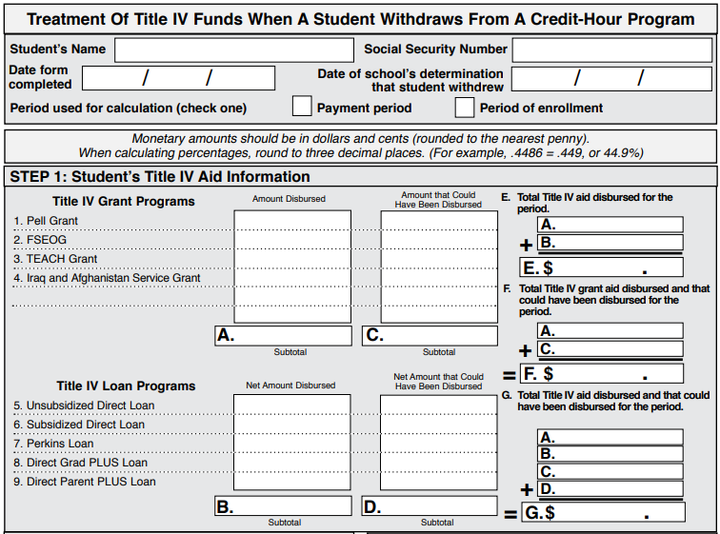
Anatomy of an R2T4
Student/School Info
Aid Info

Slide 17
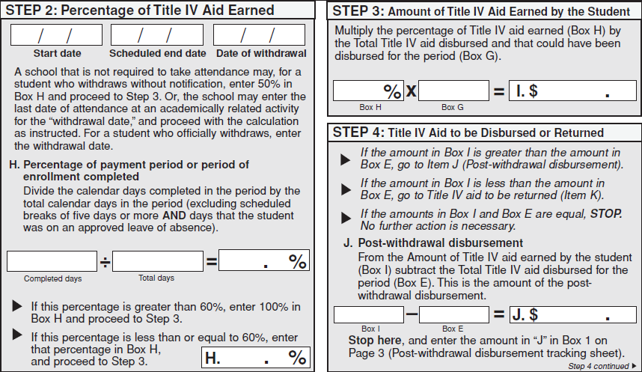
Anatomy of an R2T4 (cont’d)
Date Info
Eligible
For PWD?

Slide 18
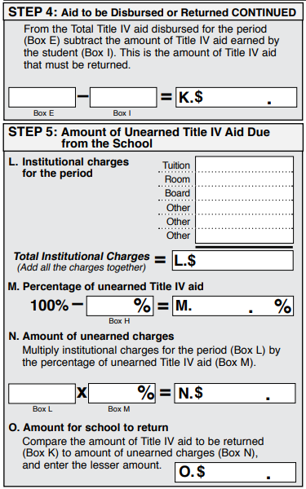
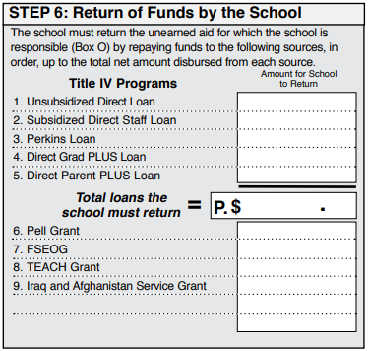
Anatomy of an R2T4 (cont’d)
Return Info

Slide 19
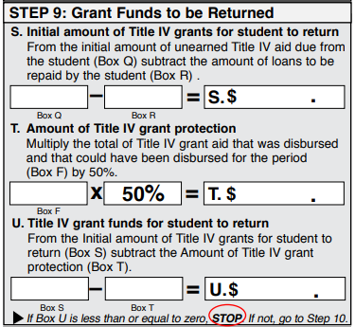
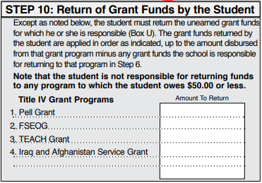
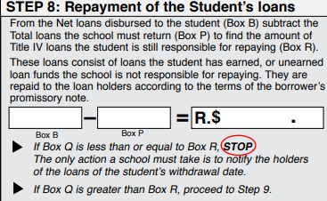
Anatomy of an R2T4 (cont’d)
50% Grant Protection
Loans “Returned”

Slide 20
Full Term - 114 Days (August 21st – December 12th)
*9 Day Hurricane Break
*5 Day Thanksgiving Break
Attended
October 1st LDA
(42 Days In)
60% Mark
What is the Denominator?
A. 114 Days B. 105 Days C. 100 Days D. 72 Days
What is the Numerator?
A. 28 Days B. 33 Days C. 42 Days D. 114 Days

Slide 21
Full Term - 114 Days (August 21st – December 12th)
*9 Day Hurricane Break
*5 Day Thanksgiving Break
Attended
September 5th LDA
(16 Days In)
60% Mark
Aid That Could Have Been Disbursed Includes _______.
A. Pell Grant
B. Loans
C. Pell Grant + Loans
D. None of the Above
FAFSA Received on September 3rd
Pell Grant Disburses September 4th
Loans Originated, But Missing MPN

Slide 22
PWD Loan Notifications
FSA Handbook, Volume 5, Chapter 2:
PWD Loan Offer must include the information necessary for the student, or parent for a Direct Parent PLUS Loan, to make an informed decision as to whether the student or parent would like to accept any disbursement of loan funds.
Must identify the type and amount of the loan funds it wishes to credit to the student’s account or disburse directly to the student or parent, and explain that a student, or parent for a Direct Parent PLUS Loan, may accept or decline all or a portion of the funds. The notice must also explain to the student, or parent for a Direct Parent PLUS Loan, the obligation to repay the loan funds.

Slide 23
Applicable Deadlines
14 Days For Schools Required to Take Attendance, Determination Date (DD)
30 Days If NOT Required to Take Attendance, DD for Unofficial WDs (from End of Term)
30 Days Complete R2T4 Calculation (From DD)
30 Days Offer Loans from Post-Withdrawal Disbursement (From DD)
45 Days Return Title Funds (From DD)
45 Days Disburse Grants from Post-Withdrawal Disbursement (From DD)
180 Days Disburse Loans from Post-Withdrawal Disbursement (From DD)

Slide 24
Practical Do’s and Don’ts
Do:
Inform Students of R2T4 Policy (Consumer Information Requirement)
Coordinate with Student Accounts, Registrar’s Office, and Academic Departments
Identify and Monitor All Points of Withdrawal Notification
Ensure that Automated Systems are Appropriately Processing Information

Slide 25
Practical Do’s and Don’ts
Don’t:
Manipulate Enrollment Data to Avoid (or to Create) R2T4
Change R2T4 Practices Based on Reasons for WD
Counsel Students to Remain in Class Only to Avoid R2T4
Confuse R2T4 with State/Institutional Returns and Billing Policies

Slide 26
Covid-19 Exemptions
CARES Act (Pub. L. 116-136) March 13, 2020, thru Dec 21,2020 or the last date when national emergency is in effect
For students who begin attendance during a qualifying payment period or period of enrollment and subsequently withdrew due to COVID-19, the CARES Act:
Waives requirements to return Title IV funds through R2T4 requirements;
Excludes that period from the students Subsidized Loan usage;
Excludes Pell Grant funds received from LEU; and
Cancels Direct Loan debt received for the period.

Slide 27
Case Study – Christel
Full Term - 116 Days (January 13th – May 7th)
*9 Day Spring Break
Christel begins attendance in the Spring Term, enrolled in 6 credit hours. She runs into a work conflict and needs to withdraw. She withdraws from her classes through the school’s online portal on February 14 (33 Days into the term).
Type of WD: | Official
Withdrawal Date: | February 14th
Term Start Date: | January 13th
Term End Date: | May 7th
Total Days in Period: | 116 Days
Scheduled Break: | 9 Days
Numerator: | 33 Days
Denominator: | 116 - 9 = 107 Days

Slide 28
Case Study – Christel
Total Days in Period: 116 Days
Scheduled Breaks: | 9 Days
Numerator: | 33 Days
Denominator: | 116 - 9 = 107 Days
33/107 Days = | 30.8% (Earned)
Institutional Charges
Tuition and Fees: | $2621.48
Housing: | $0
Meals: | $0
Aid Disbursed
Unsubsidized Loan: | $10,142
Total Aid to Be Returned: $7018.00
Institution’s Share: | $1814.00
Student’s Share: | $5204.00

Slide 29
Case Study – Annette
Full Term - 115 Days (August 16th – December 8th)
*5 Day Thanksgiving Break
Annette begins attendance in the Fall Term, enrolled in 15 credit hours. She withdraws from 6 credit hours on September 5th. At the end of the semester, the Financial Aid office discovers that she has failed all of her courses. Her instructors report that her last date of attendance is October 10th (56 Days into the term).
Type of WD: | Unofficial
Withdrawal Date: | October 10th
Term Start Date: | August 16th
Term End Date: | December 8th
Total Days in Period: | 115 Days
Scheduled Break: | 5 Days
Numerator: | 56 Days
Denominator: | 115 - 5 = 110 Days

Slide 30
Case Study – Annette
Aid Disbursed
Pell Grant: | $2,335
Total Days in Period: 115 Days
Scheduled Breaks: | 5 Days
Numerator: | 56 Days
Denominator: | 115 - 5 = 110 Days
56/110 Days = | 50.9% (49.1% Unearned)
Aid That Could Have Been Disbursed
Subsidized Loan: | $2,721
Unsubsidized Loan: | $990
Total Aid: $6046.00
6046 x 50.9% = $3,077.41
Disbursed Aid = $2,335.00
Post-Withdrawal Disbursement Offered: $742.00

Slide 31
What About Modules?

Slide 32
Modules Defined
668.22(l)(6)
- “when a course or courses in program do not span entire length of payment period (term) or period of enrollment”
Doesn’t matter what modules are called at the institution
- e.g., mini-terms, J-terms, mini-mesters, mini-sessions, modules...
Modular programs often consist of accelerated coursework, with students taking only one or two courses per module.

Slide 33
Full Term vs Modular WD’s
Attended
Full Term Course - 16 Weeks
Attended
Full Term Course - 16 Weeks
Full Term Course - 16 Weeks
Attended
Attended
Full Term Course - 16 Weeks

Slide 34
Modules Defined (cont’d)
Full Term - 16 Weeks
8 Weeks
8 Weeks
5 Weeks
5 Weeks
5 Weeks
4 Weeks
4 Weeks
4 Weeks
4 Weeks

Slide 35
Full Term vs Modular WD’s
Full Term - 16 Weeks
5 Week Course
Attended
5 Week Course
5 Week Course
Attended
Attended
Accelerated coursework, with students taking only one or two courses per module.
Drop/WD from one, no remaining enrollment for that time period!

Slide 36
Three Questions
1. Did the student cease to attend before completing, or fail to begin attending, a course scheduled to attend?
• If yes, go to question 2
• If no, student is not a withdrawal
2. When ceased to attend or failed to begin attendance in a scheduled course, was the student attending other courses?
• If yes, student is not a withdrawal
• If no, go to question 3
3. Did the student confirm attendance in a later module in the payment/enrollment period (45 day rule, if applicable)?
• If no, student is a withdrawal
• If not a withdrawal, Pell recalculations may apply

Slide 37
Enrollment Confirmation
Attended
5 Week Course
Attended
5 Week Course
5 Week Course
Attended
I’ll be back!
I’ll be back!
Student in a modular program is not considered withdrawn if:
– Provides written confirmation of intent to return
– Must be provided at the time of withdrawal
– Can be paper or electronic process
– Prior registration in future modules does not constitute written confirmation
– Student may change return date in writing
Must provide change prior to original return date

Slide 38
Oh, and One More Thing…
Attended
8 Week Course
8 Week Session
8 Week Course
Drop Next Module on or before
last day of Current Module…
No R2T4 required
(Pell Grant Recalculation Still Required)
8 Week Course
8 Week Session
Attended
8 Week Course
Drop Next Module after
last day of Current Module…
R2T4 required
(Pell Grant Recalculation Required First)
Beware of Sequential Coursework

Slide 39
Case Study – Multiple Withdrawals
4 Weeks
4 Weeks
4 Weeks
4 Weeks
4 Weeks
Attended
Attended
Attended
I’ll be back!
I’ll be back!
Withdraws from Mod 1, Drops Mod 2 on Same Day, Confirms for Mod 3
Withdraws from Mod 3, Confirms for Mod 4
Withdraws from Mod 4
Numerator: Attended Days
Denominator: Days in All Modules (include 2nd Dropped Module)

Slide 40
Case Study – R2T4 Reversal
8 Week Course
Attended
8 Week Session
8 Week Course
Attended
Attended
F Grade
8 Week Course
8 Week Course
Attended
Student Returns! Reverse R2T4.
If No Enrollment Confirmation for
Module 2, R2T4 Required
Student Fails Last Module.
R2T4 Required…Again.

Slide 41
Resources
FSA 2020 Conference
Return of Title IV Funds: Resources and Q&A
Administering Adds, Drops, and Withdrawals
NASFAA Student Aid Index: Search for “R2T4”

Slide 42
Questions?
Full Term

